Slide 1
Health literacy and its associated factors among outpatients in Hue university hospital, Vietnam
Hue University of Medicine and Pharmacy
Faculty of Public Health
Vo Van Thang^{1,2}, Luong Thanh Bao Yen^{1,2}, Tran Thi Tao¹, Hoang Dinh Tuyen¹, Le Dinh Duong^{1,2}
¹Department of Biostatistics-Demography-Reproductive Health, Faculty of Public Health, Hue University of Medicine and Pharmacy, Vietnam
² Institute for Community Health Research, Hue University of Medicine and Pharmacy, Vietnam
Presentation by: Hoang Dinh Tuyen, MPH
HAI PHONG, NOVEMBER 9, 2016

Slide 2
Outline
Introduction
Research methods
Conclusion
Results
Objectives
1
2
3
4
5

Slide 3
Introduction
The concept of health literacy appeared in relation to health education in the 1970s in the USA and the interest in the topic has increased highly since the 1990s.
Health literacy have been concluded as a stronger predictor of an individual’s health status than income, employment status, education level and racial or ethnic group.
In recent years, health policy and health evidence has strengthened the rights of the patient to make decision in healthcare and manage their own health.
Patients should receive adequate information on the health situation and the right to choose health care services.
Health literacy is an important factor affecting the information exchange between medical staff and patients with the condition of the patient at the hospital.
The higher aware of outpatient in health literacy will contribute to higher effect of health management.
In Vietnam, there has been some database on health literacy of general population, but there are limited data in the patients, especially outpatients.
Notes:
The concept of health literacy appeared in relation to health education in the 1970s in the USA and the interest in the topic has increased highly since the 1990s.
Health literacy have been concluded as a stronger predictor of an individual’s health status than income, employment status, education level and racial or ethnic group.

Slide 4
Objectives
1. To investigate the the health literacy levels among outpatients in Hue university hospital, Vietnam.
2. To assess the association between potential factors and health literacy among outpatients in Hue university hospital, Vietnam.
Notes:
This study aim to…..

Slide 5
Research design
This cross-sectional study was conducted in Hue university hospital.
Duration: from 1st May to 30th September, 2016.
Sample size: 900 outpatients.
Examined via a face to face interview using tablet survey method.
Notes:
This cross-sectional study was conducted in Hue university hospital in 2016.
A sample of 900 outpatients were selected at Hue university hospital at the time we collected data.
Examined via a face to face interview by using tablet survey method.

Slide 6
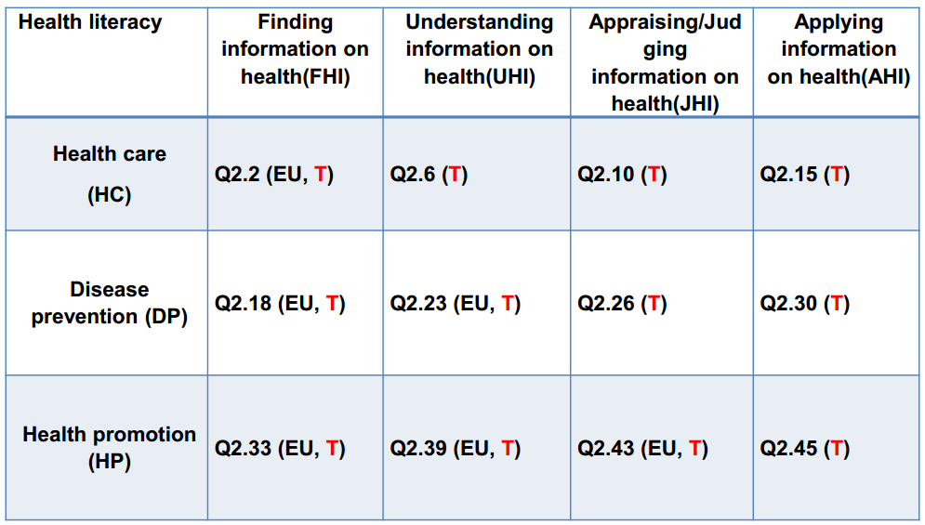
Measurement
The instrument used in this research is the short-form health literacy survey tool (HL-SF12) based on the HLS-EU Conceptual Model with 12 items (Tuyen V. Duong et al, 2015).
Notes:
A matrix is formed based on this conceptual model including row and colum
The row show the 3 dimentions of health literacy: health care, disease prevention and health promotion
The colum show the ability of outpatient: finding…..

Slide 7
Measurement (cont.)
The score of each question is given by the following numerical values:
1=very difficult; 2=fairly difficult; 3=fairly easy; 4=very easy.
The mean score of specific health literacy indices were standardized on a metric between 0 and 50, using the following formula:
Index $=\frac{\left(Mean−1\right)x50}{3}$
Health literacy levels:
0-25: inadequate
>25-33: problematic
>33-42: sufficient
>42-50: excellent
Limited health literacy: index ≤ 33 (inadequate + problematic)
Notes:
The HLQ™ contains 44 questions across nine independent scales. Understand health information well enough to know what to do (‘Understanding’, 5 items), and: ability to actively engage with healthcare providers (‘Engagement’, 5 items). The ten items covered a range of simple or easy through to more challenging heath literacy-related tasks. For each item, participants indicated their perceived difficulty with the response options; 1= very difficult, 2= difficult, 3= easy, and 4= very easy. Scale scores use as dependent variables and calculate for each individual as the mean of item scores for the five items.
Based on the European study, the following score intervals were chosen for the four levels of HL: 0-25pts for”inadequate”; >25 to 33pts for “problematic”; >33 to 42pts for”sufficient” and >42 to 50pts for”excellent”.

Slide 8
Results

Slide 9
Table 1: Demographic Characteristics (n=900)
Demographic Characteristics |  | n | %
Gender | Male | 336 | 37.3
 | Female | 564 | 62.7
Age | < 25 | 329 | 36.6
 | 25-34 | 143 | 15.9
 | 35-44 | 70 | 7.8
 | 45-54 | 142 | 15.8
 | ≥ 55 | 216 | 24.0
Legal marital status | Not married | 374 | 41.6
 | Married | 496 | 55.1
 | Separated / Divorced/Widowed | 30 | 3.3

Slide 10
Table 1: Demographic Characteristics (cont.)
Demographic Characteristics |  | n | %
Having children | Yes | 520 | 57.8
 | No | 380 | 42.2
Religious belief | Yes | 304 | 33.8
 | No | 596 | 66.2
The highest attained education | Junior high school or lower | 324 | 36.0
 | Senior high school or higher | 576 | 64.0

Slide 11
Table 1: Demographic Characteristics (cont.)
Demographic Characteristics |  | n | %
Watched medical-related TV series | Often/Sometimes | 537 | 59.7
 | Rarely/Never | 363 | 40.3
Get medical-related information on the Internet | Often/Sometimes | 465 | 51.7
 | Rarely/Never | 435 | 48.3
Attend to education courses | Often/Sometimes | 95 | 10.6
 | Rarely/Never | 805 | 89.4
Attend to health-related education courses | Often/Sometimes | 123 | 13.7
 | Rarely/Never | 777 | 86.3
Enny Rachmani in Semarang City, Indonesia: 17.5% respondents often used internet to get health information, 19.9 % never used that.

Slide 12
Table 2: Personal Health Information (n=900)
Personal Health Information |  | n | % | Gen-HL score Mean ± SD
Health Self- statement | Very bad/bad | 190 | 21.1 | 28.3 ± 7.6
 | Fair | 605 | 67.2 | 31.0 ± 6.0
 | Good/very good | 105 | 11.7 | 35.4 ± 6.1
Long-term illness or health problem | Yes | 536 | 59.6 | 30.1 ± 6.7
 | No | 364 | 40.4 | 32.2 ± 6.4
Health problems limited the activities (last 6 months) | Limited | 515 | 57.2 | 30.2 ± 6.7
 | Not limited | 385 | 42.8 | 31.9 ± 6.6
Health insurance cost | Required | 407 | 45.2 | 33.0 ± 6.4
 | Voluntary | 303 | 33.7 | 29.7 ± 6.4
 | Support from Government | 185 | 20.6 | 28.7 ± 6.6
 | None | 5 | 0.6 | 27.8 ± 8.0

Slide 13
Table 2: Personal Health Information (cont.)
Personal Health Information |  | n | % | Gen - HL score Mean ± SD
Periodic health examination | Yes | 535 | 59.4 | 31.5 ± 6.4
 | No | 365 | 40.6 | 30.1 ± 7.1
Using online registration methods to avoid appointment-waiting time | Yes | 39 | 4.3 | 33.4 ± 5.4
 | Never use | 861 | 95.7 | 30.9 ± 6.7
Smoking | Yes | 187 | 20.8 | 31.0 ± 6.1
 | No | 713 | 79.2 | 31.0 ± 6.8
Drinking alcohol | Yes | 337 | 37.4 | 32.3 ± 6.3
 | No | 563 | 62.6 | 30.2 ± 6.8
Exercise | Yes | 852 | 94.7 | 31.2 ± 6.6
 | No | 48 | 5.3 | 26.6 ± 6.3
Community activity | Yes | 501 | 55.7 | 31.9 ± 6.3
 | No | 399 | 44.3 | 29.8 ± 7.0
Win Myint Oo et al, 2015 in Myanmar: smoking 19,8%, doing exercise: 14,8%,

Slide 14
Table 3: Social and Economic Information (n=900)
Social and Economic Information |  | n | % | Gen - HL score Mean ± SD
Main status of employment | Employed | 707 | 78.6 | 31.3 ± 6.5
 | Retirement, unemployed, permanently disabled or homemaker | 193 | 21.4 | 29.7 ± 7.1
Receiving medical training | Yes | 160 | 17.8 | 35.3 ± 6.6
 | No | 740 | 82.2 | 30.0 ± 6.3
Able to pay for medication | Easy | 737 | 81.9 | 31.3 ± 6.6
 | Difficult | 163 | 18.1 | 29.4 ± 7.0
Afford to see doctor | Easy | 680 | 75.6 | 31.4 ± 6.6
 | Difficult | 220 | 24.4 | 29.5 ± 6.8

Slide 15
Table 3: Social and Economic Information (cont.)
Social and Economic Information |  | n | % | Gen HL score Mean ± SD
Unable to pay for living expenses | Most of the time | 27 | 3.0 | 26.3 ± 7.3
 | From time to time | 243 | 27.0 | 30.0 ± 6.5
 | Almost never/never | 630 | 70.0 | 31.5 ± 6.6
Net income per month | poor | 26 | 2.9 | 23.9 ± 10.0
 | nearly poor | 4 | 0.4 | 33.0 ± 6.7
 | Fairly, wealth | 870 | 96.7 | 31.2 ± 6.5
Self-perceived social status | Lower level in the society | 495 | 55.0 | 30.0 ± 7.3
 | Higher level in the society | 405 | 45.0 | 32.2 ± 5.7
Comparing health to other with similar age and gender | Worse than other | 253 | 28.1 | 29.7 ± 7.2
 | Average | 452 | 50.2 | 30.5 ± 6.2
 | Better than other | 195 | 21.7 | 33.7 ± 6.4
Importance of health | Health weighs more than job/work | 669 | 74.3 | 30.5 ± 6.7
 | Other idea | 231 | 25.7 | 32.3 ± 6.5

Slide 16
Table 4: Mean and Std. Deviation (SD) of HL Indices
Health Literacy Indices | Mean ± SD
General Health Literacy | 31.0 ± 6.7
Health Care_HL | 29.2 ± 7.6
Disease Prevention_HL | 30.2 ± 8.2
Health Promotion_HL | 33.5 ± 8.1
Gen-HL index (Report on Health Literacy in Eight EU Member States, 2012):
Total sample: 33.8 ± 8.0
Ranges from 30.5 ± 9.2 (Bulgaria) to 37.1 ± 6.4 (Netherland)
Notes:
Means and SD (in this table) vary slight by kind of index. Health literacy, on average is higher for health care ( mean = 29.2) or disease Prevention (mean = 30.2)

Slide 17
Graph 1. Percentage distribution of general HL levels
and sub-domains
Limit health literacy (Index ≤ 33): 64.0%.
Pham Minh Khue et al, 2014 in Hai Phong city: 63.7%
Nguyen Trung Kien et al, 2014 in Hai Duong city and Hanoi city: 67.9%
Enny Rachmani in Semarang city, Indonesia: 64.3%.
Vo Van Thang et al, 2015 in Hue city: 74.5%

Slide 18
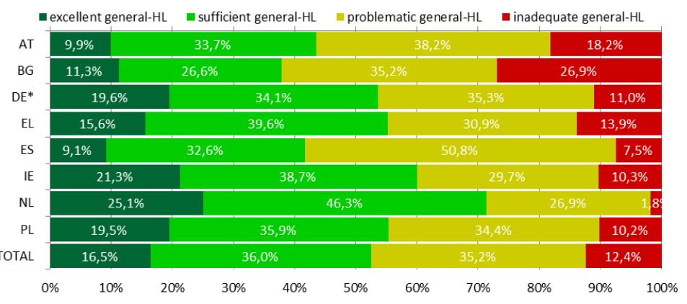
Graph 2: Percentages of Gen-HL levels Thresholds for European Countries and Total
Notes:
About 12% of respondents have inadequate general HL, and more than one third (35%) problematic HL, thus nearly every second respondent in the general sample. Therefore limited HL in Europe is not just a minority problem (nearly every second (47,6%) respondent’s HL is limited, concerning Gen-HL in the total sample)

Slide 19
Table 5:
Associated factors of Health literacy (multivariable logistic regression analysis)
Variables |  | OR | 95% CI |  | p
The highest attained education | Junior high school or lower | 2.422 | 1.653 | 3.548 | 0.0001
 | Senior high school or higher | 1
Watched medical-related TV series | Often/Sometimes | 1
 | Rarely/Never | 1.906 | 1.358 | 2.675 | 0.0001
Attend to education courses | Often/Sometimes | 1
 | Rarely/Never | 1.940 | 1.189 | 3.163 | 0.008
Health Self- statement | Very bad/bad | 2.526 | 1.331 | 4.797 | 0.005
 | Fair | 2.113 | 1.286 | 3.472 | 0.003
 | Good/very good | 1
Notes:
multivariable logistic regression analysis indicate the Associated factors of Health literacy

Slide 20
Table 5:
Associated factors of Health literacy (multivariable logistic regression analysis) (cont.)
Variables |  | OR | 95% CI |  | p
Health problems limited the activities (last 6 months) | Limited | 1.644 | 1.194 | 2.262 | 0.002
 | Not limited | 1
Exercise | Yes | 1
 | No | 2.313 | 0.907 | 5.901 | 0.079
Receiving medical training | Yes | 1
 | No | 2.233 | 1.491 | 3.343 | 0.000
Able to pay for medication | Easy | 1
 | Difficult | 1.740 | 1.133 | 2.671 | 0.011
Comparing health to other with similar age and gender | Worse than other | 1.389 | 0.853 | 2.261 | 0.186
 | Average | 1.928 | 1.297 | 2.866 | 0.001
 | Better than other | 1

Slide 21
Discussion
Health literacy could be influenced by
A negative relationship between age and HL was observed in previous studies (Kutner, 2006; Paasche-Orlow, 2005; Rootman, 2008; Rudd, 2007)
Education attainments (Kutner, 2006; Rudd, 2007; Rootman, 2008)
Financial condition (Kutner et al., 2006)
Social status (Watson, 2011; Doyle, 2012; van der Heide, 2013)
Health related activities and programs in communities and workplaces (Rootman, 2008)
Health promoting, educating television series (Chew, 2002; Collins, 2003; Do & Kincaid, 2006)
Notes:
This could be explained that aging is related to decline in cognitive function to perform the task that require information processing (Salthouse, 2009) and resulted in lower HL (Baker, 2000).

Slide 22
Conclusion
Associated factors of health literacy among outpatients in Hue university hospital
Demographic Characteristics: The highest attained education, watched medical-related TV series, attend to education courses.
Personal Health Information: Health Self-statement, health problems limited the activities (last 6 months), doing exercise, receiving medical training.
Social and Economic Information: Able to pay for medication, comparing health to other with similar age and gender.

Slide 23
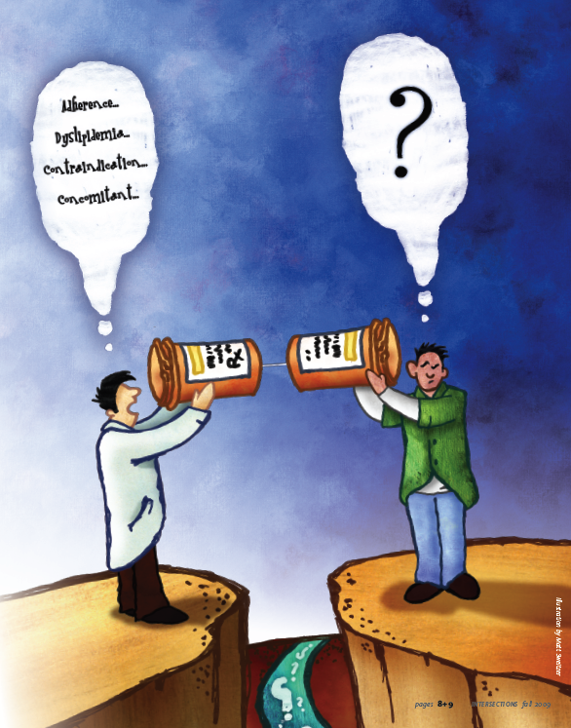
Conclusion (cont.)
Findings of this study help to determine the level of health literacy of outpatients and factors related to the health literacy in this population, which more efficient decision-making and patient care.

Slide 24
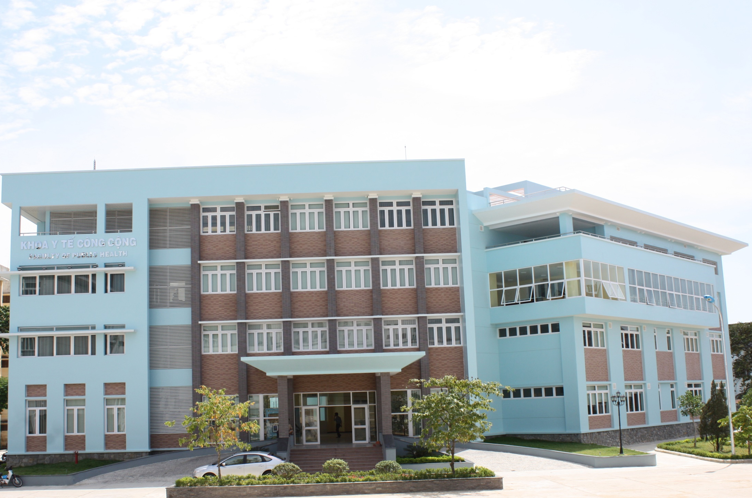
Thank you for your attention!
For all

