Slide 1
SURVEY OF NON-PRESCRIBED USE OF ANTIBIOTICS FOR CHILDREN LESS THAN 5 YEARS AND FACTORS ASSOCIATED IN THE DISTRICT OF XUAN TRUONG,
NAM DINH IN 2016
NGUYEN Thanh Hai^{1*} , VU Thi Thom²
1: Faculty of Public Health, Haiphong University of Medicine and Pharmacy
2: Institute for Francophone Tropical Medicine (IFMT)
Notes:
Good morning everyone, my name is Hai, I come from public health department of HPUMP. I’m very pleased to present to you our research about “Non-prescribed use of antibiotics for children less than 5 years and factors associated in the district de Xuan Truong, Nam Dinh in 2016.

Slide 2
Plan
1
Introduction
2
Subjects and Methods
3
Results
4
Conclusion
5
Recommendation
Notes:
The outline of my presentation include 5 parts, there are: introduction, subject and method, result, conclusion and recommendation

Slide 3
Plan
1
Introduction
2
Subjects and Methods
3
Results
4
Conclusion
5
Recommendation
Notes:
We start the first with introduction

Slide 4
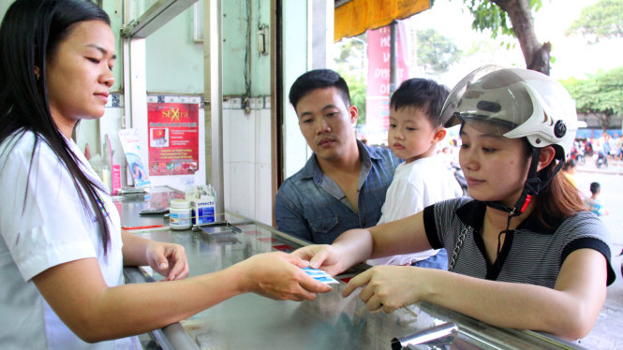
Introduction
Situation in Vietnam: overuse of antibiotics
Causes:
In Community: Buy drugs without a prescription: 78% (2007); Lack of knowledge about appropriate antibiotic use
In hospital: Inadequate infection control, patient overload; Lack of microbiological services; Lack of Medicines and Treatment Board
In Agriculture: Widespread use of antibiotics in livestock production and aquaculture (stimulate growth, disease prevention and treatment)
Consequence: antibiotic resistance, difficulties in processing,…=> influence human health
Source: Global Antibiotic Resistance Partnership 2010
Notes:
According the Global antibiotic resistance partnership in 2010, The frequent situation in VN nowadays is overuse of antibiotic.
The causes of this situation are divided into 3 groups: …..in order to stimulate growth, disease prevention and treatment.
The important consequence is AB resistance,

Slide 5
Introduction
Objectives
1
Description the situation of antibiotic use without prescription of inhabitants for children under 5 years in three villages of Xuan Truong, Nam Dinh in 2016.
2
Identification some factors associated antibiotic use without prescription for children under 5 years in the three villages of Xuan Truong, Nam Dinh in 2016
Notes:
So we have conducted this study with 2 following objectives : To estimate the prevalence and identify the determinants of non-prescription use of antibiotics for children in 3 villages of Xuan Truong district.

Slide 6
Plan
1
Introduction
2
Subjects and Methods
3
Results
4
Conclusion
5
Recommendation
Notes:
Je continue with subject and method part.

Slide 7
Subjects and Methods (1)
Place
Three villages of Xuan Truong district: Xuan Truong, Xuan Phong, Xuan Thanh
Analysis and processing of data
SPSS software 19.0, statistical test…
Population
Household with at least one child ≤ 5 years olds
Parents or primary caregivers
11/2015 - 6/2016
N = $\frac{t^{2}×p(1−p)}{m^{2}}$
Sample size
400 households : 400 childs + 400 parents/primary caregivers
(Xuan Truong: 147, Xuan Phong: 129, Xuan Thanh: 124)
Questionnaire
(Population characteristics, situation of the use of antibiotics….)
Notes:
Here is the description diagram to show the sampling and data collection in our study.
The time of our study is from November 2015 to June 2016.
We randomly selected three communes in Xuan Truong district included Xuan Truong, Xuan Thanh and Xuan Phong village.
We chosen in each village the household with at least one child less than 5 years and the parents or primary caregivers.
The sample size were 400 households including 400 children and 400 caregivers. We used a questionnaire in order to interview the caregivers about demographic characteristics, situation of antibiotic use for their children when they were sickness….(et cetera).
End then, we used the SPSS software for data entry and analysis.

Slide 8
Subjects and Methods (2)
Account of the points on the knowledge of the inhabitants about antibiotic use:
Knowledge | Points of addition
Good knowledge | ≥ 69%
Bad knowledge | < 69%
Research ethics
Permission of Ethical Council of HPUMP
All information collected from the study subject did a research goal and were secret
The recommendations are analyzed and used in the public health care framework to humans accept this principle.
Notes:
Participants answered the questions about antibiotic’s knowledge, participant had good knowledge if the correct answers was 69%.
About the research ethics, our study had permission of Ethical Council of HPUMP……

Slide 9
Plan
1
Introduction
2
Subjects and Methods
3
Results
4
Conclusion
5
Recommendation
Notes:
For the next part, I will show you some results of our study.

Slide 10
Variables | N = 400 | N (%) | Average | Median | Width | SD
Age | 400 |  | 32,9 | 30 | 19-70 | 10,208
Sex | Male Female | 41 (10,2) 359 (89,8)
Relationship with children | Father Mother Grandparents | 34 (8,5) 328 (82) 38 (9,5)
Profession | Agriculture Housewife Worker Trade Official Other | 122 (30,5) 84 (21) 53 (13,3) 42 (10,5) 76 (19) 23 (5,8)
Study level | No school Primary Secondary High school University Post University | 0 (0) 16 (4) 170 (42,5) 105 (26,3) 102 (25,5) 7 (1,7)
Civil status | Married Divorced Widowed | 391 (97,8) 5 (1,2) 4 (1)
Income |  |  | 4.750.000 | 4.000.000 | 1.000.000-20.000.000 | 3.175.920
Notes:
This table show you some characteristics of study’s population, you can see that the majority is mother, agriculture, secondary and marri

Slide 11
Results
Table 1: Situation of antibiotic use for children under 5 ages 6 months ago
Variables |  | n | %
Sickness | Yes | 245 | 61
 | No | 155 | 39
Antibiotics use | Yes | 208 | 84.9
 | No | 37 | 15.1
Antibiotic use with prescription | Yes | 92 | 44.2
 | No | 116 | 55.8
Notes:
Here we can find 61% of children had a sickness 6 months ago from the interview. Among sick children 84.9% used antibiotics. More than half of the children used antibiotics without a prescription (55.8%).

Slide 12
Results
Figure 1: Rate of children who used antibiotics without prescription
(N = 400)
Notes:
if calculated on the total children, there were 29% of children used antibiotic without a prescription.

Slide 13
Results
Figure 2: Antibiotics used without prescription for children
Notes:
Amoxicillin was the most commonly used non-prescribed antibiotic (59.4%), followed by cefalexine (22.6%), smpicilline (14.2%), Tetracycline (3.2%) and chloramphenicol (0.6%)

Slide 14
Results
Figure 3: Symptoms of sick children using antibiotics without prescription
Notes:
Caregivers had given antibiotics to their child without a prescription for symptoms of upper respiratory tract infection such as cough (31%), fever (29.3%) or angina (20.7%) and others symptoms like runny nose, grippe…

Slide 15
Results
Table 2 : Characteristic of antibiotic use without prescription
Characteristic |  | n | %
Time | 1-2 days | 4 | 3.4
 | 3-5 days | 56 | 48.3
 | 5-7 days | 26 | 22.4
 | More than 7 days | 3 | 2.6
 | Until the late symptoms | 27 | 23.3
Quantity | One antibiotic | 113 | 97.4
 | Combination of two antibiotics | 3 | 2.6
Way | Oral | 107 | 97.3
 | Injected | 3 | 2.7
 | Dermal | 1 | 0.01
Notes:
This table shows us that nearly half of caregivers have used antibiotics from three to five days. And the majority of those used only one antibiotic and via oral

Slide 16
Results
Table 3: Reasons of antibiotics used without prescription
Reasons | n | %
Belief that the illness was not severe | 66 | 33
Previous caregiver’s experience | 85 | 42.5
Others (safe time and cost) | 49 | 24.5
Total | 200 | 100
Notes:
Reasons for not seeking a physician’s advice included the belief that the illness was not severe (33%) and previous experience with the doctor always prescribing the same antibiotics for similar conditions (42,5%) and others reasons like safe time and cost is 24,5%.

Slide 17
Results
Figure 4: Supply sources antibiotics without prescription
Notes:
The main source of non-prescribed antibiotics was pharmacies (85.3%).

Slide 18
Results
Table 4: Knowledge of parents and primary caregivers on antibiotics
Knowledge | n | %
Bad | 233 | 58.2
Good | 167 | 41.8
Total | 400 | 100
Notes:
more than half (58.2%) of caregivers had poor knowledge about antibiotic and antibiotic use

Slide 19
Results
Table 5: Relationship between knowledge of the inhabitants, the age with antibiotics used without prescription
Variables | Use of antibiotic prescription
 | No |  | Yes |  | Total
 | n | % | n | % | n
Knowledge
Bad | 73 | 68,2 | 34 | 31,8 | 107
Good | 43 | 42,6 | 58 | 57,4 | 101
Total | 116 |  | 92 |  | 208
OR= 2,89, CI95%: 1,64- 5,10, p < 0,01 (*)
Middle age
Means | 31,56 |  | 34,88
p = 0,022 (**)
Test used: Chi-square (*) & T-test (**)
19
Notes:
use of antibiotics without a prescription occurred mainly in primary caregivers who have not good knowledge about antibiotics, the younger caregivers and average monthly income is less than 5 million.

Slide 20
Results
Table 6: Relationship between monthly household income with antibiotics used without prescription
Income | Antibiotic use with prescription |  |  |  |  | OR 95%IC | p
 | No |  | Yes |  | Total
 | n | % | n | % | n
< 5000000 | 73 | 61,9 | 45 | 38,1 | 118 | 1,77 1,02- 3,09 | 0,043
> 5000000 | 43 | 47,8 | 47 | 52,2 | 90
Total | 116 |  | 92 |  | 208
Test used: Chi-square

Slide 21
Plan
1
Introduction
2
Subjects and Methods
3
Results
4
Conclusion
5
Recommendation
Notes:
For conclusion,

Slide 22
Conclusion (1)
Situation of antibiotic use without prescription
55.8% (116/208) of children used antibiotics without a prescription
29% (116/400) of caregivers who used antibiotics without prescription for their children.
Symptoms frequently: cough (31%), fever (29.3%), angina (20.7%), runny nose (12.9%).
Antibiotic used without prescription: Amoxicillin (59.4%), cephalexin (22.6%) and ampicillin (14.2%)
Main source: pharmacy (85,3%)
48.3% use the antibiotic for 3-5 days, 97.4% one antibiotic and 97.3% oral
Knowledge about antibiotic: bad (58.2%), good (41.8%)
Notes:
The first conclusion is situation of AB use without a prescription.
We had 55.8% of children used AB without a prescription. The frequent symptom for treatment by AB are cough, fever, angina and runny nose.
AB used without prescription is Amoxicillin and Cephalexin. The main source supplying AB is pharmacies (85.3%). And we had too 58.2% poor knowledge about AB.

Slide 23
Conclusion (2)
Factors associated with antibiotics use without a prescription
Income level
Knowledge of the inhabitants about antibiotic
Caregiver’s age
Notes:
We found 3 factors associates with AB use without a prescription are: low income level, poor knowledge of inhabitants about AB and low caregiver’s age.

Slide 24
Plan
1
Introduction
2
Sujets et Méthodes
3
Results
4
Conclusion
5
Recommendation

Slide 25
Recommendation
Enhance the knowledge of the inhabitants on antibiotics and antibiotic use, especially for parents / primary caregivers, for young people and households with low income by using the communication (radio, newspapers, TV, health staff....).
Reinforcing the management of the sale and purchase of antibiotics in pharmacy, especially in the countryside, district.
Notes:
Base on the results of our study, we would like to give some ideas to reduce antibiotics use without a prescription like….

Slide 26
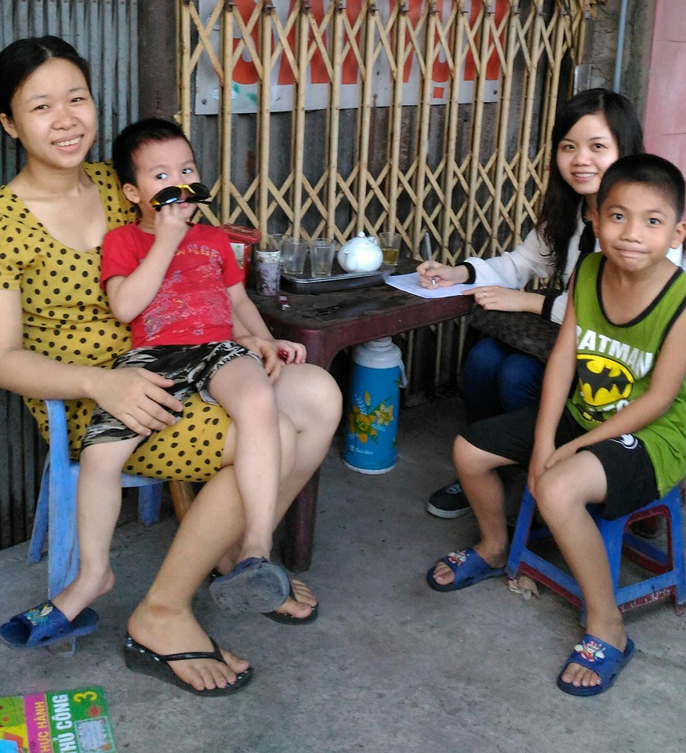
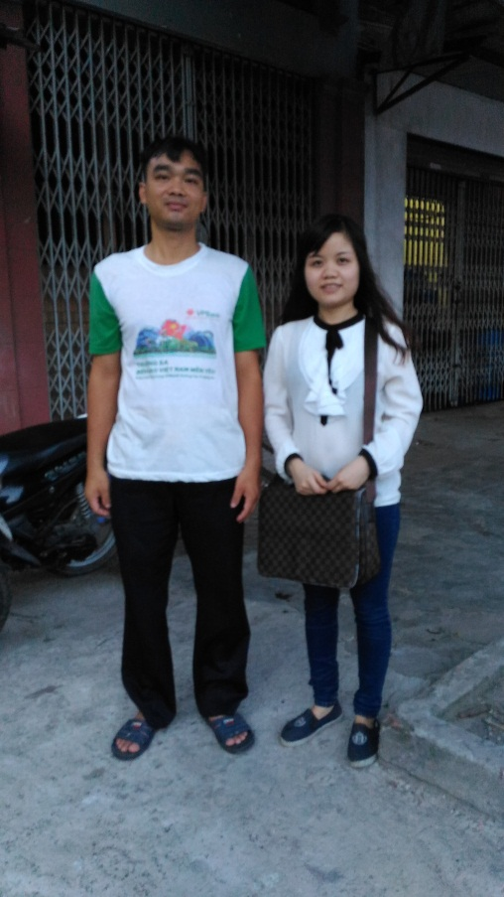
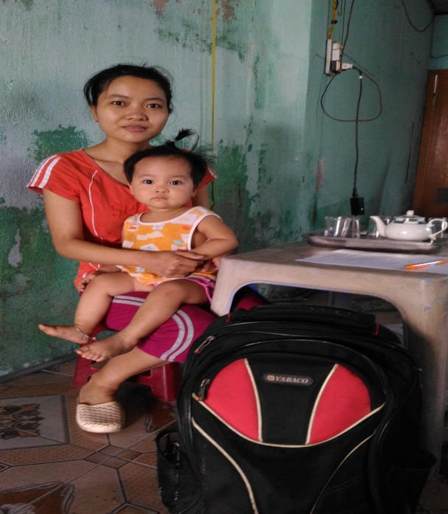
household at Xuan Truong
Household at Xuan Thanh
Household at Xuan Phong

Slide 27
Thank you for YOUR ATTENTION !

