Slide 1
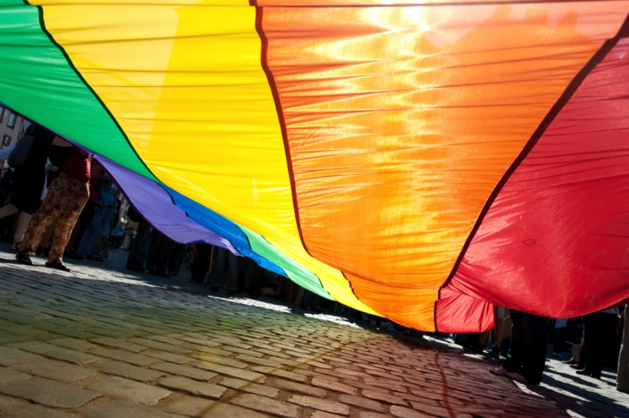
AWARENESS AND ATTITUDES TOWARDS HOMOSEXUALITY AND RELATED-FACTORS OF STUDENTS IN THE PUBLIC HEALTH FACULTY, HUE UNIVERSITY OF MEDICINE AND PHARMACY, 2016
Research group:Nguyen Thi Minh Trang, Nguyen Dao Thien An, Ho Thi Hao, Nguyen Que Chau, Vo Thi Linh Dan, Pham Ngoc Hung, Le Nhat Quynh.
Faculty advisor: Luong Thanh Bao Yen, Ph.D.
Institution: Faculty of Public Health, Hue University of Medicine and Pharmacy, VietNam

Slide 2
OUTLINE
1
INTRODUCTION
2
MATERIAL AND METHODS
3
RESULTS AND DISCUSSION
4
CONCLUSION
5
RECOMMENDATION AND REFERENCES

Slide 3
INTRODUCTION

Slide 4
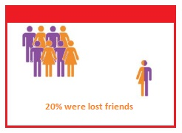
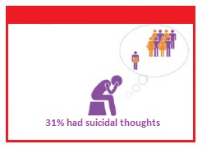
Scientists estimate that 3-5% of the world population is homosexual, or about 100 million people.
The iSEE Research Institute estimated that the number of homosexuals in Vietnam is 1.65 million, equivalent to approximately 2% of the population.
However, the attitude of community towards homosexuals is largely prejudicial and wary.
Notes:
Since 1973, American Psychiatric Association (APA) has removed homosexuality from the list of mental disorders in their diagnostic manuals and according to the World Health Organization (WHO) since 1990, has also removed homosexuality from the disease list [Institute of Social, economic and Environmental (iSEE)].
Some countries such as the Netherlands, Belgium, Spain and Sweden have allowed gay marriage.
Students are a vital part of society, representing the younger generation today. For those who are students studying at the Department of Public Health- Medical University, the correct understanding of this community is very important. Because more than anyone else, the future of medical staff will contribute significantly to the impact on the orientation of the community media through health education, thereby improving understanding as well as social attitudes to this issue, and also making healthcare for all in society are more effective.

Slide 5
OBJECTIVES
1. Assess awareness and attitudes towards homosexuality of students in the Public Health faculty, Hue University of Medicine and Pharmacy in 2016.
2. Find some factors related to awareness and attitudes towards homosexuality in study population.

Slide 6
MATERIAL AND METHODS

Slide 7
Study design: Cross sectional study
Location: Department of Public Health, Hue University of Medicine and Pharmacy
Duration: March, 2016 – July, 2016
Object of study: Students in faculty of Public Health, Hue University of Medicine and Pharmacy

Slide 8
Formula:
According to the study "Survey of public attitudes towards homosexuals" of MVA Hong Kong Limited in 2006, should we choose p = 0,491.The calculated sample size n = 384. To increase the representation, we estimate that 10% error. Thus, the sample size is 423.
Include:
N: sample size.
Z²_{α/2}: confidence interval limit at 95% probability, 1.96 respectively.
p: estimating unknown parameters of the population.
e: exact level.
$$N=\frac{z_{∝/2}^{2}×p(1−p)}{e^{2}}$$
Notes:
Awareness
47.0% of respondents "strongly agree / agree" that homosexuals are psychologically normal, while 41.9% thought otherwise.
Attitude:
49.1% of respondents said that there is a conflict between homosexuals and family values, 41.2% of people have the opposite view.

Slide 9
SAMPLING METHODOLOGY
1178 students of Faculty of Public Health, Hue University of Medicine and Pharmacy
423 students were selected
Using
a random method

Slide 10
RESULTS AND DISCUSSION

Slide 11
General Information
Information |  | Frequency (n) | Percentage (%)
Gender | Male | 118 | 29,6
 | Female | 280 | 70,4
Ethnic | Kinh | 388 | 97,5
 | Others (…) | 10 | 2,5
Age | 18-19 | 80 | 20.1
 | 20-22 | 256 | 64.3
 | >=23 | 62 | 15..6
Religion | Buddhism | 60 | 15,1
 | Catholic | 16 | 4
 | Christianity | 1 | 0,3
 | No religion belief | 321 | 80,7
Discipline | Preventive Medicine | 332 | 83.4
 | Public Health | 66 | 16.6
Permanent residence | Rural area | 256 | 64.3
 | Urban area | 142 | 35.7
Current living place | Live with family | 66 | 16.6
 | Renting a flat | 279 | 70.1
 | Dormitary | 27 | 6.8
 | Relatives house | 26 | 6.5
Monthly personal income | < 50 USD | 98 | 24.6
 | 50-150 USD | 283 | 71.1
 | > 150 USD | 17 | 4.3
Notes:
According to figure 1, we can see almost 70,4% of the respondents were female and 29,6% were male.
An overwhelming majority (97,5%) of the respondents were Vietnamese.
The majority (70,1%) lived far from home, 40,2% of them lived alone, 31,4% lived with friends, only a small percentage of students lived with their partners (3,8%).
About one-quarter (24,6%) of the respondents had monthly personal income of less than 50 USD, 71,1% earned 50- 150 USD and just merely 4,3% earned more than 150 USD a month.

Slide 12
AWARENESS OF HOMOSEXUALITY
2.5%
Notes:
Regarding awareness, only a very small number of the respondents (10 out of 488) were not aware of what homosexuality is (2,5%).
There are 62% students had no contact with homosexuals. 14% had infrequent contact with homosexuals, while only 6% had frequent contact. These rates are similar to Hongkong’s Survey.

Slide 13
ATITTUDES OF HOMOSEXUALITY
Notes:
The table 2 illustrates general attitude of students about homosexual, which includes 79% positive attitude and 21% negative one.
About discriminatory toward lesbian, the vast of 87% students have positive attitude in the contrary 13% students have negative attitude.

Slide 14
GENERAL ATTITUDES TOWARDS HOMOSEXUALS
Notes:
The first graph shows up the permission about homosexual people in variety roles in sociality- about 50-70% students. However, the proportion of acceptance homosexual people as a roommate and a leader is quietly low, 28,4% and 31,2% respectively. Compare to Hong Kong research, citizens consent a homosexual leader is significant higher with 77%.

Slide 15
DISCRIMINATORY ATTITUDES TOWARDS HOMOSEXUAL
Notes:
This graph presents some of standpoint related to homosexual. 87,4% students disagree or disagree exponentially with a viewpoint about homosexuals that they should be separated from community like their accommodation or limited career. There is 57,3% strongly disagreement or disagreement to statement that lesbian having deviant sexual behavior (such as child molestation, rape or hobbyists saw the pictures depraved) than heterosexuals; 28,4% students did not have any opinion about this issue. According to statement, 88,4% students disagree or extremely disagree with the idea that homosexual is a mental disease while the rate in Attitudes of British medical students towards male homosexuality (2000) is 60,4%. Adolescents’ and Young Adults’ Perception of Homosexualityand Related Factors in Three Asian Cities (2007) Research indicated the rate of thinking lesbian is normally exceeding low in both male and female in Hanoi , at 13,5% and 15% respectively.

Slide 16
SOME FACTORS RELATED TO AWARENESS TOWARDS HOMOSEXUALITY
 |  | Homosexual Awareness |  | Sum | p- value
 |  | Aware | Unaware
Major | Public Health | 61 | 5 | 66 | P< 0,05 related
 |  | 92,4% | 7,6% | 100%
 | Preventive medicine | 327 | 5 | 332
 |  | 98,5% | 1,5% | 100%
 |  | 100% | 0% | 100%
Notes:
Awareness of homosexuals is related with faculty of the participants. 98.5% students of Preventive Medicine faculty are aware of homosexuals while it is only 92.4% in faculty of Public Health. This phenomenon can be traced back to the duration of educational training program (6 years of Preventive Medicine and 4 years of Public Health). Moreover, Preventive Medicine program is various in extra activities including intership, community experiences in comparison with Public Health program. There is no relatedness between awareness of homosexuals and other variables (Age, Religion, Ethnic group…)

Slide 17
SOME FACTORS RELATED TO ATITTUDE TOWARDS HOMOSEXUALITY
 |  | Atittude towards homosexual |  | Sum | p- value
 |  | Positive | Negative
Gender | Male | 73 | 42 | 115 | p<0,05 related
 |  | 63,5% | 36,5% | 100%
 | Female | 234 | 39 | 273
 |  | 85,7% | 14,3% | 100%
Average monthly income | < 50 USD | 66 | 29 | 95 | p<0,05 related
 |  | 69,5% | 30,5% | 100%
 | 50- 150 USD | 228 | 48 | 276
 |  | 82,6% | 17,4% | 100%
 | >150 USD | 13 | 4 | 17
 |  | 76,5% | 23,5% | 100%
Having contact with homosexual people | Yes (Frequent) | 22 | 2 | 24 | p<0,05 related
 |  | 91,7% | 8,3% | 100%
 | Yes (Infrequent) | 48 | 5 | 53
 |  | 90,6% | 9,4% | 100%
 | No | 183 | 59 | 242
 |  | 75,6% | 24,4% | 100%
 | Not sure/ do not know | 54 | 15 | 69
 |  | 78,3% | 21,7% | 100%
Notes:
Attitude toward homosexuals in general is related with having contact with them (p<0.05). Participants who have regular or even rare contact with homosexual people express positive attitude respectively 91.7% and 90.6%. Meanwhile, those who do not have any contact with homosexual people only 78.3% have positive feelings. This may explain the great contribution of exposure to achieve more understanding and empathy toward homosexual community. Gender and average income are also related with general attitude in this perspective (p<0.05); women with possitive attitude are 85.7% of the participants while men are 63.5%; those with average monthly income below 50 USD, 50- 150 USD and above 150 USD show positive feelings in percentage of 69.5%, 82.6% and 76.5% respectively. There is no connection among other variables.

Slide 18
CONCLUSION
AWARENESS OF HOMOSEXUALITY
ATTITUDES TOWARDS HOMOSEXUALS
97,5% participants were aware of homosexuality
The percentage of those who had positive attitudes towards homosexuals is 79%
There are 20% participants had contact with homosexuals, including 14% had infrequent contact with homosexuals and only 6% had frequent contact
69,9% students agreed with tended to view homosexuality positively.
77,4% of participants agreed that homosexual acts disgusting
77,8% of participants did not agree that homosexuals should be forced into psychiatric treatment.
59,6% of interviews agreed that they continued to make friends with a homosexuals.
Including:

Slide 19
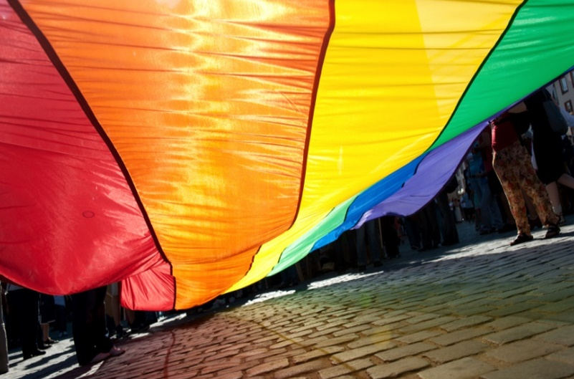
Some factors related to awareness and attitudes towards homosexuality
Awareness of homosexuals is related with faculty of the participants.
Attitude toward homosexuals in general is related with having contact with them.
Gender and average income are also related with general attitude.

Slide 20
RECOMMENDATION
Related subjects should be expanded in research.
It is necessary to conduct a depth qualitative study to find out why the negative attitude of men is higher than women.
University should establish of clubs and supporters, which connect to the homosexuality organization to share and improve knowledge related to homosexual.

Slide 21
REFERENCES
1. Institute of Social, economic and Environmental (iSEE).
2. Organization to protect and promote the rights of LGBT people in Vietnam (ICS).
3."Survey of public attitudes towards homosexuals" of MVA Hong Kong Limited in Hong Kong in 2006.
4. Attitudes Toward Homosexuality :Assessment and Behavioral Consequences Mary E. Kite and Kay Deaux Purdue University.
5. Attitudes of British medical students towards male homosexuality Andrew Parker and Dinesh Bhugra Institut e of Psychiatry, De Crespigny Park, London, United Kingdom.
6.Attitudes Towards Homosexuality: A Literature Review Gail Mason & Mischa Barr Sydney Institute of Criminology, Sydney Law School, University of Sydney January 2006.

Slide 22
THANK YOU FOR ATTENTION

