Slide 1
Health literacy differed partially in outpatients and the general public in a short-form survey in Taiwan.
Tuyen Van Duong*, Shih-Hsien Yang, Ming-Chu Chen, Wei-Ting Chao, Tara Chen, Priscilla Chiao, Hsiao-Ling Huang, Peter WuShou Chang.

Slide 2
Outlines
Assumptions
Research methods
Results
Discussion

Slide 3
Assumptions
The difference between general public and outpatients in regard to the health literacy is that patients experienced existing health issues and healthcare system while in contact with healthcare services.
Patients who visited different departments carried with them different healthcare experiences, which may incur various reflections on their health literacy.
→ It is important for healthcare providers to evaluate and understand patients’ health literacy before deliver their education and instruction.

Slide 4
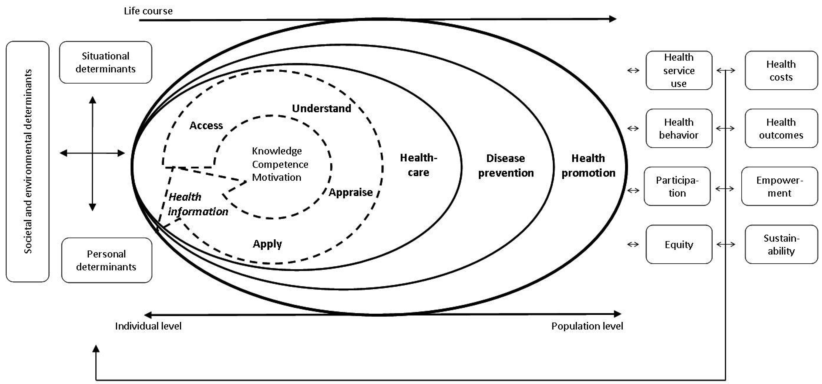
The conceptual model
Figure 1. The HLS-EU Conceptual Model of Health Literacy (Sørensen et al. 2012)
Notes:
Societal and environmental determinants: demographic situation, culture, language, political forces, societal systems
Personal determinants: age, gender, race, socioeconomic status, education, occupation, employment, income, literacy
Situational determinants: social support, family and peer influences, media use and physical environment
Health literacy in turn influences health behavior and the use of health services, and thereby will also impact on health outcomes and on the health costs in society.
At an individual level, ineffective communication due to poor health literacy will result in errors, poor quality, and risks to patient safety of the healthcare services.
At a population level, health literate persons are able to participate in the ongoing public and private dialogues about health, medicine, scientific knowledge and cultural beliefs. → greater autonomy and personal empowerment. → more equity and sustainability of changes in public health.

Slide 5
Methods
A cross-sectional survey was conducted by using the short-form health literacy questionnaire (HL-SF12).
Convenient sampling technique was used to recruit patients who visited the General OPD, Orthopedics Department (OD), and TCM in the National Taipei Hospital, June to July, 2015.
A sample in the Northern Taiwan (n=928) via the HLS-EU-Q in 2013-4 was used as a reference to compare the HL between those of the general public and patients.
Notes:
These three departments represented three main groups of patients in this community general hospital, with patients in the general OPD representing those for non-surgical treatment, in orthopedics department representing surgical patients, and in TCM department representing those sought for traditional medicinal treatment.
A total of 453 patients during the above-mentioned period were invited to the survey. Among them, 403 patients (response rate 89 %) completed the interviews and were included in the final analysis.

Slide 6
Analyses
CFA, and Multiple linear regression models were used.
All statistical analyses were performed using the SPSS Version 20.0 and AMOS version 22.0 (IBM Corp; Armonk, NY, USA).
The significance level was set with p < .05.

Slide 7
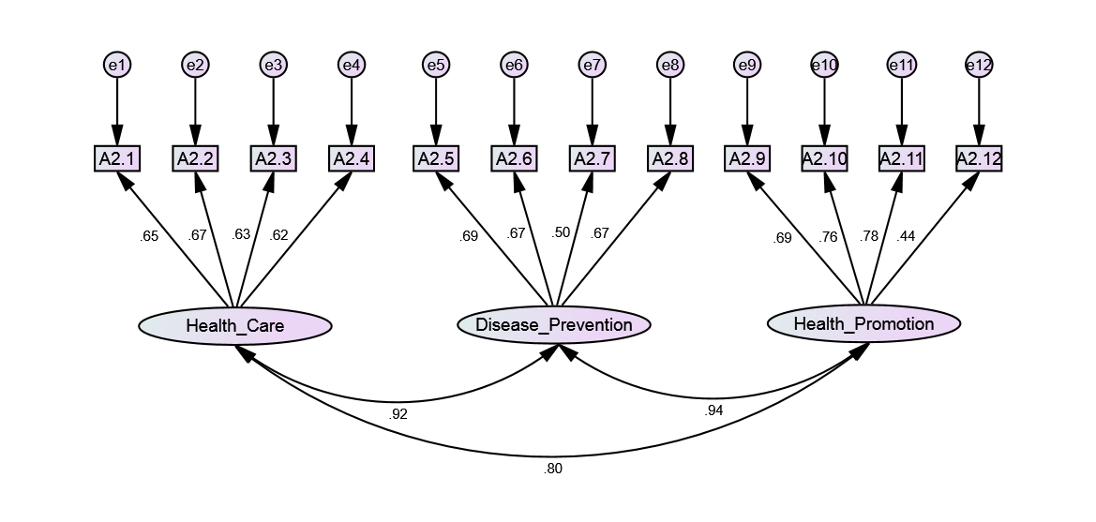
Figure 1. Structure Equation Model of Health Literacy with 12 selected items from 12 components loading into three domains of health (health care, disease prevention, and health promotion) of short-form health literacy 12 items questionnaire (HL-SF12).
Notes:
Satisfied model fit index
The reliability of the HL-SF12 was very high, with the internal consistency for the 12 items revealed Cronbach’s alpha for all the study population equal to .87, and for patients from General out-patient Department, Orthopedics Department, and TCM Department, .88, .87, .88, respectively, at acceptable level [17]. In addition, its split-half Spearman-Brown coefficient of .80 to .86 was satisfactory for all the patients and those in different departments (Table 1) [18,19]
Note. A2.1, A2.2, A2.3, A2.4, A2.5,A2.6, A2.7, A2.8, A2.9, A2.10, A2.11, A2.12 are items of HL-SF12 questions, in which on a scale from very easy to very difficult, how easy would you say it is to:
A2.1 …find information on treatments of illnesses that concern you?
A2.2 …understand the leaflets that come with your medicine?
A2.3 …judge the advantages and disadvantages of different treatment options?
A2.4 …call an ambulance in an emergency?
A2.5 …find information on how to manage mental health problems like stress or depression?
A2.6 …understand why you need health screenings (such as breast exam, blood sugar test, blood pressure)?
A2.7 …judge which vaccinations you may need?
A2.8 …decide how you can protect yourself from illness based on advice from family and friends?
A2.9 …find out about activities (such as meditation, exercise, walking, Pilates etc. ) that are good for your mental well-being?
A2.10 …understand information in the media (such as Internet, newspaper, magazines) on how to get healthier?
A2.11 …judge which everyday behavior (such as drinking and eating habits, exercise etc.) is related to your health?
A2.12 … join a sports club or exercise class if you want to?

Slide 8
Table 3 Bivariate and Multivariate linear regression analyses for health literacy and socio-demographics (N=403).
 | n | % |  | Model 1 |  |  |  | Model 2
 |  |  |  | B(95%CI) | β | p |  | B(95%CI) | β | p
Gender
Women (reference) | 245 | 61.1 |  | Reference |  |  |  | Reference
Men | 156 | 38.9 |  | -2.83 (-4.32 to -1.33) | -.18 | <.001 |  | -2.40 (-3.93 to -0.87) | -.15 | .002
Net income per month (USD)
<667 | 47 | 11.9 |  | Reference |  |  |  | Reference
667-1,667 | 194 | 49.2 |  | 3.62 (1.22 to 6.02) | .24 | .003 |  | 2.84 (0.28 to 5.41) | .19 | .030
>=1,667 | 153 | 38.8 |  | 4.12 (1.66 to 6.58) | .27 | .001 |  | 2.90 (0.13 to 5.67) | .19 | .040
Departments
General OPD | 190 | 47.1 |  | Reference |  |  |  | Reference
Orthopedics | 130 | 32.3 |  | -0.58 (-2.27 to 1.11) | -.04 | .502 |  | 0.60 (-1.11 to 2.31) | .04 | .490
TCM | 83 | 20.6 |  | -2.08 (-4.03 to -0.13) | -.11 | .037 |  | -1.50 (-3.53 to 0.53) | -.08 | .147
Watched health-related TV
Never and rarely | 142 | 35.4 |  | Reference |  |  |  | Reference
Sometimes | 186 | 46.4 |  | 2.73 (1.09 to 4.37) | .18 | .001 |  | 1.94 (0.27 to 3.61) | .13 | .023
Often | 73 | 18.2 |  | 3.00 (0.89 to 5.12) | .15 | .006 |  | 3.22 (0.97 to 5.48) | .16 | .005
Note. B = unstandardized regression coefficient; CI = confident interval; β = standardized regression coefficient; p = significant level; BMI = Body mass index; OPD = Out-Patient Department; TCM = Traditional Chinese Medicine. Model R² = 0.099.
Model 2 was adjusted for Age, Gender, Education, Employment status, Social status, BMI.

Slide 9
Table 4. The different between general public and out patients regarding health literacy via multiple linear regression analysis.
 | General Public N=928 Mean ± SD | Out Patients N=403 Mean ± SD | B (95%CI)* | β | p
General HL | 34.8 ± 6.5 | 35.6 ± 7.6 | 0.81 (-0.27, 1.66) | 0.055 | .058
Healthcare HL | 34.4 ± 7.6 | 35.9 ± 8.3 | 1.65 (0.70, 2.61) | 0.097 | .001
Disease Prevention HL | 34.5 ± 7.6 | 35.3 ± 8.9 | 0.84 (-0.15, 1.82) | 0.048 | .095
Health Promotion HL | 35.7 ± 7.9 | 35.5 ± 8.6 | -0.05 (-1.05, 0.95) | -0.003 | .922
Note. * The analysis was adjusted for age, gender, education, general public was reference; SD= Standard deviation; B= unstandardized regression coefficient; CI= confident interval; β = standardized regression coefficient; p= significant level; HL= Health Literacy.

Slide 10
Discussions
The result showed that HL was found to be significantly different between male and female. → similar with those in previous studies, that women’s health literacy was generally found to be higher than those of men (Sørensen et al. 2015; Nakayama et al. 2015).
Positively associated with net income per month (HLS-EU Consortium 2012; Sørensen et al. 2015), and watching health promoting televisions or health-related series (Do and Kincaid 2006).

Slide 11
Discussions (Cont.)
HL was less influenced by basic education, but was more influenced by income, life-long learning experiences (i.e. watching health related TV) (Do and Kincaid 2006). → inadequate health related contents in general education curriculum in Taiwan that education attainment was less important to health literacy in the study population.
HL was not found to be different between patients from departments. → Patients visited different departments based on their health needs or demands, while HL was an accumulated process that people need to develop knowledge, skills through their life-time to manage their own health (Sørensen et al. 2012).
Notes:
Casual relationship?
Survey time was after their exposure

Slide 12
Discussions (Cont.)
The HL-SF12 was able to identify the difference between general public and patients, specifically on healthcare health literacy.
The patients who experienced healthcare services in the hospital were expected to have higher HL in healthcare than those of the general public, while their health literacy in disease prevention and health promotion were similar to those of the general public.

Slide 13
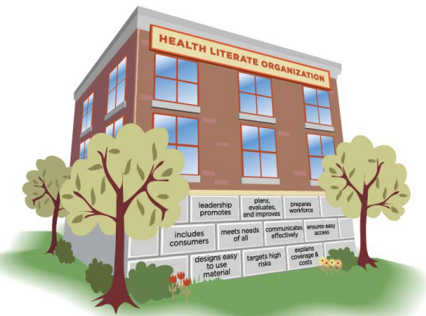
Ten attributes of health literate health care organization
Figure 2. Foundations of a Health Literate Organization (IOM, 2012)

Slide 14
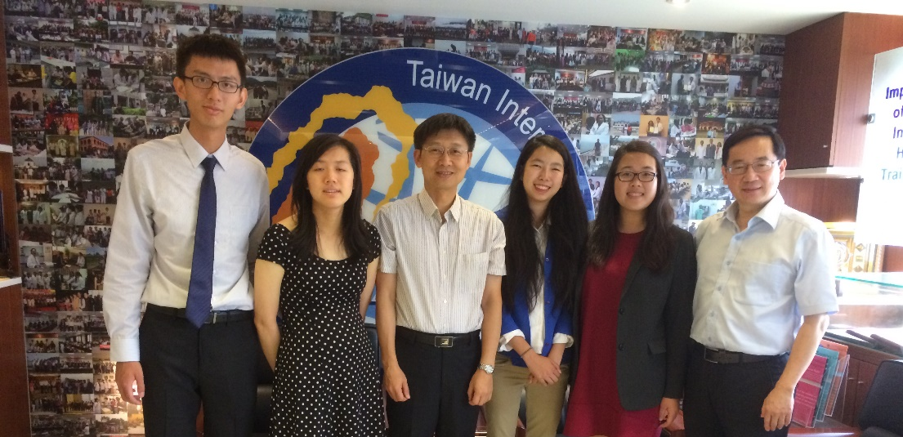
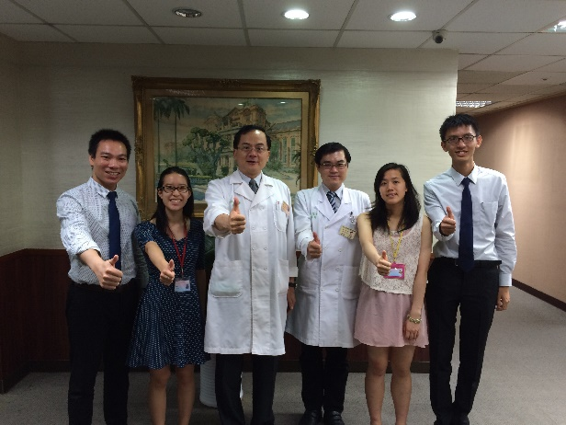
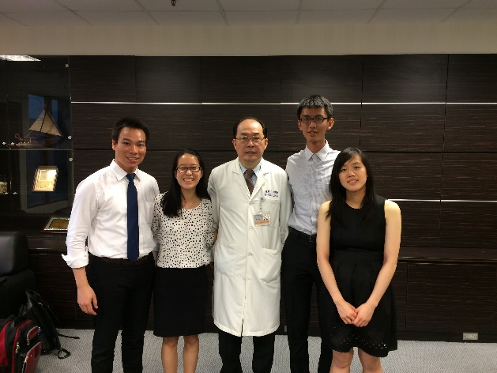
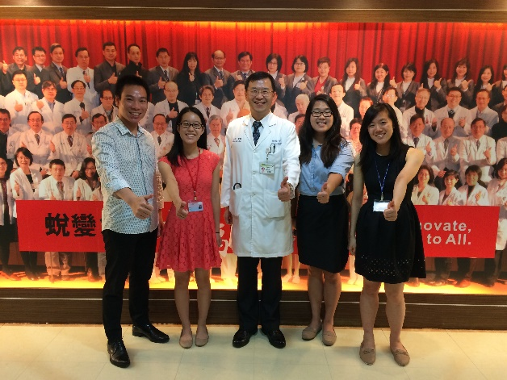

Slide 15
Progresses, ways ahead
International survey on Health Literate Healthcare Organization (ISHLHO)
HLS-EU-Q validated in Taiwan
HLS-EU-Q validated and used in Asia
Developed and validated HL-SF12 in Asia
→ HL among DM patients in Vietnam (Conducting)
→ HL among CKD patients in Asia (Submitting)
Expected to use in different types of diseases, hospitals, countries
Tested the HL-SF12 in Patients
Expected to use in different general population (AHLS 2.0)
(Conducting)
Notes:
Duong will mention details about validation and tests of tools in next presentation.

Slide 16
Conclusions
This was the first study to investigate the validity of the comprehensive HL-SF12, in different patient populations, and compared with a reference general public population.
The results indicated that the HL-SF12 was a valid tool in the clinical settings to serve as a comprehensive health literacy survey for doctors and nurses to assess patients’ health literacy.

Slide 17
References
Do, M. P., and D. L. Kincaid. 2006. Impact of an entertainment-education television drama on health knowledge and behavior in Bangladesh: an application of propensity score matching. Journal of Health Communication. 11:301-325. doi:http://dx.doi.org/10.1080/10810730600614045.
Duong, T. V., I.-F. Lin, K. Sørensen, J. M. Pelikan, S. Van den Broucke, Y.-C. Lin, and P. W. Chang. 2015. Health Literacy in Taiwan: A Population-Based Study. Asia-Pacific Journal of Public Health 27:871-880. doi:http://dx.doi.org/10.1177/1010539515607962.
HLS-EU Consortium. 2012. Comparative report of health literacy in eight EU member states. The European Health Literacy Project 2009–2012. Available from http://www.maastrichtuniversity.nl/web/file?uuid=d101b63c-dbbe-472d-971f-7a4eae14ba47&owner=d5b3681e-fc4a-476e-b9ff-a807c26760b9.
Nakayama, K., W. Osaka, T. Togari, H. Ishikawa, Y. Yonekura, A. Sekido, and M. Matsumoto. 2015. Comprehensive health literacy in Japan is lower than in Europe: a validated Japanese-language assessment of health literacy. BMC Public Health 15:505. doi:http://dx.doi.org/10.1186/s12889-015-1835-x.
Sørensen, K., J. M. Pelikan, F. Röthlin, K. Ganahl, Z. Slonska, G. Doyle, J. Fullam, et al. 2015. Health literacy in Europe: comparative results of the European health literacy survey (HLS-EU). European Journal of Public Health 25:1053-1058. doi:http://dx.doi.org/10.1093/eurpub/ckv043.
Sørensen, K., S. Van den Broucke, H. Brand, J. Fullam, G. Doyle, J. Pelikan, and Z. Slonszka. 2012. Health literacy and public health: a systematic review and integration of definitions and models. BMC Public Health 12:80. doi:http://dx.doi.org/10.1186/1471-2458-12-80.

Slide 18
Thank you for your attention!

