Slide 1
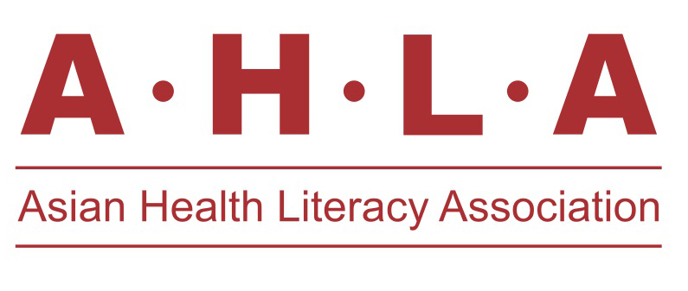
Preference of Health literacy content and choice of media among patients with diabetic retinopathy- qualitative study.
4th AHLA annual conference in Vietnam in Nov 7th- 9th, 2016
Ramesh. S Ve ¹*, Singh Megha ², Lakshmikantha Nandini ³, Mayya S. Shreemathi ⁴, Andrews Teddy ²
Affiliation (s)
1. Department Of Optometry, School of Allied Health Sciences, Manipal University, Manipal
2. Department Of Public Health, Manipal University, Manipal
3. School Of Communication, Manipal University, Manipal
4. Department Of Statistics, Manipal University, Manipal

Slide 2
Introduction
Diabetes mellitus is an increasing health problem globally.
171 million affected in 2000 and this is expected to affect around 366 million by the year 2030.¹
Most common complication of diabetes is diabetic retinopathy which make 1.8 million people blind every year around the world (2006). ¹
Diabetic retinopathy is likely to be a public health challenge in coming years.
Occurrence of diabetic retinopathy cannot be prevented but early detection and Increasing awareness will help avoid undue blindness. ²
Wild S et al Diabetes Care. 2004; 27(5):1047-1053.
Rema M et al. Investigative Ophthalmology & Visual Science. 2005; 46(7):2328.

Slide 3
Introduction
There is ample health literacy content available-³
most materials are clinically oriented and focuses mainly on facts and figures (in case of hospitals )
product oriented in case of pharma companies ) in their approach towards the disease.
Health literacy is a important method to bring Behavioral changes among patient
adhere to timely care regimen⁴
3. American Academy of Ophthalmology, 2015- http://store.aao.org/media/resources/11947651/Diab%20Retinopathy_09-14_WM_RGB.pdf
4. American academy of ophthalmology. Diabetic retinopathy summary benchmarks for preferred practice pattern guidelines, 2014.

Slide 4
Rationale
Poor Knowledge, awareness and practices towards uptake of eye care services have been reported among diabetic retinopathy patients.⁵
Media (Print, audio, video) - most commonly available mode for enhancing health literacy.
Most of the existing DR related health literacy content are either pharma oriented, statistics oriented or doctor centric.
Thus the rationale of this study is to understand patient’s perspective in developing innovative health care literacy contents.
5. Rani P, et al Rural and Remote Health [Internet]. 2008 [cited 8 December 2015]; 8:838

Slide 5
Aim
To understand the patients opinion towards available health literacy content on diabetic retinopathy.
To understand the patients opinion towards choice of media among patients with diabetic retinopathy

Slide 6
Methodology
Study setting : Hospital based study
Study design : cross sectional study
Study duration : January to June 2016
Operational definitions: diabetes mellitus , diabetic retinopathy, in depth interviews , visual acuity
Inclusion criteria:
Participants having diabetes mellitus (type 2) with diabetic retinopathy
Visual acuity worse than 6/18 in the better eye with best possible correction.

Slide 7
Methods
Exclusion criteria : Visual acuity of 6/18 or better in the better eye with best possible correction.
Those who could not come on the FGD time / interview time
Those who are Unwilling/unable to give consent.
Sampling technique : convenient sampling
Sample size : Minimum of 5 focus group discussions each having 8 to 9 participants and minimum of 6 in depth interviews will be conducted. Thus total sample size will have minimum of 35 participants.
ethical consideration: ethical consideration was obtained from institutional ethics committee ( IEC NO. 52/2016)
Study tools : FGD guide , Clinical and Vignette health literacy content

Slide 8
Methods
Data was collected through in-depth interviews.
Informed consent was obtained
Interview guide was wetted and validated by experts
Guide and trigger questions were also translated in Kannada and Hindi Language
Interview was conducted in the preferred language of participant
English/Hindhi / Kannada
Interviewer had prior experience in qualitative methods and was trained to administer uniformly

Slide 9
Methods
The discussions was started through a simple questionnaire
basic knowledge of participants about diabetes mellitus and diabetic retinopathy
Clinical³ and Vignette⁶ content was shared for participant reflection
participants were shown 2 different kind of available health literacy content
English or Kannada translation version
The main discussion focused to gather information
opinion on health literacy content- Clinical and vignette
Choice of medium
Further questions was asked to check their perception towards the available literacy content and discuss the type of health literacy content they seek for
3. American Academy of Ophthalmology, 2015- http://store.aao.org/media/resources/11947651/Diab%20Retinopathy_09-14_WM_RGB.pdf
6. National Eye Institute, National institute of Health, USA https://nei.nih.gov/sites/default/files/nehep-pdfs/OJO_Cartoon_English_508.pdf

Slide 10
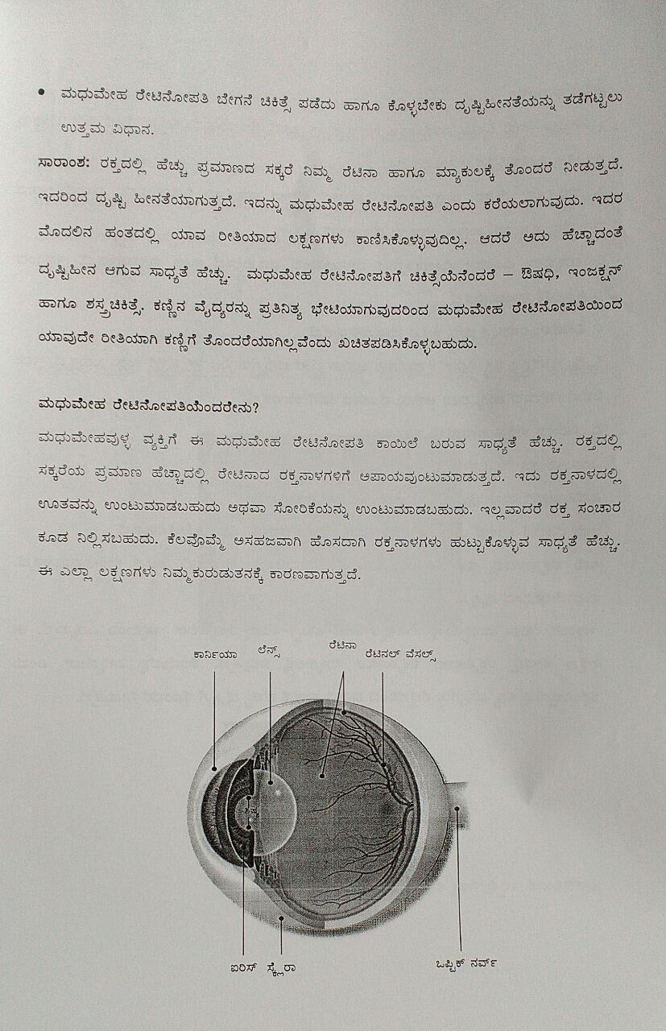
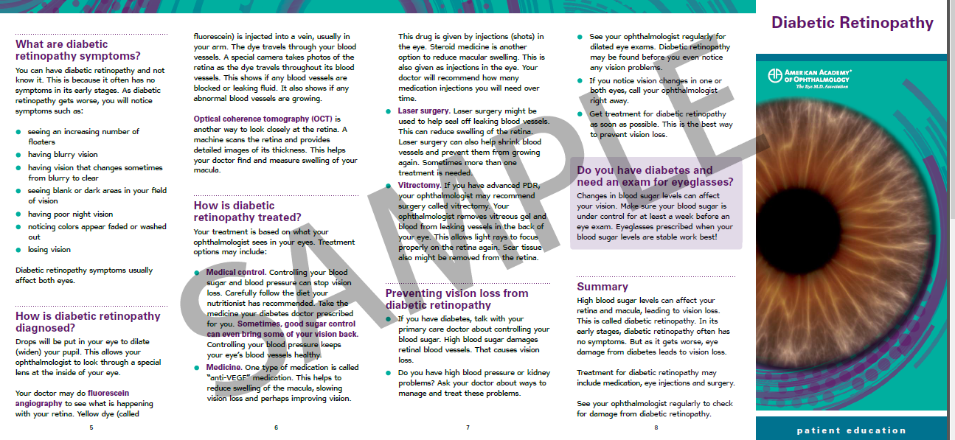
KANNADA VERSION
Clinical Content
Request for translation and study use sought from AAO

Slide 11
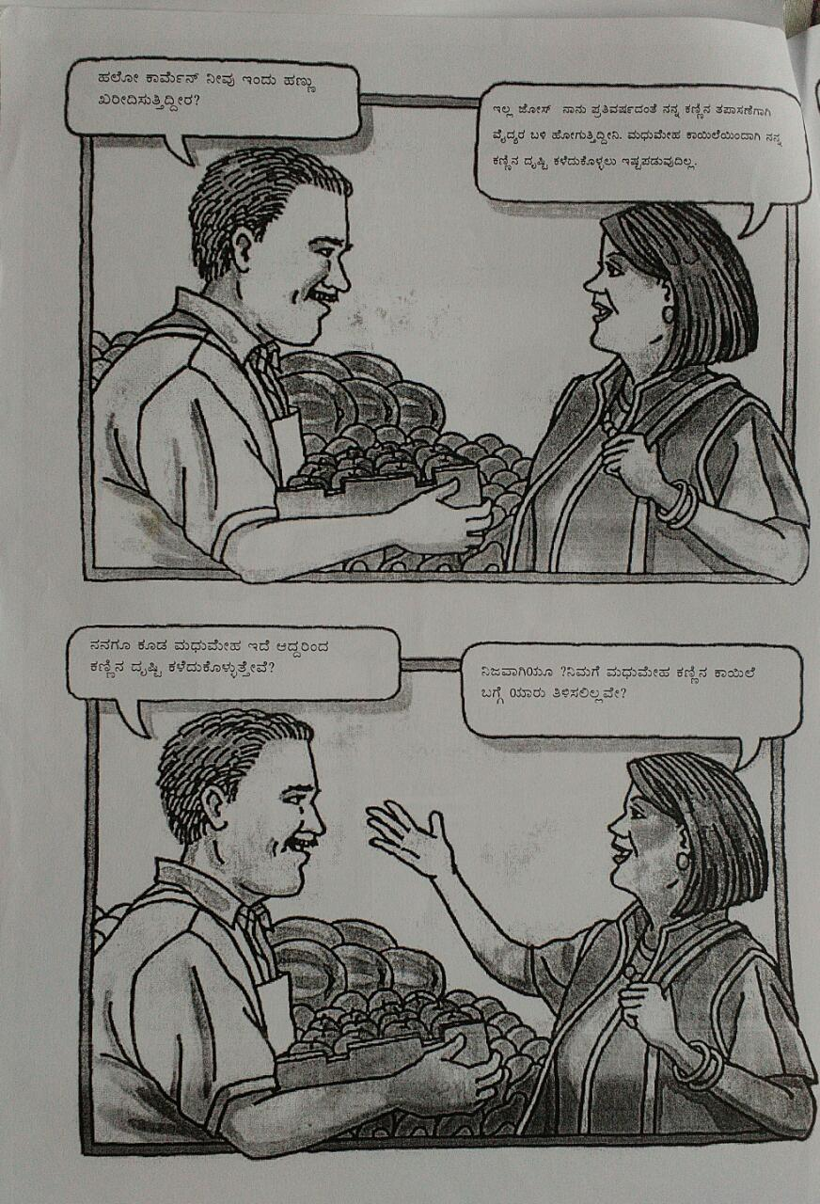
Vignette Content
KANNADA VERSION
Request for translation and study use sought from NIH

Slide 12
Result
In depth interviews were conducted among 35 participants till saturation of information was achieved.
emerging categories obtained in this study are :
Perspective towards available health literacy content
Desired content
Preferred medium of delivery
35 participants 15 were not aware about the term diabetic retinopathy.
Few participants mentioned the poor counselling by the doctors to be the cause of this

Slide 13
Clinical vs Vignette content-
Perspective towards content- 12 participants found the clinical content to be interesting while 23 participants felt that story telling content is good.
Vignette content-
“This story telling content tells in easy way the importance of eye checkup. Other content is like a medical text book. I don’t understand this. This story telling content should tell more about what if you get the retinopathy? What are the further steps you should take, treatment options available? Keep everything very simple with text and pictures.” (Male participant-49 years)
Clinical content-
“Clinical content is good. It addresses the seriousness of the problem. None of the doctors have time to explain how serious the disease could be so these content should address that. Unless seriousness is addressed people tend to ignore what is being said.” (female participant-43 years)

Slide 14
Choice of Media- Television and Print media
Desired content-
“Those who are illiterate also watches television. If this information is given in newspaper they might miss it so television is better. Make some animated videos and it can be shown between the shows in form of advertisement.” (female-50 years)
“Pamphlet is good.it can be given by general physician to the patient. Print media can be preserved as later reference also so I would prefer print media.” (male participant-58 years)

Slide 15
Choice of Media- Smart phone & Digital media
Desired content-
“Everyone in this country has smartphones these days, some small videos can be made and circulated through WhatsApp or Facebook. This is free and it will reach out to many people.”(male participant-58 years)
“Television is good. In the era of technology forums on internet will be good where many diabetics facing eye problems can join, talk about their eye problems and find better ways to adapt to these problems…Google is the most popular search engine, it can take some initiative. Where when you open Google a window will pop up which will have health literacy materials in the form of videos and text of many diseases. Patient can select suitable material for him and those of you who do not want to watch can just skip this option.” (female-50 years)

Slide 16
Discussion
The Pune diabetic retinopathy awareness and screening model ⁷
Media activation- Creating awareness and screening were used simultaneously.
Local participation, affordable indigenous technology, and awareness through the press were the three pillars of this model.
The model was found to be viable, reliable, reproducible, and scalable.
Customized DR related health literacy content that best suits
Regional
Language
Literacy
Disease stage
Media
7 Gadkari S. Journal of Clinical Ophthalmology and Research. 2015; 3(1):23-26.

Slide 18
Limitations
Though focus group discussion was proposed- Indepth interview were only conducted
Difficult to get eligible participants in a hospital set-up

Slide 19
Recommendations
To study diabetic patients without retinopathy and visual deficits
Series of content is needed to suit the patient preference and educational level rather than a single health literacy content.
Regional specific content
Customized awareness content
Access to these materials should be made at an early stage.
Choice of content
Print, audio visual
Social media
Media Activation Model- Involving stake holders in bringing about behavioral change

Slide 20
Conclusion
Illustrative vignette content was preferred by most of the participants because of its patient friendly language.
Though print media was more preferred, content preference and media dissemination methods needs to be further studied.

Slide 21
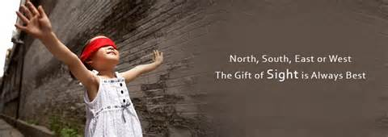
Thank you Questions ???

