Slide 1
Ensuring Patient Rights to informed consent & Satisfaction
Presented by Do Van Niem, MD, MSc.
Quality Management Department
Children’s Hospital 1 – HCMC, Vietnam

Slide 2
Content
Introduction
Objectives
Methodology
Results & Discussion
Conclusion

Slide 3
Introduction
Right to be informed
Fundamental Right (Clause7&10, Law on Healthcare)
Important requirement of patient & family centered care
Core content of Patient safety
Notes:
Right to informed consent is not only as fundamental patient rights stipulated by the Law on Medical Examination and Treatment, but also as an important content of patient safety. According to Joint Commission International statistics, non-effective communication is root causes of 86% treatment delays during the period of 1994-2005. Due to overload of work, some staff may not comply with internal recommendations of informing patient of care processes. That impacts on patient satisfaction and safety.

Slide 4
Goal & Objectives
Goal: To enhance the quality of communication with inpatients and families, and the compliance of professional procedures.
Objectives:
[1] To increase patient satisfaction score of communication over 3.25 [1-4 scale] [short: PSS].
[2] To increase professional procedure compliance rate over 85% (2.54σ) [short: PCR].
[3] To increase effective communication rate to patients and families over 93.3% (3σ) [short: ECR].
Notes:
To enhance the quality of communication with inpatients and families, and the rate of professional procedure compliance for improving patient satisfaction & safety.

Slide 5
Quality Indicators
Indicator | Standard | Threshold
PCR (%) = [∑ CO]*100 / [∑ SO] | 100% | 85% (2.54σ)
ECR (%) = [∑ ECT]*100 / [∑ SET] | 100% | 93.3% (3.0 σ)
Patient Satisfaction Score (CSQ8-m scale) | 4 | 3.25
Supervised Opportunity (SO): a conducted step of a procedure is looked
Compliance Opportunity (CO): an SO where the staff comply the procedure
Selected Evaluation Turns (SET): a patient is selected to evaluate
Effective Communication Turn (ECT): SET with “yes/right” answer
Sample size: 30 opportunity/procedure/department/week

Slide 6
Methodology
Design: “before and after” time series design
Implement: PDCA methodology based on 3 phases
Data analysis:
Run chart/Control chart, Pareto
Estimate sigma level: 1.5 + NORM.S.INV (probability).
Pilot
Spreading
Maintaining
General Dept. 2
Low PSS
+ 4 Depts.
General Dept. 2
Rules
Monitor indicators
Notes:
The study was conducted a population-based, “before and after” time series design trial and used PDCA methodology to make change through 3 consecutive periods. The changes that have been implemented include: [1] recommendation to physicians for informing to patient initial diagnosis, intended steps of diagnostic processes and treatment; [2] making more details of oral informed consent into nursing procedures; [3] training staff in new procedures; [4] making new procedures visualized at working places; and [5] set up a supervising and feedback system weekly.

Slide 7
Interventions
[1] To recommend physicians to inform patients of initial diagnosis, intended steps of diagnostic processes and treatment;
[2] To make more detailed contents of oral informed consent into nursing procedures; [7 procedure]
[3] To train staff in new procedures;
[4] To make new procedures visualized at working places; and
[5] To set up a supervising and feedback system weekly

Slide 8
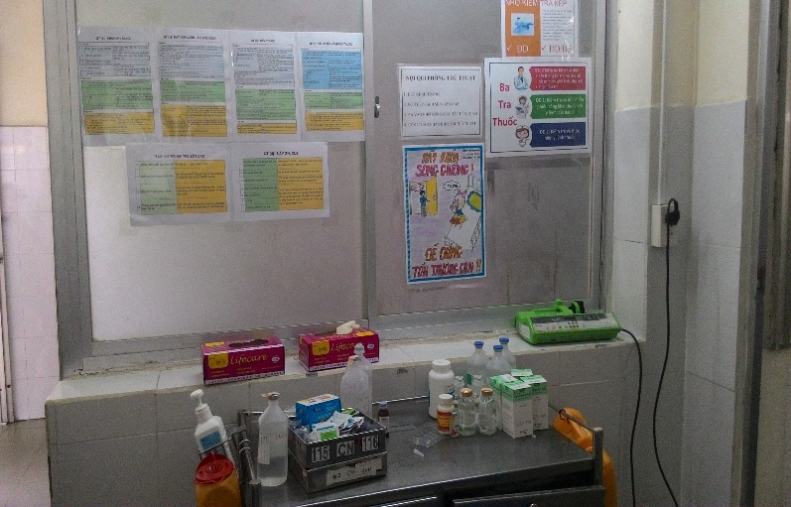
Some photos of implemented activities
Training course
Visual procedures

Slide 9
Result & Discussion
The trend of PCR improved from 57.4% (1.68σ) to
94.2% (3.07σ) after intervention, maintained at 86% (2.58σ).

Slide 10
Using Pareto diagram to identify priorities for improvement in the department every 3-week cycle
P [a]: Nebulizer | P [c]: Infusion | P [e]: High fever care
P [b]: Drug injection | P [d]: Collect samples | P [f]: Delivery of medicine

Slide 11
The level of physician’s ECR met 2.98σ in the spreading phase, but it was down some weeks in maintaining phase (small sample effect)

Slide 12
The level of nurses’ ECR met 3.23σ in spreading phase, but it was unstable in maintaining phase (small sample effect)

Slide 13
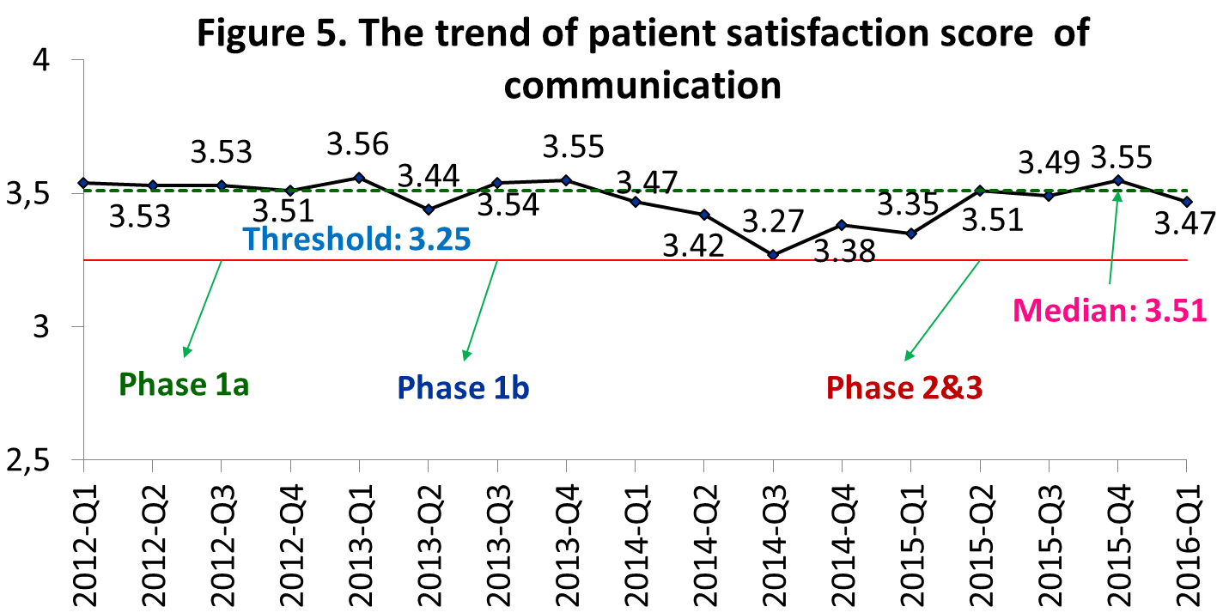
The trend of PSS was stable over the threshold of 3.25 [scale: 1-4]

Slide 14
Conclusion
Integration of informed consent into professional procedures made improvements of:
sigma level of PCR from 1.68σ to 2.58-3.07σ
sigma level of physicians’ and nurses’ ECR getting 2.98σ and 3.23σ respectively
PSS over the threshold of 3.25
It needs to set up a routine supervision and feedback system to build “informed consent culture”.
The continual plans are necessary to maintain the improvement results.
Notes:
Integration of informed consent and professional procedure contents is an effective solution for improving communication quality and patient rights. However, communication belongs to behavior and the change in short time may be unstable. Routine supervision and feedback are necessary to maintain the results forward “informed consent culture” in hospital.

