Slide 1
Health Literacy Contributed to the Associations between Long-Term Illness and Physical Limitations in several population studies in Asia.
Tuyen V. Duong, Altyn Aringazina, Gaukhar Baisunova, Nurjanah Nj, Thuc V. Pham, Khue M. Pham, Tien Q. Truong, Kien T. Nguyen, Win Myint Oo, Hsiao-Ling Huang, Kristine Sørensen, Jürgen M. Pelikan, Stephan Van den Brouke, Peter Wushou Chang.
Acknowledgment: Prof. Yuwen Chang, Prof. I-Feng Lin, Prof. Yi-Hua Chen, Prof. Pei-Shan Tsai.

Slide 2
Backgrounds
In Asia Pacific region NCDs are the pivotal cause of disease burden and mortality, claiming 55% of total life in the South East Asia, and 75% in the Western Pacific region each year (WHO, 2013).
The four major behavioral risk factors for NCDs in Asia-Pacific region are: tobacco use, alcohol consumption, inadequate physical activity, and unhealthy diet (Low et al., 2014).
Along with the development of HL in society especially in US, People start to paying attention to live healthy, keeping in training, breaking the bad habit like tobacco, cigarette and alcohol and avoiding from poor diet (İlgün et al., 2015).
Health literacy plays a crucial role in chronic disease self-management and necessary element for achieving health equity (Logan et al., 2015).

Slide 3
Backgrounds
Low HL has been seeing as a potential health risk factor (Nutbeam, 2008), associated with poor health outcomes (Lee et al., 2010), poor disease control (Souza et al., 2014), and higher mortality (Bostock & Steptoe, 2012).
HL closely links to
health seeking behaviour (Gray et al., 2005), health risk behaviours (Wolf et al., 2007),

Slide 4
Objective
Health literacy of individuals with long-term illnesses (LTIs), however, was not well examined in Asia.
→ This study was adapted the Conceptual model of the European Health Literacy Survey to examine the role of health literacy in the associations between long-term illness (LTIs) and physical limitation (PL) among people in five Asian countries (Indonesia, Kazakhstan, Myanmar, Taiwan, Vietnam).

Slide 5
Research methods
A cross-sectional design in Indonesia, Kazakhstan, Myanmar, Taiwan, and Vietnam.
Multistage stratification random sampling,
Overall samples of 10,024 participants aged 15 years and above.
Measurements:
Health Literacy: HLS-EU-Q47 (inadequate, problematic, sufficient, excellent)
Long-term illnesses (LTIs) (Yes/No); Physical limitation ( Yes/No)
Age, Gender, Education, Social status, ability to pay for medication, Doing exercise

Slide 6
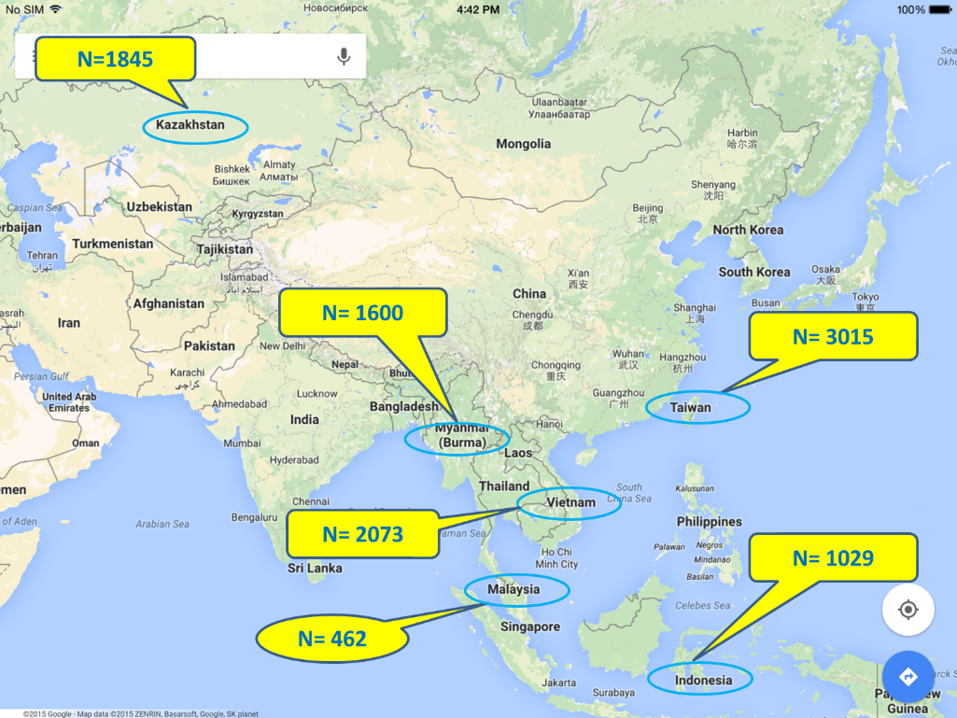
Notes:
Malaysia: with small sample, will not take into multi-country comparison at this stage
Pakistan:
the responses were more rated as 2 or 3, not well distributed from scale 1 to 4. This may not fit the tool and scale.
It is impossible to run factor analysis and modeling on your data.
The reliability of HLS-EU-Q47 shown strong limitation.
The proportion of rating difficult was very high, almost 90% for most of items.

Slide 7
The study was approved from the Institutional Review Board in all partner countries

Slide 8
Data analyses
Regression models to examine long-term illness (LTIs) effect on physical limitation (PL) and effect modifiers
Using the SPSS Version 20.0, p < 0.05.
Notes:
The analyses were adjusted for age (year), gender (“female” as the reference), education (“junior and below” as the reference), self-perceived social status (“low” as the reference), ability to pay for medication (“very and fairly difficult” as the reference), doing exercise (“not at all” as the reference).

Slide 9
Participants characteristics
 | Indonesia |  | Kazakhstan |  | Myanmar |  | Taiwan |  | Vietnam
 | (n=1,029) |  | (n=1,845) |  | (n=1,600) |  | (n=3,015) |  | (n= 2,073)
 | n | % | n | % | n | % | n | % | n | %
Age, mean (SD) | 30.6 (12.5) |  | 35.1 (15.8) |  | 39.6 (14.3) |  | 34.2 (16.8) |  | 41.1 (17.1)
15-24 | 468 | 45.5 | 623 | 34.9 | 295 | 18.4 | 1387 | 46.4 | 443 | 21.6
25-44 | 371 | 36.1 | 650 | 36.4 | 741 | 46.3 | 744 | 24.9 | 763 | 37.2
45-59 | 176 | 17.1 | 350 | 19.6 | 389 | 24.3 | 564 | 18.9 | 515 | 25.1
60+ | 14 | 1.4 | 161 | 9.0 | 175 | 10.9 | 292 | 9.8 | 331 | 16.1
Gender
Female | 570 | 55.4 | 1052 | 57.5 | 1015 | 63.5 | 1,654 | 54.9 | 1182 | 57.3
Male | 459 | 44.6 | 776 | 42.5 | 584 | 36.5 | 1,361 | 45.1 | 880 | 42.7
Education attainments
Elementary school | 90 | 8.7 | 66 | 3.9 | 219 | 14.2 | 132 | 4.4 | 219 | 10.7
Junior high school | 190 | 18.5 | 373 | 21.8 | 529 | 34.2 | 316 | 10.5 | 745 | 36.3
Senior high school | 510 | 49.6 | 261 | 15.3 | 411 | 26.6 | 1,263 | 41.9 | 656 | 31.9
University and above | 239 | 23.2 | 1009 | 59.0 | 387 | 25.0 | 1,301 | 43.2 | 434 | 21.1
Ability to pay for medication
Very difficulty | 13 | 1.3 | 124 | 7.3 | 19 | 1.2 | 160 | 5.3 | 221 | 10.8
Fairly difficulty | 150 | 14.6 | 255 | 15.1 | 245 | 15.4 | 784 | 26.2 | 715 | 34.9
Fairly easy | 696 | 67.6 | 913 | 53.8 | 755 | 47.3 | 1,603 | 53.5 | 950 | 46.3
Very easy | 169 | 16.4 | 404 | 23.8 | 576 | 36.1 | 450 | 15.0 | 163 | 8.0
Social status
Low | 168 | 16.6 | 609 | 41.5 | 455 | 30.0 | 1,181 | 40.1 | 877 | 43.2
Middle | 744 | 73.7 | 603 | 41.1 | 866 | 57.1 | 1,651 | 56.0 | 1056 | 52.0
High | 98 | 9.7 | 255 | 17.4 | 195 | 12.9 | 114 | 3.9 | 98 | 4.8
Doing exercise
Not at all | 143 | 14.0 | 309 | 32.1 | 930 | 59.5 | 532 | 18.1 | 461 | 33.7
Few times a moth | 290 | 28.4 | 138 | 14.3 | 166 | 10.6 | 860 | 29.2 | 254 | 18.6
Few times a week | 420 | 41.1 | 274 | 28.5 | 240 | 15.3 | 1188 | 40.4 | 298 | 21.8
Everyday | 168 | 16.5 | 242 | 25.1 | 228 | 14.6 | 364 | 12.4 | 355 | 26.0
Notes:
KZ conducted
The respondents in Indonesian were the youngest 30.6 (12.5) years, and Vietnamese were the oldest 41.1 (17.1) years. Female participants were more than male participants in each countries. Concerning education, the proportions with levels of junior high schools or lower were 48.4%, 47.0%, 27.2%, 25.7%, and 14.9% in Myanmar, Vietnam, Indonesia, Kazakhstan, and Taiwan, respectively. Proportions of the respondents claimed very or fairly difficult to pay for medication were shown in 45.7%, 31.5%, 22.4%, 16.6%, and 15.9% in Vietnam, Taiwan, Kazakhstan, Myanmar, and Indonesia, respectively. While 43.2% of those in Vietnam reported low self-perceived social status, 41.5%, 40.1%, 30.0%, and 16.6% were shown in Kazakhstan, Taiwan, Myanmar, and Indonesia, respectively (Table 4).

Slide 10
Health literacy (HL) modified the relationship between LTIs and PL
 |  | Indonesia |  |  |  | Kazakhstan |  |  |  | Myanmar |  |  |  | Taiwan |  |  |  | Vietnam
 |  | (n=1,029) |  |  |  | (n=1,845) |  |  |  | (n=1,600) |  |  |  | (n=3,015) |  |  |  | (n= 2,073)
 |  | B | SE | OR |  | B | SE | OR |  | B | SE | OR |  | B | SE | OR |  | B | SE | OR
Model 1
Long-term illness |  | 1.88 | , | 6.52*** |  | 2.21 | 0.12 | 9.08*** |  | 1.57 | 0.15 | 4.78*** |  | 1.79 | 0.09 | 6.00*** |  | 2.67 | 0.12 | 14.48***
Model 2 (LTIs + HL + associated factors ª)
Long-term illness | 2.09 |  | 0.23 | 8.10*** |  | 2.08 | 0.20 | 8.02*** |  | 1.55 | 0.17 | 4.73*** |  | 1.91 | 0.10 | 6.78*** |  | 2.31 | 0.16 | 10.10***
Inadequate HL | Reference |  |  |  |  | Reference |  |  |  | Reference |  |  |  | Reference |  |  |  | Reference
Problematic HL | -0.44 |  | 0.23 | 0.64 |  | -0.67 | 0.26 | 0.51** |  | 0.05 | 0.19 | 1.06 |  | -0.47 | 0.20 | 0.63* |  | -0.09 | 0.17 | 0.92
Sufficient HL | -0.60 |  | 0.25 | 0.55* |  | -0.84 | 0.28 | 0.43** |  | 0.22 | 0.20 | 1.24 |  | -0.52 | 0.20 | 0.60** |  | -0.51 | 0.20 | 0.60*
Excellent HL | -0.76 |  | 0.42 | 0.47 |  | -1.34 | 0.37 | 0.26*** |  | 0.03 | 0.26 | 1.03 |  | -0.85 | 0.23 | 0.43*** |  | -0.73 | 0.27 | 0.48**
Model 3 (=Model 2 + LTIs* HL ^{b})
LTIs*Inad HL ^{b} |  | 1.84 | 0.66 | 6.27** |  | 2.74 | 0.36 | 15.51*** |  | 1.14 | 0.33 | 3.14*** |  | 2.33 | 0.30 | 10.32*** |  | 2.80 | 0.31 | 16.49***
LTIs*Prob HL^{b} |  | 0.19 | 0.71 | 1.20 |  | -0.76 | 0.39 | 0.47 |  | 0.26 | 0.40 | 1.30 |  | -0.36 | 0.30 | 0.70 |  | -0.47 | 0.37 | 0.63
LTIs*Suffi HL^{b} |  | 0.31 | 0.76 | 1.36 |  | -0.84 | 0.42 | 0.43* |  | 0.90 | 0.42 | 2.47* |  | -0.44 | 0.31 | 0.64 |  | -0.98 | 0.41 | 0.37*
LTIs*Excel HL^{b} |  | 0.88 | 1.26 | 2.40 |  | -1.41 | 0.55 | 0.24** |  | 0.38 | 0.49 | 1.46 |  | -0.72 | 0.34 | 0.49* |  | -0.75 | 0.50 | 0.47
p values * 0.01 < p <0.05, ** 0.001 < p < 0.01, *** p < 0.001 Note. ª The analyses were adjusted for age (year), gender (“female” as the reference), education (“junior and below” as the reference), self-perceived social status (“low” as the reference), ability to pay for medication (“very and fairly difficult” as the reference), doing exercise (“not at all” as the reference).

Slide 11
Results and Discussions
With long-term illness more likely to have physical limitation, provided higher economic burdens, long-term illnesses or NCDs, and significant burden of disability (Klijs, et al, 2011).
With higher HL less likely to have health-related physical limitations. BUT, not in Myanmar
→ health outcomes in Myanmar was influenced by other factors,
i.e. health status less influenced by HL (β=.02) and influenced
more by age (β= -.22) or ability to pay for medication (β= -.16).

Slide 12
Results and Discussions
health literacy significantly modified the long-term illness associated physical limitation.
with higher HL had a better ability to manage their health (HLS-EU Consortium, 2012).
with higher HL less likely to smoke, and doing more exercise (Nancy D. Berkman et al., 2011; HLS-EU Consortium, 2012) → partly contributed to decrease or eliminate the physical limitation among people with LTIs.

Slide 13
Conclusions
HL significantly modified the negative effect of long-term illness and LTIs associated physical limitation in 5 Asian countries.
Health literacy could mediate the effect of chronic diseases on disability.
Integrating HL into healthcare agenda in Asian countries an effective mean to reduce the burden of long-term illnesses.
Investment in HL as smart healthcare service.

Slide 14
Health literate the life-long learning journey!

