Slide 1
Towards SDGs What Low-and-middle Income Countries Can Contribute Further in Maternal and Child Health? A case study from Vietnam
Prof. Bui Thi Thu Ha, MD. PhD
Hanoi School of Public Health

Slide 2
Outline
Overview of SDGs related to Maternal and Child Health (MCH)
Experiences from Vietnam on SDGs related to MCH
Conclusion

Slide 3
Sustainable development goals (SDGs)
17 goals with 169 targets, apply to all countries
Health:
Ensure healthy lives and promote well-being for all at all ages
March 2016: finalized indicators and targets
Health: 40.6% indicators (SDG3 and 23 health related indicators in 9 targets)

Slide 4
Sustainable development goals (SDGs)

Slide 5
MCH related indicators in SDG 3
No | Target | Indicators
3.1 | Global maternal mortality ratio to less than 70 per 100,000 live births. | MMR
3.2 | Neo- natal mortality: 12 per 1000 under-5 mortality: 25 per 1000 | Neonatal mortality/Under 5 mortality

Slide 6
MCH related indicators in SDG 3
Decreasing maternal and child health mortalities
Strategies
Improving gender equality
Linking up with MNCH improvement
Universal health coverage and decreasing disparity
Comprehensive approach: community, service provision, financing, governance
Multi-sectoral works and health system strengthening

Slide 7
LMIC and SDGs
SDG moved from focus on poorest countries to an approach that is universal and equitable: health of everyone, including marginalized in middle and high income countries
Need the holistic approach, beyond health sector, need coordination and well balanced economic, social and environmental aspects
Focus on illness prevention and promotion of well-being, curb the “profit driven” determinant of illness
LMIC need to address the challenges: lack of resource; NCDs challenges, health workforce (quantity and quality)
Focus on priorities of SDG measurement (devise metrics, establish monitoring mechanisms, evaluate progress, enhance infrastructure, and standardize and verify data)

Slide 8
Viet Nam
Population: 91.7 millions; 70% living in rural area
LMIC (2010):
GDP constitute of 22% agriculture,
41% industries, and 38% services
Among 10 “fast-track” countries making progress to achieve MDGs 4 and 5a
_{(Source: Worldbank 2016)}
Notes:
http://databank.worldbank.org/data/views/reports/ReportWidgetCustom.aspx?Report_Name=CountryProfile&Id=b450fd57

Slide 9
Viet Nam – 2/3 of the way achieving MDGs

Slide 10
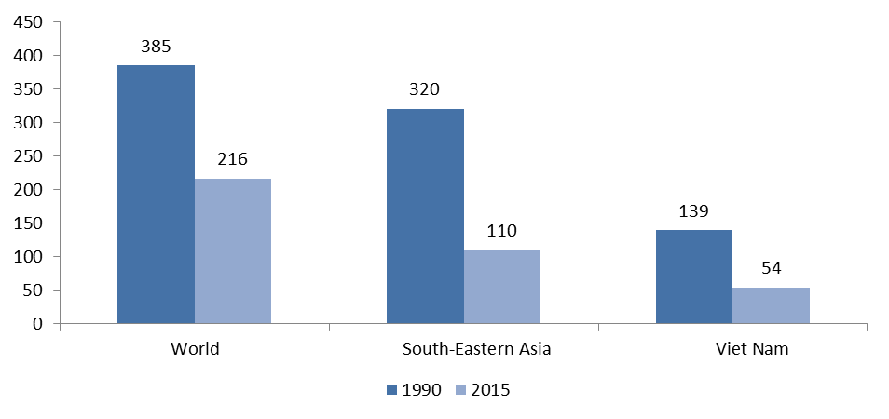
SDG 3.1. MMR of 70/100 000 live births
Global level (2015): MMR dropped from 385/100000 live births to 216/100000 during 1990-2015 (off track), significant intra-and inter-countries variation
Vietnam: 54/100000 newborns (achieved MDG5)
Source: WHO, UNICEF, UNFPA, World Bank Group and UNPD (2015). Trends in maternal mortality: 1990 to 2015: estimates by WHO, UNICEF, UNFPA, World Bank Group and the United Nations Population Division
Notes:
MDG 5: off track, significant intra-and inter-countries variation

Slide 11
SDG3.2: End preventable deaths of newborns (12/1000 live birth)
Global level (2015): neonatal mortality dropped from 63/1000 live births to 36/1000 (off track)
Vietnam: < 19/1,000 live births (achieved MDG4)
Source: United Nations, Department of Economic and Social Affairs, Population Division (2015). World Population Prospects: The 2015 Revision, custom data acquired via website.
Notes:
United Nations, Department of Economic and Social Affairs, Population Division (2015). World Population Prospects: The 2015 Revision, custom data acquired via website.
MDG 4: While a very large burden remains, the burden of mortality and morbidity has shifted to those infants who die in the first month of life—44% of all under-5 deaths occur at this time [14] —a group that was not specifically recognized in the MDGs [15]. The concept of “ending preventable deaths” in this population has not yet been quantified,

Slide 12
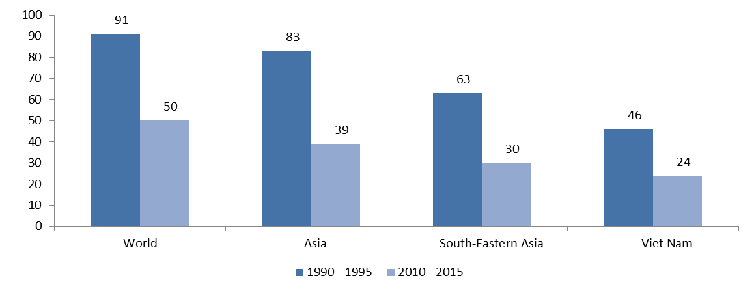
SDG 3.2. Under 5 mortality (25/1000 live births)
Global level (2015): Under-5 mortality rate dropped from 90 deaths per 1,000 live births in 1990 to 48 in 2012
Vietnam: 46-24/1000 new borns ( achieved MDG4)
Source: United Nations, Department of Economic and Social Affairs, Population Division (2015). World Population Prospects: The 2015 Revision, custom data acquired via website.
Notes:
MDG4: but a Lancet Commission highlighted that an under-5 mortality rate of 16/1000 live births should be achievable in most low- and middle-income countries [16] (compared to the current rate in developing countries of 99/1000 live births [2]).

Slide 13
Few initiatives in Vietnam towards MDG’s achievement
Investment in health sector in terms of health expenditures (51$ in 1995 to 232$ in 2011)
Network of RHC services from central to commune level
Initiative on ethnic minority midwifes (EMM) with official recognition on job and allowance
Vital registration system set up, M&E indicators
National strategy on population and reproductive health
Interventions focused on remote and mountainous regions and ethnic people

Slide 14
Few initiatives in Vietnam towards MDG’s achievement
Initiatives in other sectors
Education: literacy about 91-95%
Nutrition: % of malnutrition reduced from 51;4 to 17.5%
Investment in infrastructure, water supply and sanitation
ICT strategy for all sectors

Slide 15
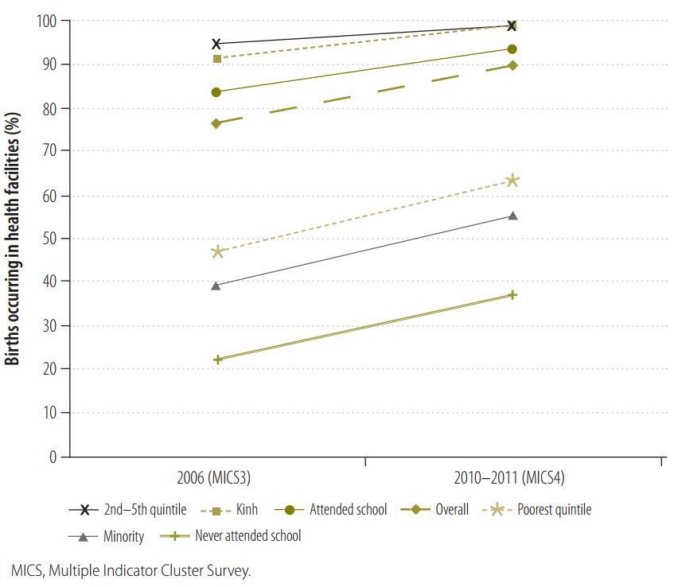
Challenges: Increasing equity gaps
Equity gaps in delivery in health facilities, by maternal ethnicity, education and household economic status, Viet Nam, 2006 and 2010–2011
(Mats Målqvist, 2013)
Notes:
http://www.who.int/bulletin/volumes/91/4/12-112425.pdf
Birth delivery in health facilities increased from 80 to >92%, but are lower for those are poor, minorities and low education level

Slide 16
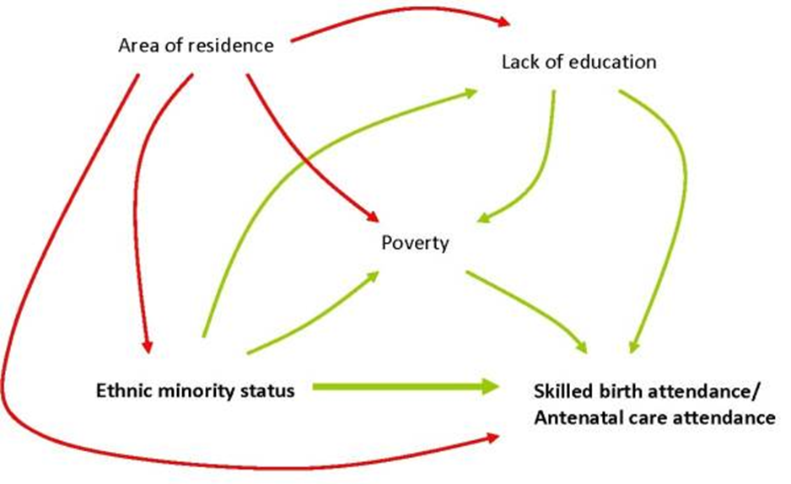
Challenges: Increasing equity gaps
Directed Acyclic Graph on causal effects and mediators of ethnicity and SBA/ANC, Vietnam 2006.
Emilia Goland, 2012
Notes:
https://www.ncbi.nlm.nih.gov/pmc/articles/PMC3477052/
Factors influencing SBA/ANC attendance are areas of residence, education, ethnicity and economic levels

Slide 17
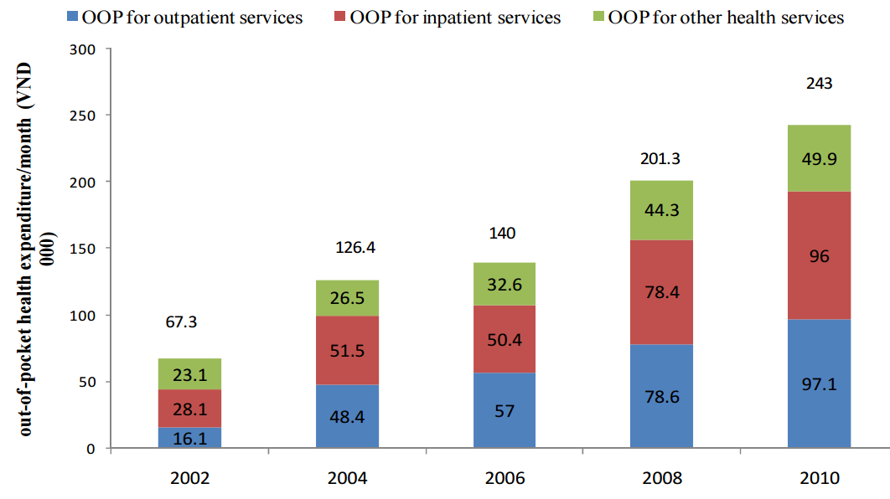
Challenges: High OOP payment
Increasing Out – of – Pocket payment for health care per household per month
Minh HV, 2012
Notes:
http://www.wpro.who.int/vietnam/topics/health_financing/vietnam_cata_report_jul_2012.pdf
Still very high OOP for all kinds of health services

Slide 18
Roadmaps towards SDG’s achievement in Vietnam
Need to built on MDGs agenda and looking into unfinished goals
Matching as much as possible already existing program documents
Prioritizing based on already existing program
Develop VSDG indicators, integrating in the existing socio-economic development program
Promoting enforcement systems to effective implement SDGs
Efforts of multiple stakeholders at different governance levels
Integrating poverty issues and environmental protection
Promoting transformation of growth models towards green growth and sustainable development

Slide 19
Roadmaps towards SDG’s achievement in Vietnam
Better M&E mechanism for SDG indicators
SDG indicators to be approved by the Government and Ministry of Planning and Investment will be responsible for M&E of SDG implementation
Develop tools to collect, synthesize information on M&E
Strengthen national statistical capacity
Improving data availability (registration, medical records, information from communities, survey, facilities based reporting data)
Enhancing capacity on data analysis, processing and used for decision making
Better human resources on HMIS (poor)
Informatics and innovation

Slide 20
Conclusion
LMIC contributed significantly in achievement of global SGDs
MCH is still high in agenda of SDGs
Need to learn from MDG achievement and shortcomings and plan for comprehensive approach, concerted efforts from different sectors
Lots of challenges ahead
Governance and leadership is crucial in pursuing SDGs
Believe to achieve SDGs in MCH

Slide 21
Strategies driving success

Slide 22
Thank you very much

