Slide 1
Developing short forms for the HLS-EU-Q47 instrument to measure comprehensive Health Literacy in general and specific populations
Jürgen M. Pelikan
em. Prof. Institute for Sociology, Vienna University
Director, WHO-CC Health Promotion in Hospitals and Health Care, at The Austrian Public Health Institute, Vienna / Austria
The 4th AHLA International Health Literacy Conference
Health Literacy and Quality of Healthcare Services
November 7-9, 2016 Haiphong, Vietnam
Notes:
The presentation will present the underlying procedures and results for constructing two short forms for the HLS-EU-Q47 instrument for measuring comprehensive health literacy (HL)
Background/objectives: HL is an evolving concept with a tendency of broadening the understanding of the underlying concepts of “health” and “literacy” and by that of the roles and tasks for which HL is seen as relevant. The HLS-EU Consortium has offered a model and definition for this comprehensive understanding of HL (Sörensen et al 2012). For measuring comprehensive HL in general populations the HLS-EU-Q47 has been developed and validated within the HLS-EU study in eight countries (HLS-EU Consortium 2012, Sörensen et al 2013). In the meantime the instrument has been translated into further languages and applied in more European and selected Asian countries. But for many research purposes a measurement instrument containing a battery of 47 items is seen as too long and uneconomical. Therefore it was seen as necessary to develop short forms for this instrument.
Methods: Item selection was based on psychometric Rasch modeling (1 parametric dichotomous model) and content and face validity criteria (for good representation of the original HLS-EU Matrix). As split criteria for Rasch modelling were used: median, gender and dichotomized education within every of the 8 country samples. By that it was possible to construct a Rasch scale HLS-EU-Q16 containing the same 16 items in every country. This scale has been also validated for further countries and for specific population sub-groups. For selecting fewer items for an even shorter sub-scale HLS-E- Q6, CFA modelling was used.
Results: Both short forms correlate highly (around r= .80) with the HLS-EU-Q47 index of comprehensive HL in the researched countries and represent selected bi-variate associations of this index with relevant determinants and consequences of HL quite well. By fulfilling Rasch criteria, the two short forms have better psychometric properties than the original index. Instead taking about ten minutes in an interview they can be executed in about 3 minutes respectively in 1 minute.
Conclusions/implications: When measuring sub-dimensions of HL is not intended and it is necessary to have a shorter and more economical comprehensive measure of HL, the two short forms HLS-Q16 and HLS-EU-Q6 are a reliable and valid alternative to the HLS-EU-Q47 index. In contrast to short forms based only on factor analyses of the items of the HLS-EU-Q47, these short forms have the advantage that by Rasch analyses the same 16 items have already been identified to work well in many different countries.

Slide 2
Overview
The HLS-EU-Q47 long form
Criteria and strategies for creating short forms
Rasch modelling HLS-EU-Q16 short form
Rasch modelling HLS-EU-Q6 short-short form
Comparing the HLS-EU indices and scales
Factor analyses modelling

Slide 3
Health literacy - an “evolving concept” (Nutbeam 2008) – with 3 observable trends
Broadening of understanding of
Health: Disease & positive health and wellbeing
Literacy: Literacy & other information/communication competences
Roles & tasks: Patient role & other roles in everyday life
Integrative comprehensive definition of HL (Sorensen et al. 2012):
“Health literacy is linked to literacy and encompasses people’s knowledge, motivation and competences to access, understand, appraise, and apply health information in order to make judgments and take decisions in everyday life concerning healthcare, disease prevention and health promotion to maintain or improve quality of life during the life course.”
Differentiating of HL for specific contexts & contents
types ( e.g. functional, interactive, critical; medical, public health)
aspects (e.g. mental, medication, eHealth, oral, numeracy)
stages in life-cycle (e.g. child, youth, adult, parentage, old age)
lifestyles (e.g. nutrition, physical activity, smoking)
(chronic) diseases (e.g. aids, depression, diabetes, cancer)
Relational/contextual/dual understanding of HL > measure & increase personal competences & decrease situational demands
> organizational HL, health literate organization/setting
Notes:
Budapest 05-16!
Curitiba 05-16!
Genf 05-15
JMP 22.04.15

Slide 4
1. The HLS-EU-Q47 long form

Slide 5
The HLS-EU-Q47 long form is ….
a theory based,
comprehensive (concerning meaning of „health“ & „literacy“)
but modularized (for 7 sub-indices & 12 sub-sub-indices)
instrument of 47 self-reporting questions, (therefore already rather short!)
measuring the fit (of personal HL competences to actual situational expectations or complexities concerning HL),
by Likert scales of 4 categories from very easy to very difficult.
Indices for comprehensive HL and 7 sub-indices range from 0 to 50, for 12 sub-sub-indices from 0 to 5.
Four levels (…) have been defined for the comprehensive index and the 7 sub-indices.
That makes the instrument a perfect tool for measuring comprehensive HL in populations in a theoretically differentiated manner with many concrete indicators and possible indices.
But if one is just interested in one aggregate measure for comprehensive HL, 47 items and a duration of 10 minutes seem to be too long and un-economical, therefore a short form was asked for by researchers

Slide 6
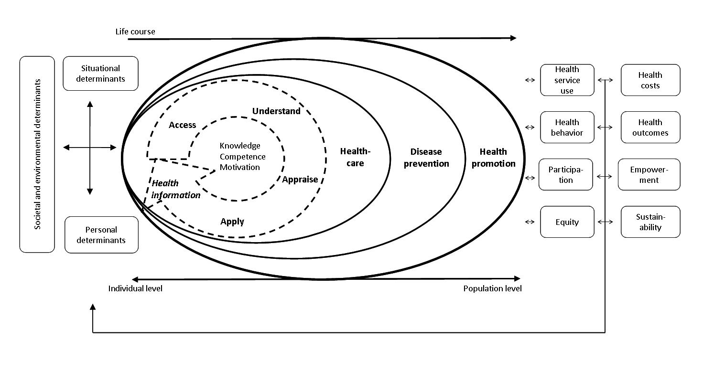
The HLS-EU integrative & comprehensive conceptual & generic model and definition of Health Literacy (Sørensen et al. 2012)
“Health literacy is linked to literacy
and encompasses people’s knowledge, motivation and competences
to access, understand, appraise, and apply health information
in order to make judgments and take decisions in everyday life
concerning healthcare, disease prevention and health promotion
to maintain or improve quality of life during the life course.”
Notes:
Budapest 05-16!
Manipal 02-16
Lisbon 04-15
Taipeh 10-14
TALLINN – 7.6.2013, JMP 9.8.2013

Slide 7
The HLS-EU Definition Matrix: Dimensions, cells, number of questions & possible indices
Health literacy (47) | Access/obtain information relevant to health (13) | Understand information relevant to health (11) | Process / appraise information relevant to health (12) | Apply / use information relevant to health (11)
Health care (16) | 1) Ability to access information on medical or clinical issues (4 Questions) | 2) Ability to understand medical information and derive meaning (4 Questions) | 3) Ability to interpret and evaluate medical information (4 Questions) | 4) Ability to make informed decisions on medical issues (4 Questions)
Disease prevention (15) | 5) Ability to access information on risk factors for health (4 Questions) | 6) Ability to understand information on risk factors and derive meaning (3 Questions) | 7) Ability to interpret and evaluate information on risk factors for health (5 Questions) | 8) Ability to make informed decisions on risk factors for health (3 Questions)
Health promotion (16) | 9) Ability to update oneself on health related issues (5 Questions) | 10) Ability to understand health related information and derive meaning (4 Questions) | 11) Ability to interpret and evaluate information on health related issues (3 Questions) | 12) Ability to make a informed decision on health related issues (4 Questions)
Notes:
Geneva 06-16
Budapest 05-16!
Manipal 02-16
Unterscheidung in Wissensabfrage, Navigation,..
K Manipal 02-16
Lisbon 04-15
References:
BRIEF: CHEW SCREEING ITEMS: Chew L.D., et al (2008) Validation of Screening Questions for Limited Health Literacy in a large VA Outpatient Population. Journal of General Internal
DAHL (Demographic Assessment of Health Literacy. (Hanchate et al, 2008)
FHLT: Zhang, XH. Et al (2009): Development and validation of a functional health literacy test. Patient 2(3): 168-78.
Health LiTT: Hahn, E.A. et al (2011): Health Literacy Assessment Using Talkin Touchscreen Technology (Health LiTT): A New Items Response Theory-based Measure of Health Literacy. J. Health Communication 16 (Suppl 3): 150-162
HALS: Rudd R, Kirsch I, Yamamoto K. Literacy and Health in America: Policy Information Report. Princeton, NJ: Educational Testing Service; 2004. Apr,
HLSI: Bann, C.M. et al (2010): The Health Literacy Skills Instrument: A 10-Item Short Form. Journal of Health Communication: Internationl Perspectives 17:sup3, 191-202
McCormack et al (2010): Measuring Health Literacy: A Pilot Study of a New Skils-Based Instrument, Journal of Health Communication: International Perspectives, 15:S2, 52-71
HLSQ – Osborn, et al. 2013
MART: Hanson-Divers, E.C. (1997): Developing a medical acievment reading test to evaluate patient literacy skills: a preliminary study. J. Health Care Poor Underserved 8(1): 56-69
NVS: Weiss B.D., et al (2005): Quick assessment of literacy in primary care: the Newest Vital Sign. Ann Fam Med; 3: 514–22.
NLS: Nutrition Literacy Scale (NLS) (Diamond, 2007)
TOFHLA: Parker, R.M., et al (1995): The test of functional health literacy in adults: A new instrument for measuring patients‘ literacy skills. Journal of General Internal Medicine, 10, 537-541.
REALM: Davis, T.C., et al (1993): Rapid estimate of adult literacy in medicine: A shortanted screening instrument. Family Medincine, 25, 391-395.
Weitere Abwandlungen des REALM: REALM-SF; REALM-VS; REALD- 99; REALM-Teen; REAL-G; HKREALD-30
SAHLSA: Lee, SY et al. (2006): Development of an easy-to-use Spanish Health Literacy test. Health Serv Res.;41(4 Pt 1):1392-412.
SILS: Morris N.S., et al. (2006):The Single Item Literacy Screener: Evaluation of a brief instrument to identify limited reading ability. BMC Family Practice. 7(21)
WRAT: Dell, Harrold & Dell, 2008 – Test ist kostenpflichtig

Slide 8
Selected examples of questions of the HLS-EU-Q47
Format of questions
„On a scale from very easy to very difficult, how easy would you say it is to … “very easy” - “fairly easy” - “fairly difficult” - “very difficult”, (don´t know)
Five examples
Health care
5. … understand, what your doctor says to you?
12. … judge if the information about illness in the media is reliable?
Disease prevention
18. …find information on how to manage mental health problems like stress or depression?
29. …decide if you should have a flu vaccination?
Health promotion
38. … understand information on food packaging?
47. … take part in activities that improve health and well-being in your community?
Notes:
Genf 06-16
Budapest 05-16
K Manipal 02-16
Lisbon 04-15
Bern 09-14, korr JMP 13-09-14
Pattaya, Measuring Health Literacy in General Populations in Europe. Selected Results from the HLS-EU Study., 21st IUHPE Conf., 27.8.2013
e.g. Tallinn 7.6.2013 , JMP 9.8.2013

Slide 9
HLS-EU Survey Overview: Sampling, Data collection
Countries | Austria (AT), Bulgaria (BG), Germany (DE) (only NRW), Greece (EL) (only Athens +), Spain (ES), Ireland (IE), Netherlands (NL), Poland (PL)
Survey Institut | TNS Opinion on behalf of the HLS-EU Consortium
Survey Periode | Summer 2011
Target Population, Population Coverage | EU citizens (!) aged 15 years and over (Euro-barometer Methodology)
HL Instrument | HLS-EU-Q86 (including HLS-EU-Q47 and NVS Test)
Data collection | by computer-assisted personal interviewing technique (CAPI) (BG, IE = PAPI)
Sampling design | Euro-barometer Methodology Stratified probability sampling (multistage random sample): National sampling points selected randomly (applying random-walk procedure) after stratification for population size and population density (metropolitan, urban and rural areas).
Response Rates | Austria (67%), Bulgaria (75%), Germany (DE) (53%), Greece (65%), Spain (62%), Ireland (69%), Netherlands (36%), Poland (67%)
Sample Sizes | Austria (1015), Bulgaria (1002), Germany (DE) (1057), Greece (1000), Spain (1000), Ireland (1005), Netherlands (1023), Poland (1000)
Weights | National samples were weighted by gender, age group and size of locality, based on national census data Country size was not used as a weighting criterion for the analyses of the total sample. Total sample values therefore represent a ‚country average‘ where all countries are represented with equal weights regardless of their population size.
Notes:
Genf 06-16!
Lisbon 04-15
Data collection by one Provider - TNS Opinion
Eurobarometer methodology applied for all sampling and data collection precedure in all participating countries (→ present Europbarometer Metholody)
Sample restricted to EU citizens (!)
15+
National Samples to respresent the national population -Except for Germany (only North-Rhine Westphalia) and Greece (only Athens and ist surroundings)
Computer Assisted Personal Interview (CAPI) only in Blugaria and Irland Papaer Assisted Personal Interview (PAPI)
Mulitstage random sample – National sampling points were selsected randomly after stratification for population size and population density (metropolitan, urban and rural areas). Within each sampling point a random sample of households (addresses) was visited by interviewers (applying random-walk procedures). In case of noncontact, interviewers re-visited the address for a second or a third time.

Slide 10
Procedure of HLS-EU Index Construction for HL
Index scores where only computed for respondents who answered at least 80% of the items associated to the specific indices. Depending on the index no value could be calculated for 2,4 – 12, 7 % of the total sample!
For calculation the item values where inverted – so that a higher value of the index denotes better health literacy.
The comprehensive index and the 7 sub-indices were standardized on a scale from a minimum of 0 to a maximum of 50 (=best possible HL)
The 12 sub-sub-indices were standardized on a scale from a minimum of 0 to a maximum of 5 (= best possible HL)
5. Cronbach´s alphas for comprehensive HL index are very high!
6. Correlations with functional HL (NVS) are moderate
GEN HL R ,208**,381**,151**,347**,214**,242**,088**,302**,266**
 | AT | BG | DE (NRW) | EL | ES | IE | NL | PL | TOTAL
GEN HL | 0,96 | 0,97 | 0,96 | 0,97 | 0,96 | 0,97 | 0,95 | 0,98 | 0,97
Notes:
JMP Haiphong 11-16
Genf 06-16!
Taipeh 10-14
11.11.2013
Index…... is the specific index calculated
Mean…..is the mean of all participating items for each Individual
1 …………is the minimal possible value of the mean (leads to a minimum value of the index of 0)
3 ………..is the range of the mean
50…….is the chosen maximum value of the new metric

Slide 11
Comprehensive HL-Index (CHL) (Percentage Distributions, Means & S.D. for 8 Countries & Total Sample) (HLS-EU 2012) > Bell shaped distribution with some ceiling effect for all countries!
● Austria (Ø32/SD 7.6)
Bulgaria (Ø30.5/SD 9.2)
Germany (Ø34.5/SD 7.9)
Greece (Ø33.6/SD 8.5) Spain (Ø32.9/SD 6.1)
Ireland (Ø35.2/SD 7.8)
Netherlands (Ø37.1/SD 6.4)
Poland (Ø34.5/SD 8)
Total (Ø33.8/SD 8)
Grouped Scores of Comprehensive Health Literacy Index
Notes:
Budapest 05-16!
JMP Taipeh 10-14 (Überschrift!)
Pattaya, Measuring Health Literacy in General Populations in Europe. Selected Results from the HLS-EU Study., 21st IUHPE Conf., 27.8.2013
Hannover 1.9.2012, Pattaya small changes JMP 11.8.2013 (untere Tab ändern!)

Slide 12
Types of Health Literacy Indices by the HLS-EU Model 1 comprehensive index, 7 sub-indices and 12 sub-sub-indices
Comprehen. HL Index | OI-Index (13Items) Access/obtain health information | UI-Index (11Items) Understanding health information | PI-Index (12 Items) Process/Appraise health information | AI –Index (11 Items) Apply/Use Health information
HC-HL Index (16Items) Health Care | 1) Ability to access information on medical or clinical issues (4 Questions) HC-FHI (2012) | 2) Ability to understand medical information and derive meaning (4 Questions) HC-UHI (2012) | 3) Ability to interpret and evaluate medical information (4 Questions) HC-JHI (2012) | 4) Ability to make informed decisions on medical issues (4 Questions) HC-AHI (2012)
DP-HL Index (15 Items) Disease prevention | 5) Ability to access information on risk factors for health (4 Questions) DP-FHI (2012) | 6) Ability to understand information on risk factors and derive meaning (3 Questions) DP-UHI (2012) | 7) Ability to interpret and evaluate information on risk factors (5 Questions) DP-JHI (2012) | 8) Ability to judge the relevance of the information on risk factors (3 Questions) DP-AHI (2012)
HP-HL Index (16 Items) Health promotion | 9) Ability to update oneself on health realted issues (5 Questions) HP-FHI (2012) | 10) Ability to understand health related information and derive meaning (4 Questions) HP-UHI (2012) | 11) Ability to interpret and evaluate information on health related issues (3 Questions) HP-UHI (2012) | 12) Ability to make a informed decision on health related issues (4 Questions) HP-AHI (2012)
Notes:
JMP Taipeh 10-14
Bern 09-14, korr JMP 13-09-14
Pattaya. Measuring Health Literacy in General Populations in Europe. Selected Results from the HLS-EU Study.. 21st IUHPE Conf.. 27.8.2013
Southampton 22.5.2012. rev. Pattaya JMP 18.08.2013

Slide 13
2. Criteria & Strategies for Creating short forms

Slide 14
Criteria for short forms
Shorter, executable in less time and by that more economical
Representing the same sope of theoretical content –retaining the conceptual framework
The same or better psychometric characteristics
Accounting for high percentage of variation of full form
Internal consistency reliability (Cronbach alpha)
Good criterion related validity
Moderate & high level of item-scale convergent validity
Without too big floor or ceiling effects
Similar associations between specific socio-demographics of full and short form
Dimensionality

Slide 15
3. Rasch modelling HLS-EU-Q16 short form

Slide 16
Process of Item Selection
Items selection was based on Rasch modeling (1-parametric dichotomous model), for content and face validity criteria (good representation of the 12 HLS-EU sub-dimensions and importance of items).
As split criteria for Rasch modeling were used: Median, gender and dichotomized education within every country sample.
Results of the initial analysis for 8 countries were in the mean time also cross-validated for
an independent quota sample of N=571 15 year old adolescents in the Austrian health literacy youth study (Österreichische Gesundheitskompetenz Jugendstudie, 2013).
independent probability samples for 300 people with Turkish and 300 people with Jougoslavian migration background living in Austria
Other national surveys (Czech Republic, Hungary)
Notes:
Taipeh 10-14
Rasch testet, ob eindimensional + gleich schwierig in verschiedenen Gruppen, d.h. bei gleicher Personenfähigkeit ist Item gleich schwierig, für alle gleich konditional auf Personenfähigkeit

Slide 17
Resulting Items for HLS-EU Short Scale
Health Literacy (16 of 47) | Obtain/Access information (4 of 13) | Understand information (6 of 11) | Process/Appraise information (3 of 12) | Apply/use information (3of 11)
Health Care (7 of 16) | Q1…find information on treatments of illnesses that concern you? Q2…find out where to get professional help when you are ill? (2 of 4) | Q3…understand what your doctor says to you? Q4…understand your doctor’s or pharmacist’s instruction on how to take a prescribed medicine? (2 of 4) | Q5…judge when you may need to get a second opinion from another doctor? (1 of 4) | Q6…use information the doctor gives you to make decisions about your illness? Q7…follow instructions from your doctor or pharmacist? (2 of 4)
Disease Prevention (5 of 15) | Q8…find information on how to manage mental health problems like stress or depression? (1 of 4) | Q9…understand health warnings about behaviour such as smoking. low physical activity and drinking too much? Q10…understand why you need health screenings? (2 of 3) | Q11…judge if the information on health risks in the media is reliable? (1 of 5) | Q12…decide how you can protect yourself from illness based on information in the media? (1 of 3)
Health Promotion (4 of 16) | Q13…find out about activities that are good for your mental well-being? (1 of 5) | Q14…understand advice on health from family members or friends? Q15…understand information in the media on how to get healthier? (2 of 4) | Q16…judge which everyday behaviour is related to your health? (1 of 3) | No adequate items identified! (0 of 4)
Notes:
JMP Taipeh 10-14
Bern 09-14
JMP Üb & 5.4.2014
!!! Hinweis auf andere quantitative Zusammensetzung der beiden Matrices Vgl. mit F15!

Slide 18
Combined Shares of ‘Fairly Difficult’ and ‘Very Difficult’ Answers of 16 HLS-EU-Q16 Items for Countries and Total
● Austria Bulgaria Germany (NRW) Greece Spain Ireland Netherlands Poland Total
Notes:
Taipeh 10-14

Slide 19
Scoring of Short Scale
Dichotomization of answer categories.
Both difficult categories (‘fairly difficult’ & ‘very difficult’ are coded with 0 (zero).
The easy categories (‘fairly easy’ & ‘very easy’) are coded with 1.
Don´t know answers that are optional for personal interviews are coded as missing values.
The HL score is a simple sum score, computed by counting the number of 1es for all cases with two or less than two missing values.
The short scale ranges from a minimum of 0 to a maximum of 16.
Due to the empirically skewed distribution of the scale values differentiation between sufficient and excellent HL was not advisable. Therefore only three levels for the scale have been defined. Criterion was correct classification, as far as possible, compared to Q47 levels.
(Likely) inadequate HL (0-8)
(Likely) problematic HL (9-12.
(Likely) sufficient HL (13-16)
Notes:
Korr Taipeh 10-14
Bern 09-14
JMP 5.4.2014

Slide 20
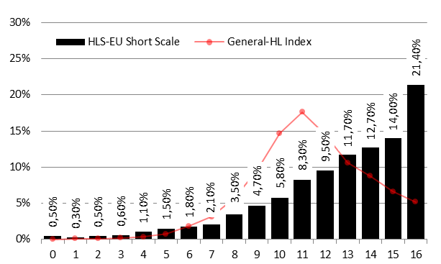
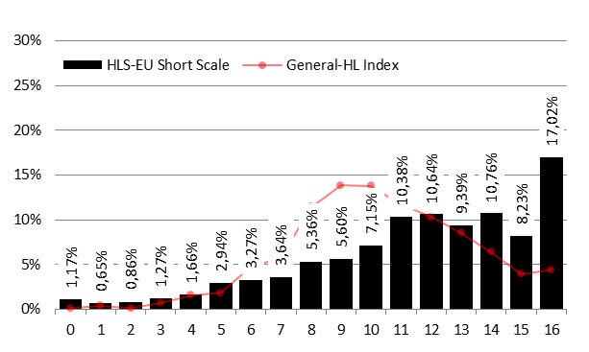
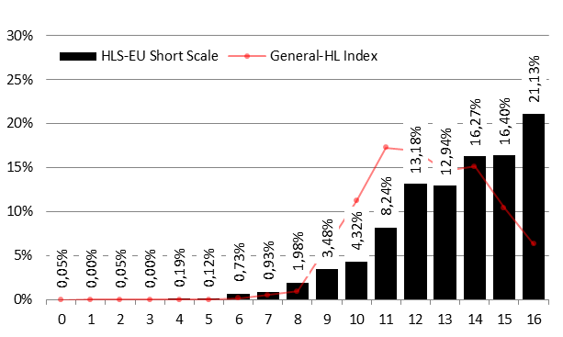
Distribution of Q16 scores and the Q47 general HL-Index (grouped in 16 intervals) for total and 2 countries
TOTAL SAMPLE
BULGARIA
The distribution of the
short scale (rather J)
differs from the
comprehensive index
(rather normal)!
NETHERLANDS
Notes:
Taipeh 10-14
Bern 09-14

Slide 21
Distributions of HLS-EU Q16 short scale for all countries
The distribution is rather similar for all countries!
Notes:
Taipeh 10-16
Bern 09-14

Slide 22
Percentages of HLS-EU Q16 levels compared to corresponding HLS-EU Q47 levels, and percentages of concurrent classifications (accuracy) for total and countries
 | (Likely) inadequate |  |  | (Likely) problematic |  |  | (Likely) sufficient*
 | Q16 | Q47 | diff. | Q16 | Q47 | diff. | Q16 | Q47 | diff. | % of concurrent Classifications
Austria | 18.0 | 17.8 | 0.2 | 34.2 | 38.2 | -4.0 | 47.8 | 44.0 | 3.7 | 74.8
Bulgaria | 20.6 | 26.7 | -6.1 | 33.5 | 34.7 | -1.2 | 45.8 | 38.5 | 7.3 | 74.4
Germany | 13.4 | 10.8 | 2.5 | 35.1 | 35.2 | -0.1 | 51.6 | 54.0 | -2.4 | 76.1
Greece | 11.8 | 13.9 | -2.1 | 20.7 | 30.8 | -10.1 | 67.5 | 55.3 | 12.2 | 79.3
Spain | 7.9 | 7.5 | 0.4 | 26.5 | 50.7 | -24.1 | 65.6 | 41.8 | 23.7 | 67.5
Ireland | 8.1 | 9.8 | -1.7 | 27.8 | 29.5 | -1.7 | 64.1 | 60.7 | 3.5 | 77.4
Netherlands | 4.0 | 1.8 | 2.3 | 29.2 | 26.4 | 2.8 | 66.8 | 71.8 | -5.1 | 78.3
Poland | 10.4 | 10.3 | 0.1 | 18.5 | 33.1 | -14.6 | 71.2 | 56.7 | 14.5 | 78.6
TOTAL | 11.7 | 12.2 | -0.5 | 28.3 | 34.8 | -6.6 | 60.0 | 52.9 | 7.1 | 75.8
*combination of the Q47 levels sufficient and excellent HL
Notes:
Taipeh 10-14
Bern 09-14

Slide 23
Correlations of short scale HLS-EU-Q16 with HLS-EU sub-indices & NVS for countries and total
HLS-EU-Q16 (Short Scale) | AT | BG | DE (NRW) | EL | ES | IE | NL | PL | TOTAL
NVS | ,239** | ,380** | ,144** | ,363** | ,225** | ,214** | ,143** | ,245** | ,231**
GEN HL | ,853** | ,876** | ,846** | ,865** | ,767** | ,798** | ,732** | ,807** | ,822**
HC HL | ,795** | ,807** | ,788** | ,804** | ,710** | ,703** | ,624** | ,738** | ,754**
PREV HL | ,786** | ,844** | ,766** | ,810** | ,715** | ,741** | ,678** | ,783** | ,767**
HP HL | ,721** | ,794** | ,728** | ,799** | ,660** | ,716** | ,656** | ,738** | ,739**
OBTAIN HL | ,779** | ,814** | ,788** | ,814** | ,732** | ,758** | ,658** | ,780** | ,770**
UNDERSTAND HL | ,792** | ,839** | ,803** | ,813** | ,697** | ,727** | ,640** | ,728** | ,764**
PROCESS HL | ,772** | ,820** | ,754** | ,806** | ,726** | ,769** | ,668** | ,768** | ,768**
APPLY HL | ,763** | ,787** | ,707** | ,774** | ,602** | ,692** | ,604** | ,725** | ,705**
HC OBTAIN HL | ,666** | ,717** | ,624** | ,690** | ,595** | ,566** | ,494** | ,666** | ,638**
HC UNDERSTAND HL | ,673** | ,686** | ,678** | ,702** | ,570** | ,582** | ,450** | ,584** | ,628**
HC PROCESSHL | ,671** | ,721** | ,676** | ,720** | ,648** | ,680** | ,647** | ,695** | ,687**
HC APPLY HL | ,666** | ,685** | ,632** | ,593** | ,512** | ,513** | ,422** | ,614** | ,579**
PV OBTAIN HL | ,665** | ,761** | ,689** | ,753** | ,633** | ,661** | ,536** | ,707** | ,684**
PV UNDERSTAND HL | ,609** | ,740** | ,603** | ,662** | ,499** | ,551** | ,429** | ,649** | ,596**
PV PROCESS HL | ,682** | ,750** | ,643** | ,700** | ,636** | ,644** | ,582** | ,700** | ,671**
PV APPLY HL | ,602** | ,724** | ,605** | ,625** | ,540** | ,631** | ,561** | ,639** | ,620**
HP OBAIN HL | ,642** | ,683** | ,643** | ,729** | ,607** | ,663** | ,587** | ,697** | ,671**
HP UNDERSTAND HL | ,656** | ,762** | ,708** | ,757** | ,644** | ,671** | ,636** | ,663** | ,698**
HP PROCESS HL | ,544** | ,671** | ,552** | ,642** | ,492** | ,595** | ,393** | ,583** | ,572**
HP APPLY HL | ,535** | ,593** | ,463** | ,621** | ,425** | ,547** | ,420** | ,605** | ,528**
Notes:
Taipeh 10-14

Slide 24
Comparison of selected bi-variate associations of comprehensive HL index (Q47) and HL short scale (Q16) for total HLS-EU sample
 | HL determinants and consequences | Correlation with Q47 Compreh. HL | Correlation with Q16 | Listwise Valid N | Difference of corr. coefficient | t-Score of difference | P value of difference
Total | Gender | .043 | .044 | 8039 | -0.001 | 0.169 | .866
 | Age | -.123 | -.134 | 8039 | 0.011 | 1.686 | .092
 | Migrational background | .005 | -.006 | 8021 | 0.011 | 1.721 | .085
 | Education | .241 | .204 | 8015 | 0.037 | 5.697 | <.001**
 | Financial deprivation | -.298 | -.198 | 7717 | -0.100 | 15.531 | <.001**
 | Social Status | .289 | .218 | 7748 | 0.072 | 11.037 | <.001**
 | Employment Status | -.120 | -.138 | 7972 | 0.018 | 2.720 | .007**
 | Household net income | .224 | .169 | 5898 | 0.055 | 7.262 | <.001**
 | Global perceived health | -.275 | -.234 | 8024 | -0.041 | 6.451 | <.001**
 | Long standing health problems | .157 | .172 | 8005 | -0.015 | 2.312 | .021*
 | Limitations in daily living | .171 | .190 | 2848 | -0.019 | 1.715 | .086
 | Physical exercising | -.189 | -.125 | 8014 | -0.063 | 9.699 | <.001**
 | Alcohol consumption | .063 | .057 | 7848 | 0.007 | 1.028 | .304
 | Smoking | -.012 | .006 | 7987 | -0.017 | 2.597 | .009**
 | Body-Mass-Index | -.065 | -.056 | 7708 | -0.010 | 1.450 | .147
 | Emergency service contacts | -.063 | -.069 | 8009 | 0.006 | 0.899 | .369
 | Doctor contacts | -.115 | -.117 | 8022 | 0.002 | 0.298 | .766
 | Hospital stays | -.066 | -.079 | 8006 | 0.013 | 1.957 | .050
 | Other health professionals contacts | .063 | .005 | 8023 | 0.057 | 8.654 | <.001**
Notes:
Taipeh 10-14
Average intercorrelation Q47 and Q16 (total sample): .822

Slide 25
Summary of Properties of Short Scale
Associations of Short Form
vs. Comp.-HL index are high (.82 in total sample, .73 to .88 in country samples) and
vs. sub-indices (HC-HL. DP-HL. HP-HL.) are rather high (ranging from .74 to .77 in total sample, and from .62 to .84 in country samples).
Correlation patterns of the Comp.-HL index and the HLS-EU Short Scale with important determinants and consequences are very similar.
The short scale is Rasch homogeneous, i.e. fair for comparisons of HL-scores within countries
HOWEVER:
Not all 12 HLS-EU sub-dimensions are represented equally well in the Short Scale. Disease prevention (7 items) is given more weight than health promotion (5 items), and one sub-sub-dimension is completely missing)!
The shape of the distribution of the short scale is not as nearly normally distributed as for the comprehensive HL index, but is rather skewed J-shaped.
The Short Scale is a much coarser measure than the compr. HL-index (uses less information). Persons that scored near threshold values of the comp.-HL index can be misclassified in the levels of the Short Scale.
The Short Scale cannot be divided into subscales!
The Short Scale loses favourable properties (Rasch homogeneity) for between-country-comparisons.
Notes:
Taipeh 10-14
Bern 09-14

Slide 26
4. IRT Rasch modelling HLS-EU-Q6 short-short form

Slide 27
Process of item selection for short-short form Q6
Items for the Q6 where selected from Q16 items based on higher item difficulty, HL domain, position on the information cycle and psychometric properties.
Each domain is represented by 2 items. All 4 stages of the information cycle are represented.
The item battery was developed using CFA modelling (Estimator WLSMV) in a random subsample of N= 3411 observations of the HLS-EU sample and cross validated for the other cases (same sample size)
Of the total HLS-EU Sample (N=8015) cases with missing values were excluded listwise.
Notes:
Taipeh 10-14

Slide 28
Resulting Items for HLS-Q Short-Short Form
Health Literacy | Find/Access information relevant to health | Understand Information relevant to health | Evaluate/Appraise information relevant to health | Apply/use information relevant to health
Health Care |  |  | Q11… judge when you may need to get a second opinion from another doctor? | Q13… use information the doctor gives you to make decisions about your illness.
Disease Prevention | Q18… find information on how to manage mental health problems like stress or depression. |  | Q28… judge if the information on health risks in the media is reliable.
Health Promotion | Q33.. find out about activities that are good for your mental well-being. | Q39… understand information in the media on how to get healthier.
Notes:
Taipeh 10-14
Bern 09-14
JMP Üb & 5.4.2014
!!! Hinweis auf andere quantitative Zusammensetzung der beiden Matrices Vgl. mit F15!

Slide 29
Development and characteristics of Q6
Q5
HC
Q6
Q8
PV
COMP.
Q11
Q13
HP
Q15
Country | Chi2 | DF | CFI/TLI | RMSEA | SRMR | N
AT | 70.905 | 6 | 0.963/ 0.956 | 0.110 | 0.039 | 888
BG | 84.871 | 5 | 0.962/ 0.962 | 0.143 | 0.038 | 776
DE | 17.780 | 5 | 0.995/ 0.993 | 0.053 | 0.018 | 919
EL | 45.869 | 6 | 0.988/ 0.988 | 0.083 | 0.026 | 972
ES | 50.844 | 5 | 0.968/ 0.955 | 0.103 | 0.038 | 863
IE | 27.715 | 6 | 0.989/ 0.987 | 0.067 | 0.023 | 805
NL | 49.607 | 6 | 0.970/ 0.960 | 0.095 | 0.037 | 801
PL | 21.323 | 6 | 0.994/ 0.996 | 0.058 | 0.014 | 770
TOTAL | 315.445 | 6 | 0.981/ 0.981 | 0.087 | 0.025 | 6794
Estimator WLSMV
Developed and cross validated on 2 random HLS-EU subsamples.
Notes:
Taipeh 10-14
Bern
JMP 5.4.2014

Slide 30
Scoring of HLS-EU-Q6-short-short-scale
Coding of answer categories.
Very difficult = 1 to very easy=4 (better HL gets higher scores)
Don´t know answers that are optional for personal interviews are coded as missing values.
Score is a mean score that is calculated if at least 5 of the 6 Items are completed.((SUM of Answers/Number of Items))
The Q6 ranges from 1 to 4 (optional 0-3)
Three levels for the scale have been defined. Criterion was correct classification, as far as possible, compared to Q47 levels.
(Likely) inadequate HL [1-2]
(Likely) problematic HL (2-3)
(Likely) sufficient HL [3-4]
Notes:
Taipeh 10-14
Bern 09-14
JMP 5.4.2014
ad 3.
4 Levels do not meet the required accuracy of 75% in total sample.
Breaks are used in a mathematical sense:
[] including end points
() excluding end points

Slide 31
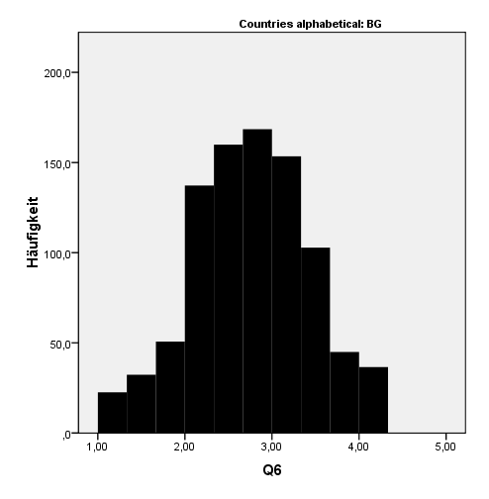
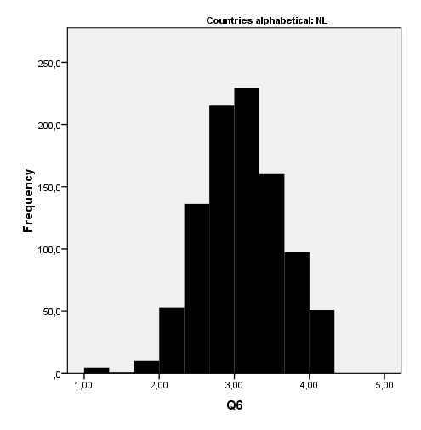
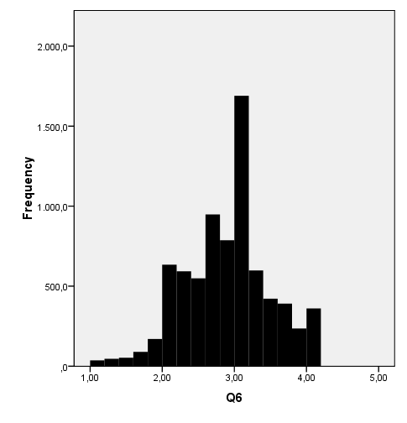
Distributions Short-short Scale for Total and two Countries
Total sample
Bulgaria
Netherlands
Notes:
Taipeh 10-14
Bern 09-14

Slide 32
Correlations of HLS-EU-Q6 with HLS-EU-Q47 & HLS-EU-Q16
HLS-EU-Q6 (Short-Short Scale) | AT | BG | DE (NRW) | EL | ES | IE | NL | PL | TOTAL
NVS | ,187** | ,367** | ,105** | ,210** | ,210** | ,200** | ,092** | ,286** | ,222**
HLS-EU-Q16 | ,824** | ,859** | ,834** | ,803** | ,803** | ,824** | ,803** | ,794** | ,826**
GEN HL-HLS-EU-Q47 | ,874** | ,918** | ,892** | ,886** | ,886** | ,890** | ,875** | ,924** | ,896**
HC HL | ,756** | ,815** | ,783** | ,781** | ,781** | ,762** | ,764** | ,826** | ,793**
PREV HL | ,810** | ,887** | ,814** | ,829** | ,829** | ,835** | ,803** | ,889** | ,842**
HP HL | ,788** | ,863** | ,811** | ,802** | ,802** | ,814** | ,776** | ,878** | ,828**
OBTAIN HL | ,820** | ,890** | ,833** | ,830** | ,830** | ,846** | ,799** | ,894** | ,848**
UNDERSTAND HL | ,753** | ,840** | ,781** | ,793** | ,793** | ,801** | ,735** | ,818** | ,799**
PROCESS HL | ,841** | ,868** | ,858** | ,852** | ,852** | ,877** | ,815** | ,897** | ,867**
APPLY HL | ,760** | ,815** | ,728** | ,719** | ,719** | ,767** | ,705** | ,834** | ,760**
HC OBTAIN HL | ,584** | ,693** | ,560** | ,580** | ,580** | ,554** | ,560** | ,705** | ,624**
HC UNDERSTAND HL | ,584** | ,654** | ,630** | ,622** | ,622** | ,611** | ,536** | ,623** | ,627**
HC PROCESS HL | ,773** | ,824** | ,774** | ,771** | ,771** | ,796** | ,768** | ,828** | ,795**
HC APPLY HL | ,599** | ,671** | ,612** | ,597** | ,597** | ,594** | ,574** | ,724** | ,617**
PV OBTAIN HL | ,726** | ,849** | ,747** | ,743** | ,743** | ,764** | ,718** | ,826** | ,779**
PV UNDERSTAND HL | ,532** | ,701** | ,552** | ,578** | ,578** | ,590** | ,485** | ,715** | ,603**
PV PROCESS HL | ,733** | ,799** | ,733** | ,748** | ,748** | ,745** | ,708** | ,806** | ,761**
PV APPLY HL | ,638** | ,751** | ,621** | ,607** | ,607** | ,688** | ,555** | ,716** | ,658**
HP OBTAIN HL | ,741** | ,803** | ,742** | ,745** | ,745** | ,773** | ,704** | ,842** | ,778**
HP UNDERSTAND HL | ,718** | ,829** | ,746** | ,756** | ,756** | ,774** | ,721** | ,794** | ,777**
HP PROCESS HL | ,562** | ,635** | ,614** | ,572** | ,572** | ,659** | ,482** | ,689** | ,618**
HP APPLY HL | ,569** | ,644** | ,521** | ,549** | ,549** | ,605** | ,495** | ,690** | ,582**
Notes:
JMP Taipeh 10-14
Bern 09-14

Slide 33
Comparison of selected bi-variate associations of comprehensive HL index (Q47) and HL short-short scale (Q6) for total
 | HL determinants and consequences | Correlation with Q47 Compreh. HL | Correlation with Q6 | Listwise Valid N | Difference of corr. coefficient | t-Score of difference | P value of difference
Total | Gender | .042 | .048 | 7961 | -0.006 | 1.257 | .209
 | Age | -.121 | -.132 | 7961 | 0.011 | 2.130 | .033*
 | Migrational background | .005 | -.002 | 7943 | 0.007 | 1.365 | .172
 | Education | .240 | .215 | 7936 | 0.025 | 5.092 | <.001**
 | Financial deprivation | -.300 | -.219 | 7646 | -0.081 | 16.328 | <.001**
 | Social Status | .289 | .243 | 7680 | 0.046 | 9.259 | <.001**
 | Employment Status | -.121 | -.131 | 7892 | 0.010 | 1.926 | .054
 | Household net income | .224 | .188 | 5856 | 0.036 | 6.187 | <.001**
 | Global perceived health | -.276 | -.247 | 7948 | -0.029 | 5.873 | <.001**
 | Long standing health problems | .157 | .149 | 7928 | 0.008 | 1.599 | .110
 | Limitations in daily living | .172 | .176 | 2823 | -0.004 | 0.454 | .650
 | Physical exercising | -.191 | -.141 | 7936 | -0.050 | 9.948 | <.001**
 | Alcohol consumption | .063 | .042 | 7771 | 0.021 | 4.058 | <.001**
 | Smoking | -.013 | .017 | 7909 | -0.030 | 5.809 | <.001**
 | Body-Mass-Index | -.063 | -.064 | 7632 | 0.001 | 0.151 | .880
 | Emergency service contacts | -.063 | -.058 | 7932 | -0.005 | 0.903 | .366
 | Doctor contacts | -.112 | -.115 | 7944 | 0.002 | 0.438 | .662
 | Hospital stays | -.067 | -.072 | 7928 | 0.005 | 0.931 | .352
 | Other health professionals contacts | .060 | .026 | 7946 | 0.033 | 6.506 | <.001**
Notes:
Taipeh 10-14
Average intercorrelation Q47 and Q6 (total sample): .896

Slide 34
Percentages of HLS-EU Q6 levels compared to corresponding HLS-EU Q47 levels, and percentages of concurrent classifications (accuracy) for total and countries
 | (Likely) inadequate |  |  | (Likely) problematic |  |  | (Likely) sufficient*
 | Q6 | Q47 | diff. | Q6 | Q47 | diff. | Q6 | Q47 | diff. | % of concurrent Classifications
Austria | 11.6 | 17.8 | -6.2 | 49.6 | 38.0 | 11.6 | 38.8 | 44.2 | -5.4 | 73.6
Bulgaria | 19.4 | 27.3 | -7.9 | 43.2 | 34.3 | 8.9 | 37.4 | 38.4 | -1.0 | 73.5
Germany | 9.9 | 10.9 | -1.0 | 47.5 | 35.2 | 12.3 | 42.6 | 53.9 | -11.3 | 73.1
Greece | 8.3 | 13.8 | -5.5 | 34.7 | 30.8 | 3.9 | 57.0 | 55.4 | 1.6 | 80.3
Spain | 4.2 | 7.7 | -3.5 | 51.5 | 50.4 | 1.1 | 44.3 | 41.9 | 2.4 | 78.5
Ireland | 9.2 | 9.9 | -0.7 | 38.8 | 29.7 | 9.1 | 52.0 | 60.4 | -8.4 | 77.6
Netherlands | 3.8 | 1.7 | 2.2 | 40.1 | 26.7 | 13.4 | 56.1 | 71.4 | -15.3 | 76.8
Poland | 5.7 | 10.7 | -5.0 | 31.5 | 32.9 | -1.4 | 62.8 | 56.4 | 6.4 | 79.6
TOTAL | 9.0 | 12.4 | -3.4 | 42.2 | 34.8 | 7.4 | 48.8 | 52.8 | -4.0 | 76.6
*combination of the Q47 levels sufficient and excellent HL
Notes:
Taipeh 10-14

Slide 35
5. Comparing the HLS-EU indices and scales

Slide 36
Comparison HLS-EU-Q 47, Q16, Q6
 | HLS-EU –Q47 | HLS-EU-Q16 | HLS-EU-Q6
No. of items | 47 | Reduction to 16 out of 47 loss of info, and of representativeness of theoretical scope loss of reliability | Reduction to 6 out of 16 > strong loss of info, and of representativeness of theoretical scope,
Economy | long > time consuming (about 10) | short > less time (3 min) | very short > (1 minute)
Type | Index, up to 19 Sub-Indices following the theoretical concept | 1 Rasch scale, but some description of 3 domains possible by single items 4?? | 1 scale consisting of 3 highly correlated sub-dimensions.
Scope & representation of concept | full | limited | very limited
Use of number of categories of single items | 4 | Dichotomized to 2 > Loss of information | 4
Distribution of indices, scale* | bell-shaped; 1,2% reach maximum | strong negative skew (21,4% reach maximum=mode, mean=12,5) | bell-shaped, light negative skew 4,7% reach maximum
Difficulty* | high | low | medium/high
Correlation with full instrument* |  | 0,822 | 0,896
Reliability* | high | Cronbach alpha not computable | Alpha=0,803
Levels | 4 | 3 | 3
Dimensionality | multi | one | 1 main 3 sub (sub dimensions not evaluated due to high correlations with main index)
Power for associations | high | somewhat limited | somewhat limited
Recommendation | For fully HL focused surveys | For partly HL focused surveys or for giving space for additional context specific items (e.g. GKM, AOK ); vulnerable Populations | Good compact HL measure in studies with other focus
* Computations based on HLS-EU total sample
Notes:
Bern 09-14

Slide 37
Recommendations
Use Q47, when HL is the main objective of the study and you want to look at sub-dimensions of HL!
Use Q16 when you need a more economical measure of HL and it is not important to look at sub-dimensions of HL
Use Q6 as an economic measure of HL, which is quite well related to a comprehensive measure, in studies with another main theme, where HL is just one factor besides many others!
Further develop the instrument in an ongoing consortium (like HBSC or PISA) jointly!

Slide 38
6. Factor analyses modelling

Slide 39
Taiwanese HL-SF12 short scale
Based on factor analysis (PCA),
using factor loadings and standardized–coefficient values of linear regression analysis for selection of items
12 items, one for each cell of the HLS-EU matrix: 2, 6, 10, 15, 18, 23, 26, 30, 33, 39, 43, 4.
Satisfactory psychometric properties
Explained variance of full form: R square = .94
criterion of item-scale convergent validity (average item-scale correlation 0.59 - 0.75)
Internal consistency reliability (Cronbach´s alpha 0.85)
Criterion related validity (Pearson correlation of index scores of full and short form 0.97)
Construct validity (comparative association – multiple regression analysis - with socio-demographic variables between full and short form)

Slide 40
Replication of method with HLS-EU 8 countries data
PCA did not give the same fitting factor structure for the 12 cells of the HLS-EU matrix for the different countries
And different subsets of items resulted for the 8 countries included in the analysis
Method, if it works well, allows to optimize a selection of items very well representing the full 47 items for a specific country.
But one gets different short scales for different countries, which makes between country comparisons ratherdifficult!

Slide 41
Contact
Thank you so much for your attention!
Jürgen M. Pelikan
Stubenring 6 1010 Vienna, Austria T: +43 1 515 61- F: +43 1 513 84 72 E: juergen.pelikan@goeg.at www.goeg.at
HPH-relevant websites:
www.hph-hc.cc/
www.hphnet.org

Slide 42
References
Sørensen K, Van den Broucke S, Fullam J, Doyle G, Pelikan JM, Slonska Z, Brand H, (HLS-EU) Consortium (2012): Health literacy and public health: A systematic review and integration of definitions and models. BMC Public Health, 12 (80).
Sørensen K, Pelikan JM, Röthlin F, Ganahl K, Slonska Z, Doyle G, Fullam J, Kondilis B, Agrafiotis D, Uiters E, Falcon M, Mensing M, Tchamov K, Van den Broucke S, Brand H : Health literacy in Europe: comparative results of the European health literacy survey (HLS-EU). Eur J Public Health. in review
Sørensen K, Van den Broucke S, Pelikan JM, Fullam J, Doyle G, Slonska Z, Kondilis B, Stoffels V, Osborne RH, Brand H (2013) : Measuring health literacy in populations: illuminating the design and development process of the European Health Literacy Survey Questionnaire (HLS-EU-Q). BMC Public Health 13(1).
HLS-EU Consortium (2012): Comparative report on health literacy in eight EU member states. The European Health Literacy Project 2009–2012. Maastricht (http://www.health-literacy.eu).
Pelikan, JM, Röthlin, F, Ganahl K (2012): Die Gesundheitskompetenz der Österreichischen Bevölkerung– nach Bundesländern und im internationalen Vergleich. Abschlussbericht der Österreichischen Gesundheitskompetenz (Health Literacy) Bundesländer-Studie. LBIHPR Forschungsbericht. (undisclosed)
Röthlin, F, Pelikan JM, Ganahl, K (2013): Die Gesundheitskompetenz der 15-jährigen Jugendlichen in Österreich. Abschlussbericht der österreichischen Gesundheitskompetenz Jugendstudie im Auftrag des Hauptverbands der österreichischen Sozialversicherungsträger (HVSV)
Notes:
Pattaya 26.9.2013

