Slide 1
THE INITIAL RESULTS OF THYROIDECTOMY USING ULTRASOUND SURGICAL KNIFE IN VIET-CZECH FRIENDSHIP HOSPITAL
HAI PHONG UNIVERSITY OF MEDICINE AND PHARMACY
Nguyen Hong Dao, Le Van Tuan,Vu Dong Hoang Hanh (Hai Phong Viet-Czech Friendship Hopital)
2017

Slide 2
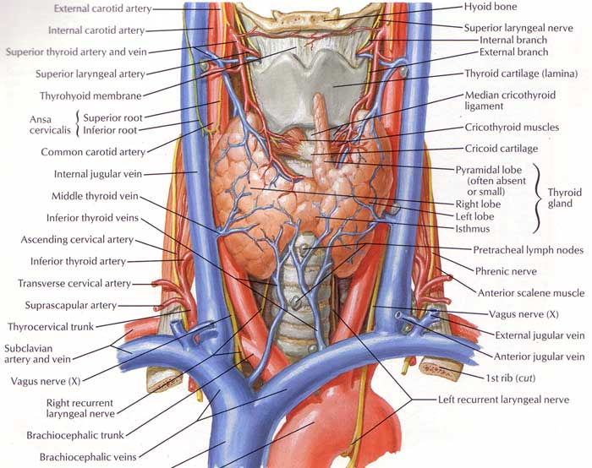
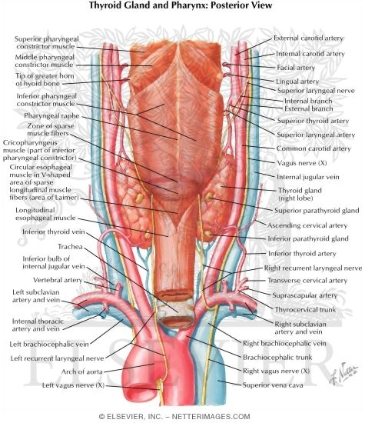
INTRODUCTION
Thyroid cancer accounts for approximately 1 percent of all malignances.
Total thyroidectomy accompanying lymph node removal is the main surgery in surgical treatment of thyroid cancer
Thyroid surgery using ultrasonic surgical knife is a advanced surgical method.
Ultrasonic surgical knife has some advantageous application in operation: decreasing the temperature of cutting and burning, avoiding the foreign body granuloma to suture materials, etc…

Slide 3
Object:
The initial results of thyroidectomy using ultrasound surgical knife in Viet-Czech friendship hospital

Slide 4
SUBJECTS AND METHODS
1. Subjects
31 patients were thyroid cancer operated by ultrasonic surgical knife.
2. Place of research
At Department 11 in Hai Phong Viet-Czech Friendship Hospital.
3. Duration of study
From April 2016 to August 2017.

Slide 5
SUBJECTS AND METHODS
2. Methods
- Non-control interventional study using the assessing pre-or postoperative efficiency model.
Physical examination: determining location, size, density, invasiveness of tumors, metastatic lymph nodes.
Clinical examination:
+ Ultrasound scan, computerized tomography evaluates location, size, boundary, density, invasiveness: trachea, muscle, blood vessels.
+ Fine needle aspiration biopsy and thyroid hormone test
+ Devices: the open surgery instruments and ultrasonic surgical knife made by Johnson & Johnson (Focus-harmonic scalpel).

Slide 6
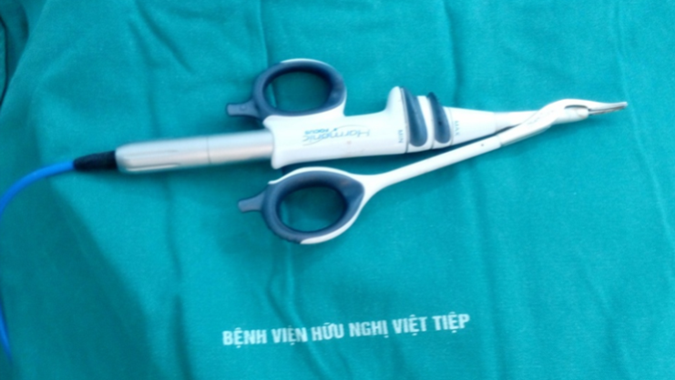
SUBJECTS AND METHODS
Mechanism of ultrasonic surgical knife
+ Forming the coagulants between the two clamps, does not spread 2 sides which maintains temperature of tissue <100⁰C
Advantages:
- Ability of hemostasis and cutting at same time. - Injury of tissues under surgical incisions is minimum.
Notes:
+Cắt và cầm máu cùng lúc, có thể cầm mạch máu đến 5mm
+Giúp giảm thiểu hiện tượng dính, hóa than hoặc tạo khói.

Slide 7
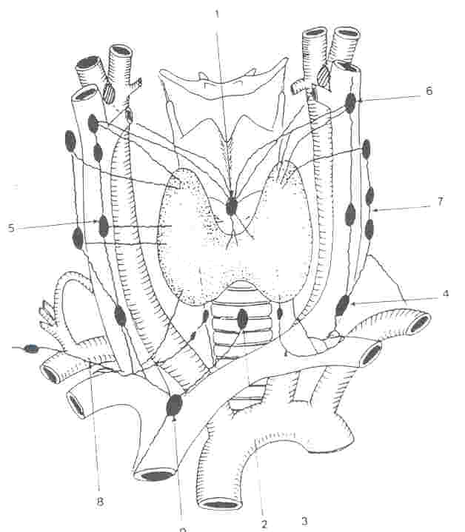
SUBJECTS AND METHODS
Surgical procedures
- Incising the skin over Kocher’s line
- Exposing the thyroid gland
From this step onwards, using the ultrasonic surgery knife
- Releasing the superior and inferior pole.
- Cutting the thyroid isthmus.
- Removing invading cancerous tissue or the whole thyroid lobes.
- Removing the lymph nodes.

Slide 8
RESULTS AND DISCUSSION
Table 1: Gender distribution of patients
Tran Ngoc Lương (2012): Female accounts for 93.3%; Male: 6.7%

Slide 9
RESULTS AND DISCUSSION
Table 2: Distribution of thyroid cancer nodule’s location
Tran Ngoc Luong (2012)
Left lobe: 30% Right lobe: 30% Both lobes: 33.3%

Slide 10
RESULTS AND DISCUSSION
Table 3: Distribution of cancerous nodule’s invasiveness
Tran Ngoc Luong 2012:
29/30 cases (96,7%) of thyroid cancerous nodules are inside the capsule
Notes:
As a result: The majority of thyroid cancerous nodules are inside the capsule

Slide 11
RESULTS AND DISCUSSION
The operating time (minutes) | The average | The shortest | The longest
Study | 72,16±10,87 | 47 | 110
Tran Ngoc Luong | 68,16±8,5 | 55 | 90

Slide 12
RESULTS AND DISCUSSION
Table 5: The rate of thyroid cancer by histopathology
Location Histopathological Diagnosis | 1 lobes |  | 2 lobes |  | Lympho nodes
 | Number | % | Number | % | Number | %
Fine needle aspiration | 14 | 45,16 | 8 | 25,81 | 0 | 0
Immediate biopsy | 5 | 16,13 | 2 | 6,45 | 2 | 6,45
Histopathological biopsy | 21 | 67,74 | 10 | 32,26 | 18 | 58,06
- Fine needle aspiration cytology: found 22 cases (70.97%)
- Immediate biopsy: found 7 cases (22.58%)
Notes:
Histopathological diagnosis

Slide 13
RESULTS AND DISCUSSION
Fine needle aspiration cytology: found 22 cases (70.97%)
Immediate biopsy: found 7 cases (22.58%)
There are two cases of which preoperative FNA biopsy did not find cancerous cells, did not undergo immediate biopsy during operation,
but postoperative histopathological reports are papillary thyroid cancer.
18 cases (58.06%) have cervical lymph nodes removed and thyroidectomy, 2 of which (6.45%) are found by immediate biopsy.
Notes:
As a result: The rate of discovery thyroid cancer before and during operation was not absolute

Slide 14
RESULTS AND DISCUSSION
Table 6: Postoperative complications
Surgical methods Postoporative complications | Total thyroidectomy |  |  | Near-total thyroidectomy | Total | %
 | None lymphadenectomy | Unilateral lymphadenectomy | Bilateral cervical lymphadenectomy
Temporary hoarseness | 0 | 0 | 1 | 0 | 1 | 3,23
Temporary tetany | 1 | 1 | 1 | 0 | 3 | 9,68
Fluid stagnancy | 0 | 0 | 1 | 0 | 1 | 3,23
Total | 1 | 1 | 3 | 0 | 5 | 16,14
Antonio Toniato 2008, the rate of recurrent laryngeal nerve paralysis was 5.5%, in which, permanent paralysis was 1.7%
Sim R: 8.1% of patients reported postoperative hoarseness, 4.7 %
permanent hoarseness
Notes:
There were no severe postoperative complications such as postoperative hemorrhage, laryngospasm and respiratory failure.
3 cases had drainages, the least volume is 10 ml, the most one is 60 ml, the mean: 45 ml, all the drainages were removed after 48 hours

Slide 15
CONCLUSION
Using the ultrasonic surgical knife in thyroid cancer surgery is safe and effective.
Reducing the complications during and after operation.

Slide 16
RECOMMENDATIONS
Cancer screening tests are necessary to find cancer early.
Fine needle aspiration cytology under ultrasound guidance.
Immediate biopsy and Histopathological biopsy become regularly in thyroidectomy, especially in thyroid cancer surgery.
Patients after thyroid surgery need to be controlled and to have check-up examinations.

Slide 17
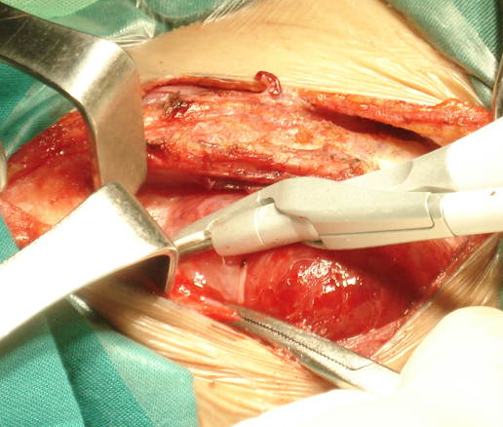
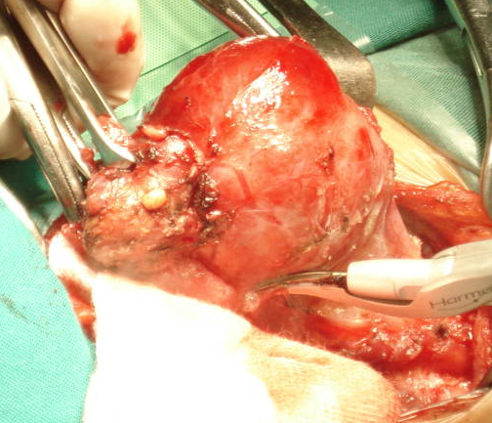
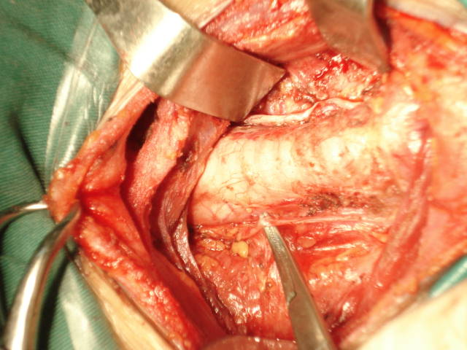
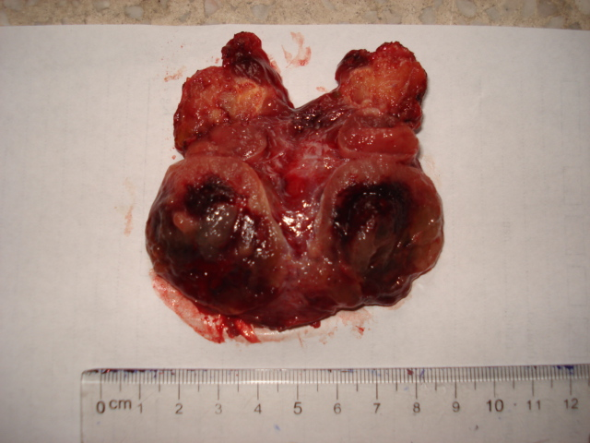
ILLUSTRATIVE IMAGES
Exposing the thyroid gland
Torsion of thyroid gland
Cutting the thyroid gland
Recurrent laryngeal nerve
Post-operative thyroid gland

