Slide 1
EVALUTE THE RESULT OF THE ENDOSCOPE AND IMPRINT CYTOLOGY TESTING IN GASTRIC CANCER IN NATIONAL CANCER HOSPITAL
PhD. Le Quang Hai
PhD.Pham Cam Phuong M.S.Bui Tien Dung

Slide 2
OPENING
The fifth most common type of cancer
in the world
(Globocan 2012)
GASTRIC
CANCER
Rank fourth in Vietnam after lung cancer,
liver cancer and breast cancer with
14,000 new cases (Globocan 2012)
Most were discovered at a late stage
that lead to uneffective treatment and poor prognosis

Slide 3
OPENING
Is the method of accurate diagnosis
  Gastroscopy
  Biopsy
Observing and evaluating tumors
Tumor biopsy for testing cytology and
histopathology
Histopathology is considered as the gold
standard for diagnosis

Slide 4
OPENING
Take the cell on the surface of the tumor,
Simple, easy to do at the medical line
Imprint cytology
Fast results, low cost and high accuracy
Not many researches have been carried out

Slide 5
Commentary on some clinical and endoscopic characteristics of patients with gastric cancer
1.
RESEARCH
TARGET
Evaluation of imprint cytology and histopathology results in the diagnosis of gastric cancer
2.

Slide 6
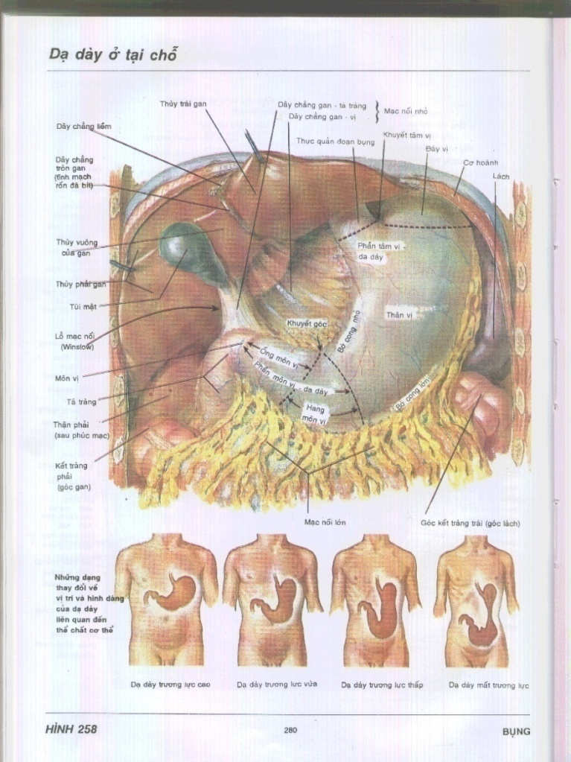
OVERVIEW
Stomach Anatony
Outside the stomach
Cardia
Fundus
Body
Pyloric Antrum
Pylorus

Slide 7
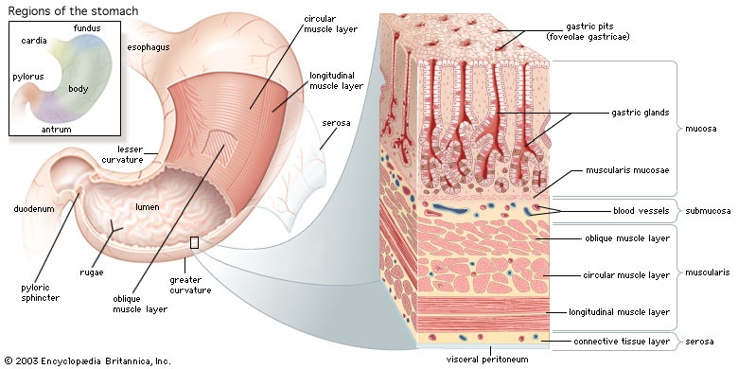
OVERVIEW
Histopathological image of the stomach
The stomach consists of four layers :
Mocosa
Submocosa
Muscularis
Serosa.

Slide 8
OVERVIEW
Symptom of Gastric cancer
Clinical :
* Early stage: Symptoms are poor, not specific
-Pain in fundus area is transient or continuous
- Tired, appetite loss, nausea, vomid, weight loss
* Late stage : - Anemia, exhausted
- Indigestion, Feel the tumor
- Lymph nodes
Subclinical :
Image Analysis: Evaluating stage of the disease
Blood tests, tumor marker

Slide 9
OVERVIEW
Subclinical :
* gastroscopy :
+ Advantage: Popular at the grassroots level, Easy to do, high precision
+ Disadvantages: Has false rates and false positives
* Imprint Cytology:
+ Advantage: Easy to do, cheap, high sensitivity, accuracy, fast results
+ Disadvantages: Can not classify the histology
* Pathylogy: considered as a gold standard with 5-7 day lead time.

Slide 10
OVERVIEW
Some studies in Viet Nam and foreign
  * Viet Nam:
  Ngo Quang Duong (1996): Studied 96 patients, sensitivity 92,7%
* Foreign countries:
Young JA (1980): Studied 329 patients (61 cancer patients) sensitivity 98%
Vijayanarasima D (2014): Specificity 97,14% Stomach
100% duodenum
Sharma P (2015): Sensitivity 96,8%, positive 98,3%

Slide 11
OBJECTIVES AND RESEARCH METHODS
RESEARCH SUBJECTS
205 patients (138 cancer patients and 67 normal patients)
Standard selection
Have suspected symptoms
Biopsy for cytology and histopathology
Diagnostic by pathology
Do not have other cancers
and chronic diseases
Full profile
Agree to participate in research
Exclusion criteria
Not enough on the above criteria
Other diseases threaten death
Stomach cancer recurrence
Other cancers
Incomplete records
Do not agree to participate in research

Slide 12
OBJECTIVES AND RESEARCH METHODS
RESEARCH METHODS
Research location: Nation Cancer Hospital
Study time : From 01/08/2015 to 31/8/2016
Research design: Descriptive research
Database: According to research sample
Research ethics: Has been agreed by the authorities
The information obtained is only for research purposes

Slide 13
OBJECTIVES AND RESEARCH METHODS
Study sample size:
Z² (1- α/2) .p.(1-p)
n =
ε ²
With n is the expected sample size; p: positive rate of cytology / Patology in research of Shama P in 2015: 0,968 [77]
ε: Approximate deviation. We choose ε = 0,034
Z: Wrong type with level 1: 1-α/2
Change Z (1- α/2) =1,96 ; p=0,968 ; ε = 0,034 => n = 103
We collected 205 patients, including 138 patients stomach cancer

Slide 14
OBJECTIVES AND RESEARCH METHODS
ACTIVE STEPS
* Clinical examination: Patients undergoing clinical examination will record clinical symptoms according to clinical samples.
* Gastroscopy: Flexoscope for Olympus, Japan Exera III CLV-190, Exera II CLV180 và CV150 have narrow light, in functional probes, National Cancer Hospital
* Imprint Cytology
Conclusion by standard of S. Cibas and S. Ducatman (2012).
Histopathology:
Conclusions and classification of pathology according to WHO 2000.

Slide 15

Clinical and endoscopic characteristics
RESULTS AND
DISCUSS
1
Age | n | Percentage %
<40 | 9 | 6.5
40-60 | 67 | 48.6
>60 | 62 | 44.9
Total | 138 | 100
Table 1: Distributed by age group
Author | Average age
N.T.Vượng | 57.3
Đ.T.Quyết | 58.2
B.T.Dũng | 59.3
Average age: 59.3
The youngest age: 26
The oldest: 92

Slide 16
Clinical and endoscopic characteristics
RESULTS AND
DISCUSS
1
Author | Men / woman
B.A.Tuyết (2003) | 1,78
Globocan 2012 | 1,97
B.T.Dũng (2016) | 2,0
Chart 1: Distribution by sex

Slide 17
Clinical and endoscopic characteristics
RESULTS AND
DISCUSS
1
Chart 2. Time from first symptom to hospitalization
Most patients are admitted to the hospital six months prior to the onset of the first episode
87,7%
Average time: 4,0 months
Lê Thành Trung: 4,6
Trịnh Hồng Sơn: 6,0
Nguyễn Khánh Toàn: 5,4

Slide 18
Clinical and endoscopic characteristics
RESULTS AND
DISCUSS
1
Position of injury | Frequency | Proportion %
Cardia | 8 | 5,9
Rugae of mucosa | 25 | 18,5
Fundus | 2 | 1,5
Polyric canal | 112 | 83,0
Body | 4 | 2,9
Serosa | 27 | 20,0
Pylorus | 5 | 3,7
Duodenum | 2 | 1,5
Researcher | Polyric canal
T.T.Bách | 66,4%
N.T.Vượng | 75,6%
B.T.Dũng | 83%
Table 3. Position of injury

Slide 19
Clinical and endoscopic characteristics
RESULTS AND
DISCUSS
1
Chart 3. Image of lesions through endoscopy
Most were ulcer consisting of 69,6% (31,2+38,4)
Nguyễn Thị Quỹ: 61%
Bùi ánh Tuyết: 65,6%
Ngô Quang Dương: 69,1%

Slide 20
RESULTS AND
DISCUSS
1
Clinical and endoscopic characteristics
Biopsy location | Patients | Tỷ lệ (%)
Bottom of ulcer | 7 | 5,1
Next to the ulcer | 99 | 71,7
Ulcer | 67 | 48,5
Bottom of ulcer and next to the ulcer | 31 | 22,5
Table 4. Biopsy location tumor
Multiple diseases were biopsied at the ulcer’s sides : 71,7%
Diem Dang Thanh: 65%
Bui Anh Tuyet: 83.3%
Hatfield: biopsy in boundary damage to result (+) 100%

Slide 21
Clinical and endoscopic characteristics
RESULTS AND
DISCUSS
1
Chart 4. Number of biopsy pieces
Author | Number of pieces- Positive rate %
N.Q.Dương | 2 – 87,5% | 4 – 92,2% | 5 – 100%
B.A.Tuyết | 2 – 80% | 3 – 95,7% | 6 – 100%
B.T.Dũng | 2 –86,2% | 3 – 99,3 | 4 – 100%

Slide 22
Clinical and endoscopic characteristics
RESULTS AND
DISCUSS
1
Table 5. Endoscopic result
Endoscopic result | Patients | Percentage %
Cancer | 120 | 86.9
Suspect | 13 | 9.4
Negative | 5 | 3.7
Total | 138 | 100
Author | Positive rate
Shirakabe (1983) | 83%
Đ.T.Quyết (2010) | 74.3%
B.T.Dũng (2016) | 86.9%

Slide 23
RESULTS AND
DISCUSS
2
Clinical and endoscopic characteristics
Chart 5: Cells on the gastric cancer group
N.Q.Dương (1996) | 92,7%
B.T.Dũng (2016) | 98,6%

Slide 24
Result and dicussion
2
EVALUATION OF TEST RESULTS
l
Table 6. Compare the result of the test imprint cytology and pathylogy
Pathylogy Imprint cytology | Positive | Negative | Total
Positive | 136 | 0 | 136
Negative | 2 | 67 | 69
Total | 138 | 67 | 205
Sensitivity = 136/(136+2) × 100% = 98,6%
Specificity = 67/(67+0) × 100% = 100%
Correctly = [(136+67)/138] × 100% = 99,02%
Positive forecast value = 136/(136 + 0) × 100% =100%
Kappa = 0,99
Researches | Sensitivity (%)
Young JA (1980) | 98
Shama P (2015) | 96,8
B.T.Dũng (2016) | 98,6%

Slide 25
RESULTS AND
DISCUSS
2
EVALUATION OF TEST RESULTS
Table 7. Morphology of cancer cells
Cell characteristic | Frequency | Percentage %
Overproduction of cells | 112 | 82,3
Multiple cells | 122 | 89,7
Single cell | 129 | 94,8
Degenerative protoplasm | 109 | 80,1
Abnormal cells | 88 | 64,7
Philip M and Takeda: Single cells in comon

Slide 26
Result and dicussion
2
EVALUATION OF TEST RESULTS
Table 8. Characteristics of cancer cell nuclei
Characteristics of cell nuclei | n | Percentage %
Thick membrane | 125 | 91.9
protoplasm frozen | 120 | 88.2
Kernel polymorphism | 82 | 60.3
Many cell nucleus shapes | 65 | 47.8

Slide 27
RESULTS AND
DISCUSS
2
EVALUATION OF TEST RESULTS
Table 9. Other characteristics of cancer cells
Characteristics | n | Percentage %
The background of necrosis | 95 | 69,8
The background of bleeding | 98 | 72,1
Inflammatory cells | 68 | 50,0
Gum | 27 | 19,8
Wang HH : after evaluation of cell morphology and cell nuclei, don’t forget to ignore the background of the template for necrosis, bleeding.

Slide 28
RESULTS AND
DISCUSS
2
EVALUATION OF TEST RESULTS
Table 10: Histopathological diagnosis
Diagnosis | n | Percentage %
Cancer | 138 | 67.3
Negative | 67 | 32.7
Total | 205 | 100

Slide 29
Result and discussion
2
Evaluation of the test result
Table 11. Histopathological diagnosis
 | Positive
Cancer result | n | Percentage %
Step 1 | 136 | 98,6
Step 2 | 2 | 1,4
Total | 138 | 100
Have 2 negative patients in the first biopsy but gastroscopy is positive, postive imprint cytology, the second biopsy was positive in both tests. We take the second result that is the final result.
MM Hossain and cs (2013) reported a false-negative case to 2 times of histopathological examination, second imprint cytology postive

Slide 30
RESULTS AND
DISCUSS
2
EVALUATION OF TEST RESULTS
Table 13. Differentiation of cancer cells
Type of pathology | Số BN | Tỷ lệ %
Low-grade epithelial carcinoma | 32 | 43,2
Moderate epithelial carcinoma | 32 | 43,2
High grade epithelial carcinoma | 10 | 13,6
Total | 74 | 100
Adachi( 2000): Low differentiation has the highest rate of lymph node metastases

Slide 31
CONCLUDE
1
Clinical and endoscopic characteristics
Mean age was 59.3 years. Men are twice as infected as women
Symptoms of epigastric pain 84,8%, weight loss 50%
90.6% patients had a history of chronic gastritis
83% of lesions are found in the polyric canal
69,6% are ulcers
71,7% multiple diseases ưere biopsy at the coast drive Stomachoscopy correct diagnosis 86,9%

Slide 32
CONCLUDE
2
Evaluation of test results
Imprint cytology has sensitivity of 98,6%, 99.02% accuracy compared with histopathology biopsy
94,8% cancer cells have naked bodies
Imprint cytology is a significant supportive measure for histopathology
Combining three endoscopic, imprint cytology and histopathology improves the diagnostic value

Slide 33
REQUEST
Biopsy for high value in diagnosis for gastric cancer, should be more commonly used for medical routes for the early diagnosis of gastric cancer.
Imprint cytology should be performed along with endoscopic and histopathologic biopsies.
At baseline medical facilities have not yet pathology, endoscopic biopsies and imprint cytology are valuable in the diagnosis of early gastric cancer screening.

Slide 34
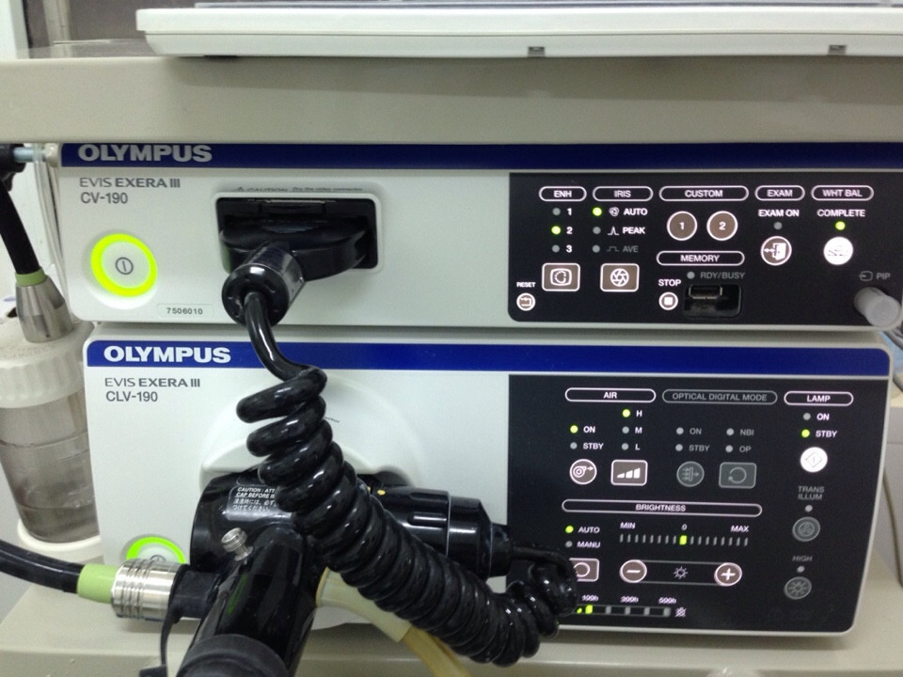
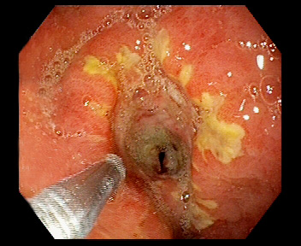
ILLUSTRATING IMAGES
Picture 1. Olympus camera pictures of Japan
(Exera III CLV 190)
Picture 2. Gastric cancer ulcers
(BN Ngô Đức T, 62T Mã KB: 15416285)

Slide 35
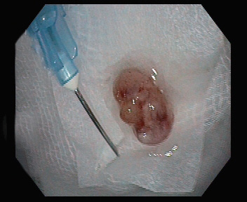
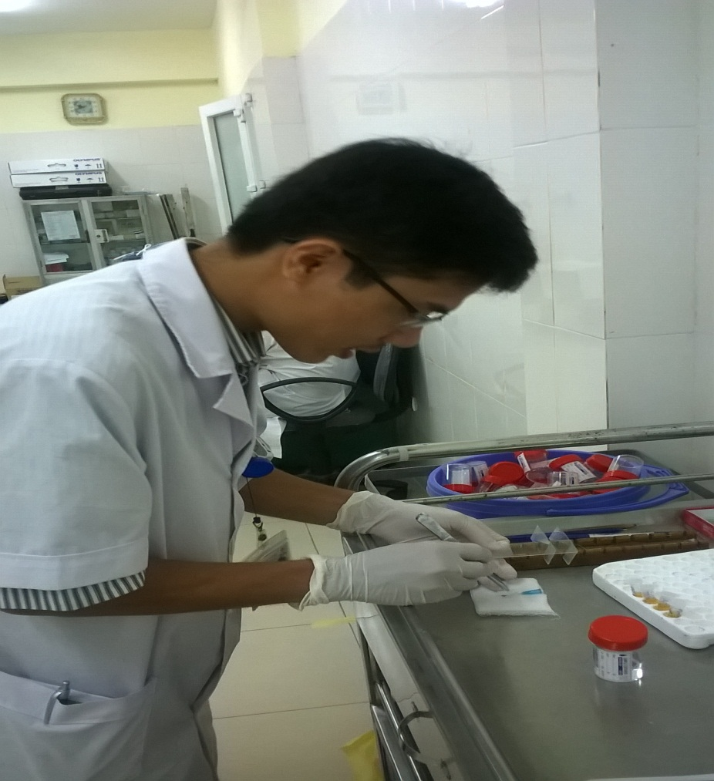
ILLUSTRATING IMAGES
Picture 3. Piece biopsy
( Tran Nho B 61Y, Code: 15860422)
Picture 4. Image of imprint cytology
( Tran Nho B 61y, Code: 15860422)

Slide 36
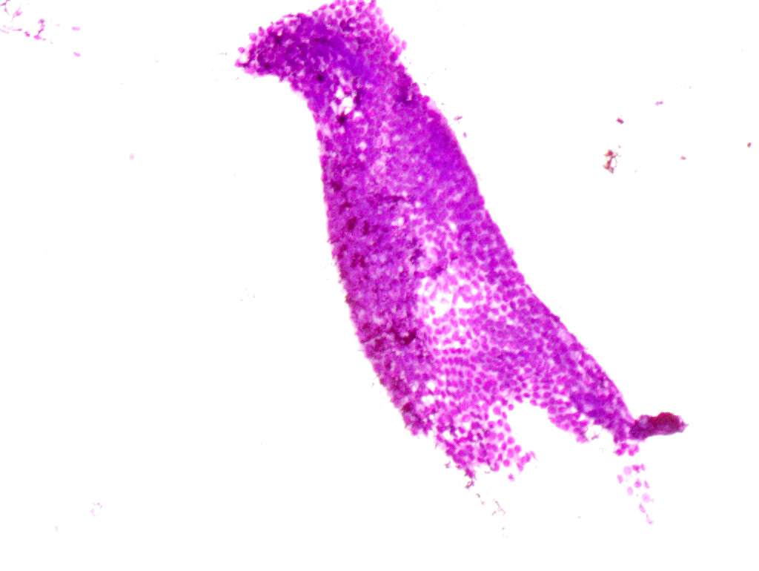
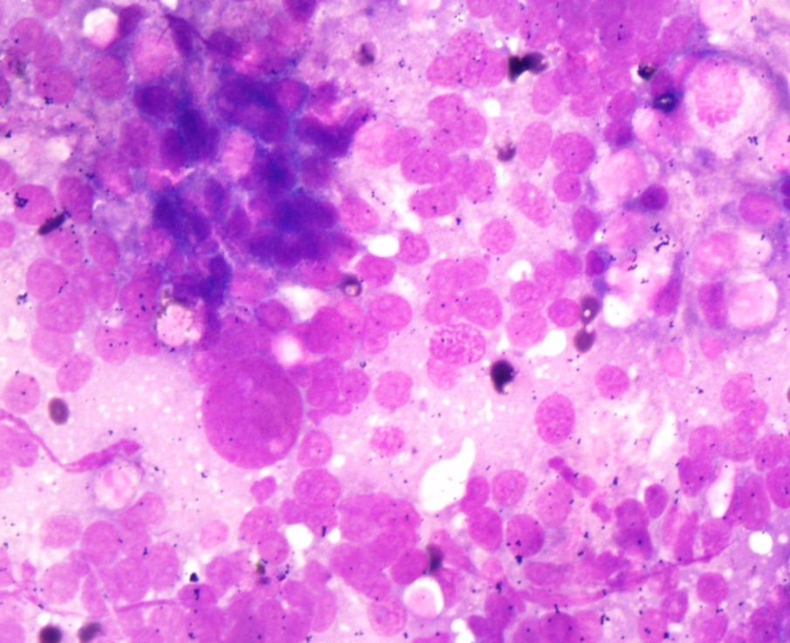
ILLUSTRATING IMAGES
Photo 5. Benign gastric cell: Standing in a honeycomb, rounded, still poles, no abnormalities in the nucleus.
( Nguyen Cong P, 60Y Code:15415416)
Photo 6: Epithelial cell carcinoma
Multiple forms, alone, split cell nucleus
( Luu Thi N, 80Y, Code: 15415493)

Slide 37
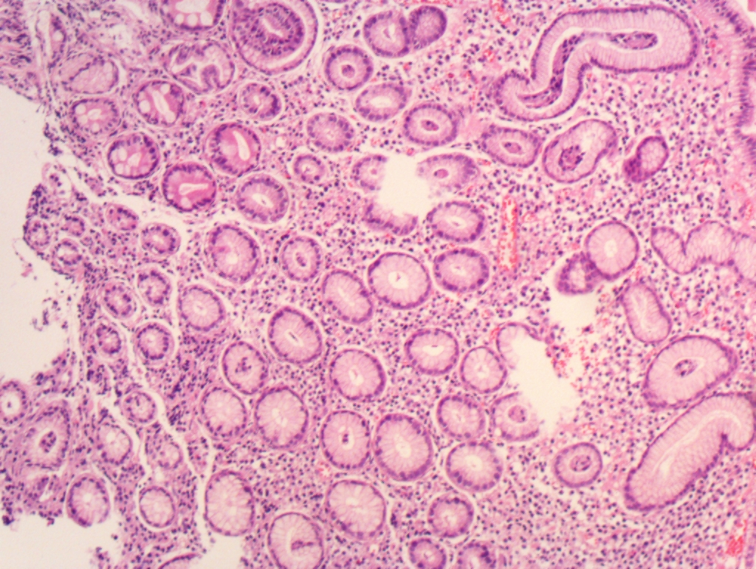
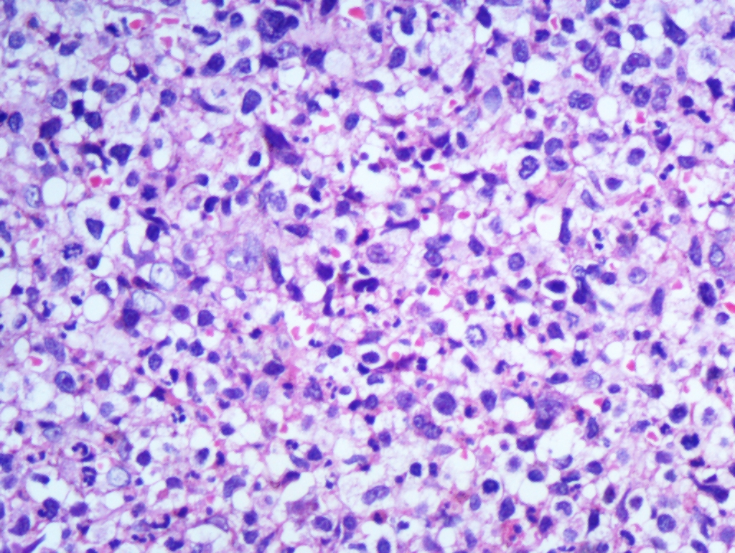
ILLUSTRATING IMAGES
Photo 6. Gastric carcinoma
Cells break down glandular structures,
polymorphisms, cromatin raw
( Đinh Van B, 60T, Code: 85560)
Picture 5: Pathology negative
Also linear structure
(Le Thi H, 45T, Code 83671)

Slide 38

Thank you very much !

