Slide 1
Rapid diagnosis tests and point of care (POC) tests for tropical infectious diseases
Eric PICHARD
Centre Médical de l’Institut Pasteur. Paris
Neglected Tropical Diseases french-speakers network

Slide 2
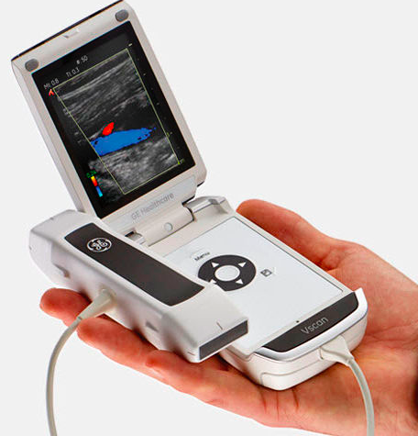
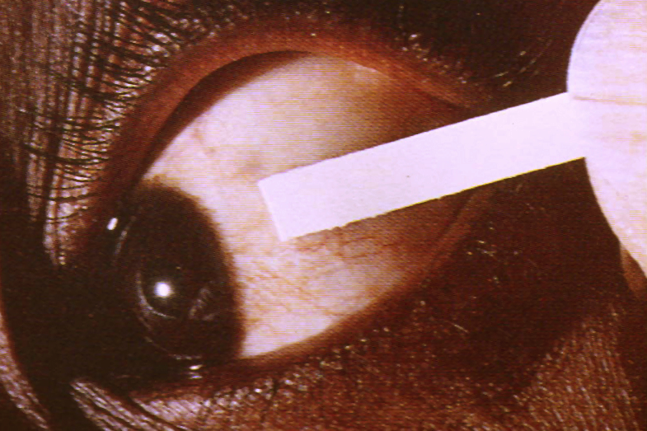
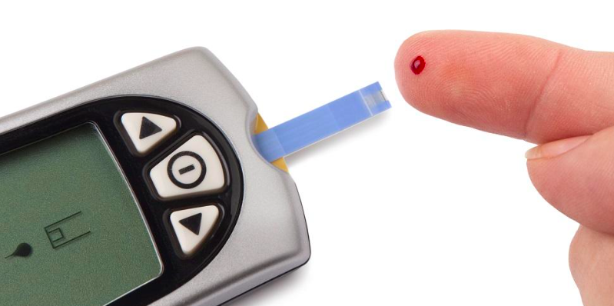
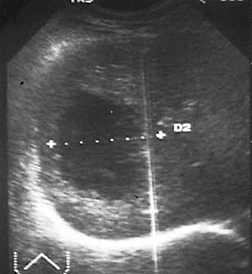
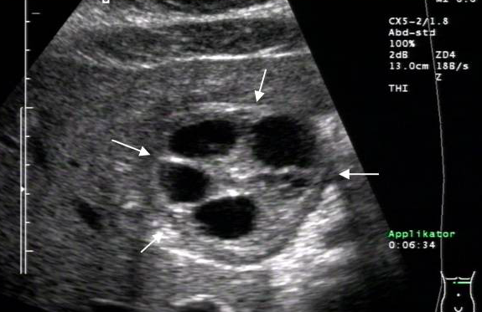
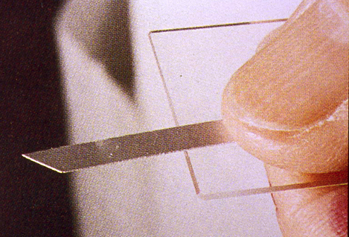
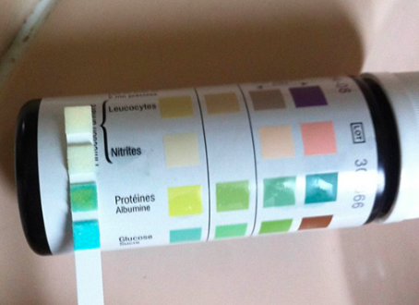
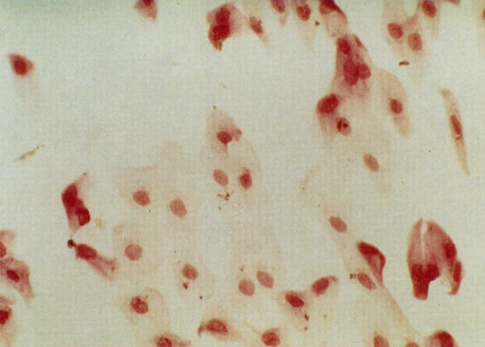
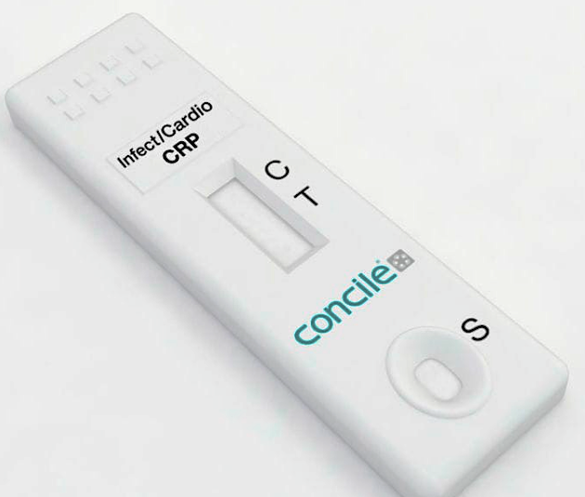
Rapid diagnosis methods do not concern
only identification of antigens or specific antibodies
Chemical methods
Ex : Glycemia
Hématuria
Proteinuria
Nitrites/leukocytes
CRP
Pregnancy
Ultrasound
Ex : Hepatic
amœbosis
Hydatidosis
Cytologia
Ex : Xerophtalmia
(conjunctival
printing)
Echo POC infections trop.
Bélard et al.
Am J Trop Med Hyg 2016

Slide 3
Bacteriology
Staphylococus sp. MRSA
Streptococcus A
S. pneumoniæ
N. meningitidis
H. influenzae
E. coli
Plague
Cholera
Shigella sp.
Helicobacter pylori
Clostridium difficile
N. gonrrhoeæ
Chlamydia trachomatis
Legionella sp.
Syphilis
Melioïdosis
Leptospirosis
Typhoid fever ±
Ab tetanos
Tuberculosis/HIV
RDT Ag et Ab in infectiology
Virology
Rotavirus
Adenovirus
Flu A/B
Inf. mononucleosis
Dengue
Hantaan
HIV 1 and 2
Hépatitis B and C
Rubella
Rabies
SRV
Rotavirus
Norovirus
Chikungunya ±
Ebola
Parasitology
Malaria
Toxoplasmosis
Visceral leishmaniasis
Lymphatic filariasis
Hydatidosis
Cryptosporidium sp.
Giardia lamblia
Trypanosomia cruzi
Mycology
Cryptococcus sp.
Candida sp.

Slide 4
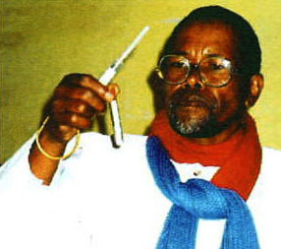
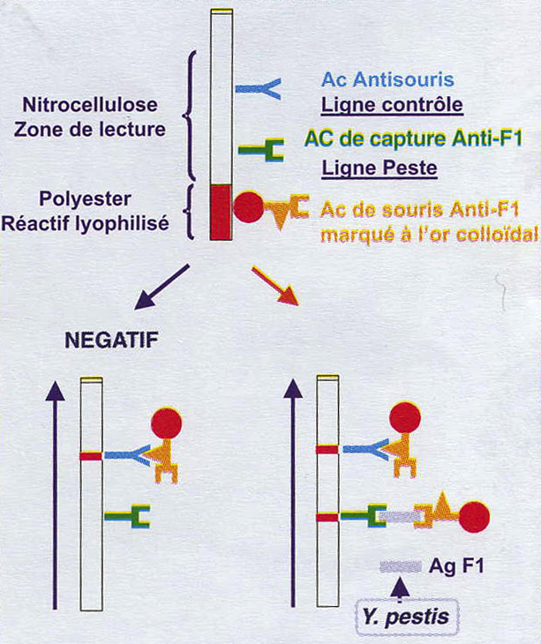
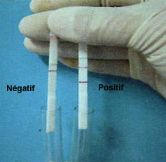
Birth of a RDT : exemple of the plague
2 monoclonal Ab anti F1 of Y.pestis detected by lateral flow
vertical stick in 1 time
Samples (sputum, serum, urine, bubo) of patients with plague
from Madagascar vs 30 Y.pestis stains from 14 other countries
vs other bacteria (Yersinia, Gram- bacilli, M.tuberculosis…)
Compairing ELISA/culture/direct microscopy and PCR if RDT-
Specificity and sensitivity : 100% on cultures and
samples + for Y.pestis
Outbreack of plague in Madagascar 2000/2001 : only RDT for diagnosis : 41 % of + tests furthermore than for direct and culture
PPV : field : 90.6% (CI 95% : 78.6-96.5) lab : 92.7% (CI 95% : 81.6-97.6)
NPV : field : 86.7% (CI 95% : 76.4-93.1) lab : 90.4% (CI 95% : 80.7-95.7)
Concordance RDT/ELISA + culture : 85% (field) et 91% (lab)
Chanteau S. et al. Lancet 2003

Slide 5
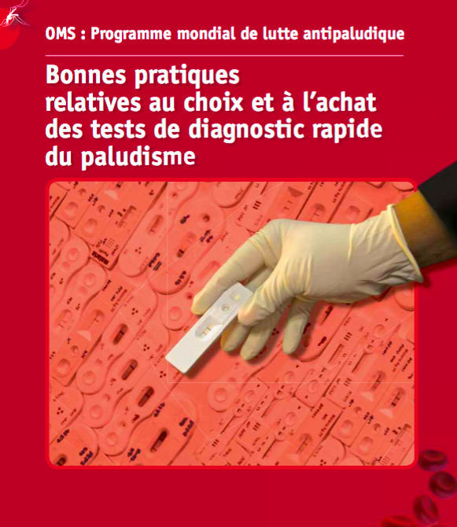
Criteria of good RDT
Simple (little treatment of the sample)
Accurate (sensitive/specific)
Easy to interpret
Training
Evaluation
…repeated
As essential medicine:
Stable in extreme conditions
Adapted in epidemiological context
Validated in the field ·
Culturally acceptable
Little expensive ·
Of checked quality
Integrated in the decision-making
algorithms ·
… Fight against counterfeiting
2012
http://apps.who.int/iris/bitstream/10665/
75237/1/9789242501124_fre.pdf?ua=1

Slide 6
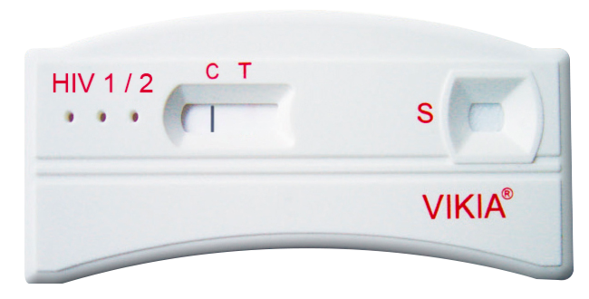
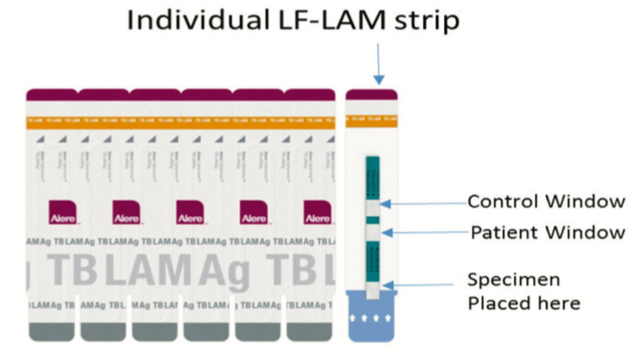
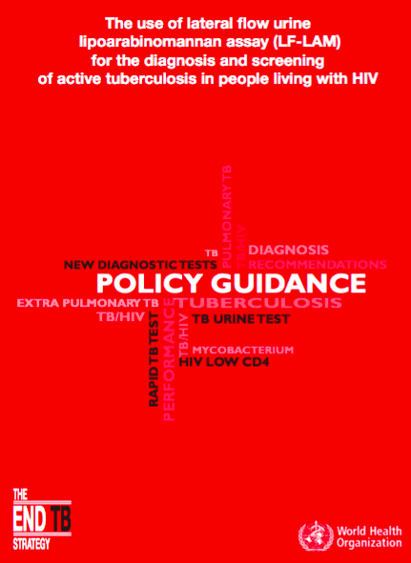
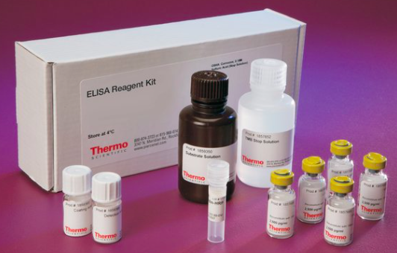
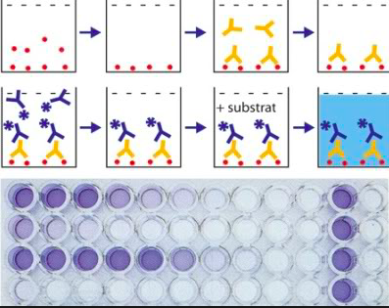
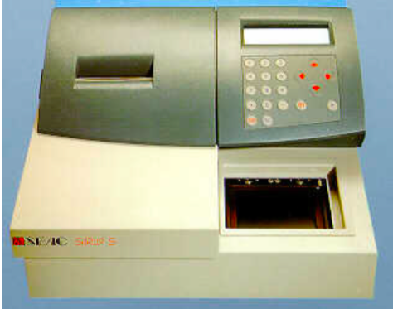
From classic RDT to POC test, rapid… but not so simple
1-TDR by chromatography or agglutination of latex particles: feasible everywhere and by all (patient, health care workers)
Ex: HIV, malaria …
Mérieux
2-Test for a particular use :
Ex: detection of TB urinary lipopoarabinomannane
by lateral flow test (Determine) in HIV patients
Policy guidance OMS 2015
http://www.who.int/tb/publications/use-of-lf-lam-tb-hiv/en/
« LF-LAM may be used to assist in the diagnosis of TB in HIV+ adult
in-patients with signs and symptoms of TB and CD4 ≤ 100 cells/μL,
or HIV+ who are seriously ill regardless of CD4 count or with unknown
CD4 count …»
3-ELISA

Slide 7
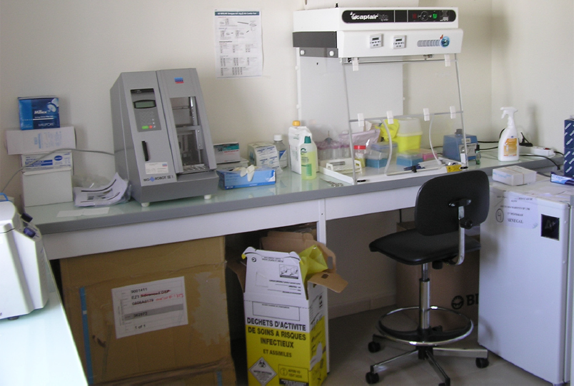
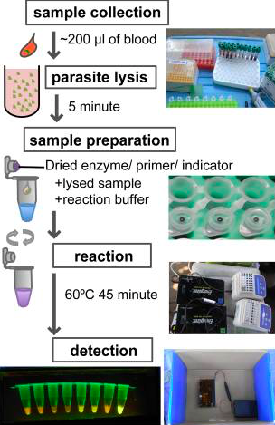
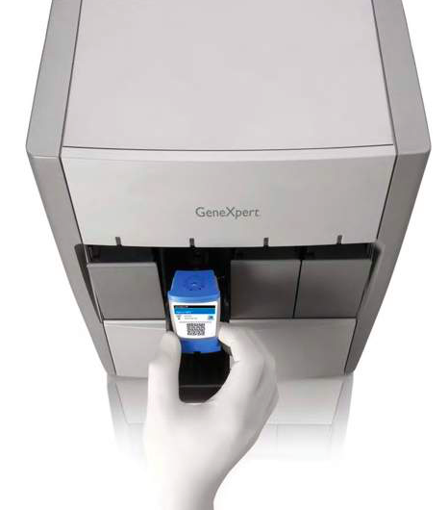
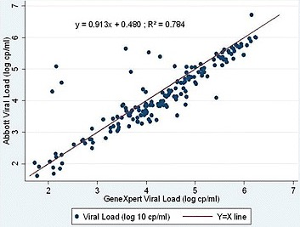
4- POC tests using molecular biology
Molecular simplified test Ex: Loop-mediated isothermal amplification (LAMP):
For AHT - ADN amplification with constant temperature
- and stabilized dry reactives in 1 tube
Hayashida et al. PLOS NTD 2015
For malaria:
Sattabongkot et al. J Clin Microbiol. 2014 (Thaïlande)
Aydin-Schmidt et al. PLoS One. 2017 (Zanzibar)
PCR automated on cassettes
Ex : GeneXpert MTB/RIF
Steingart et al. Cochrane Database Syst Rev. 2014
Ex : GeneXpert HIV1 for HIV1 viral load
Kulkarni et al. BMC Infect Dis. 2017

Slide 8
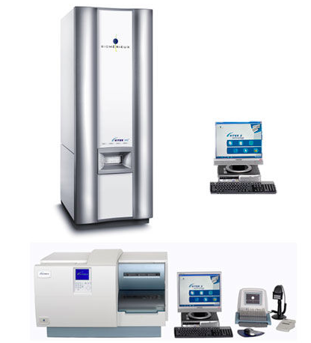
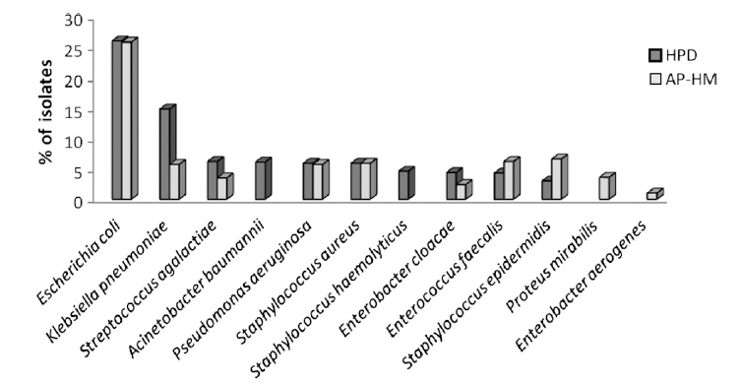
5. Rapid, multiple but expensive :
the mass spectrometry MALDI-TOF
(Matrix Assisted Laser Desorption Ionisation - Time of Flight)
Setting-up at Hôpital Principal de Dakar (Senegal)
From 2640 specimens : 2429
identified microorganisms (94,2%)
Identification :
species of 2 082 bacteria (85.7%)
and 206 fungi (8.5%)
gender of 109 bacteria (4.5%)
family of 16 bacteria (0.75%)
….16 isolates non identified (0.75%)
Identification in Dakar (HPD) and Marseille (AP-HM) with Malditof
Rapid (- 30h/traditional) and effective but cost of equipment:
100 - 200 000 €, assured in Dakar by IU. Infectio. Médit., IRD, MAE
Fall et al. Am J Trop Med Hyg 2015

Slide 9
Site of the sample: of the simplest in the most complicated
Saliva (VIH)
Mucous membranes (Streptococcus A, flu, SRV, diphteria toxin, Chlamydiae sp., Candida sp.)
Urine (N.meningitidis, Legionella sp., S.pneumoniæ, N. gonorrhoeæ, Chlamydia sp., cryptococcosis, mélioïdosis, bilharziasis, TB, malaria Oyibo et al. J Clin Microbiol. 2017)
Stools (rotavirus, adenovirus, norovirus, Giardia sp., Shigella sp.)
Pus, sputum (melioïdosis)
Blood (most frequent RDT)
CSF : N.meningitidis, S.pneumoniæ, H.influenzæ, Cryptococcus sp.

Slide 10
Types of tests according to the clinical situations
Emergency: all rapid tests
Mono (the most used RDT): symptomatic approach/ epidemiological context/screening
Bi : syndromic RDT (ex: diarrhea) or directed by the epidemiology (RDT HIV and HIV/syphilis) = guidance RDT (insufficient to commit a complex treatment)
Multiple : approche syndromic approach
(low respiratory infections, fever, STD…)

Slide 11
Adaptation of RDT according
to the level of care
Hospital
consultation/
dispensary
Malaria
HIV
Dengue
Strepto A
Hospital
HIV
Dengue
HCV HBV
Flu
CD4 VL
Ac tétanos
MRSA
Clostridium...
Home
HIV
UI
Pregnancy
« Targeted fight »
HAT
Trachoma
Cholera
Méningitidis
`
± transf
± transf
Peripheral
lab
Malaria
HIV
Dengue
HCV HBV
Flu
CD4 VL
Community health worker
Malaria
HIV
Dengue
Glycemia
Veinous and capillary blood tests, conventional lab
reference lab
Salivary and
urinary tests
Salivary, urinary,
capillary blood tests
Equipement

Slide 12
Integration in the decision-making algorithms
Ex: not grave infection at the level of peripheral health centers
Clinical syndromic approach
(fever ± caugh ± red throat
± anemia…)
Clinical syndromic approach
Rapid tests
Presumptive standardized
treatment
Specific treatment
Transfer if clinical failure
Transfer if clinical failure
/resistance
= classic model type IMCI of the 90s
= current model

Slide 13
Evaluation of the quality of the results of RDT/POCT
Ex: 6 commercial POCT for the dengue diagnosis estimated in Sri Lanka
Blacksell et al. Clin Vaccine Immunol. 2011

Slide 14
Evaluation of the use : ex malaria
RDT are effective
After introduction of RDT in ougandan rural health centers (stable malaria, feasible smear, 14357 patients)
1 106 cases of malaria (± 50% < 5 years old), among these :
- less prescription of antibiotics (ATB): 75%- 53%
- decrease of length of hospital stay: 28 -24d
- reduction of transfer: 7,4-4, 2% Ross et al. Malar J. 2015
…if the support of the nurses is good
Clinical algorithms in rural african areas vs RDT
7 studies in rural africa GH BF KE ZA OR: 17 505 cases of fever
- TDR reduces of ¾ the prescription of antimalarials (AM) (especially where prevalence of the malaria is low)
- no difference between RDT and microscopic examination
- but 0 to 81 % of the patients with negative RDT receive AM and no influence on the prescription of ATB
Odaga et al. Cochrane Library 2014

Slide 15
…and if the medical staff is formed in the use of the RDT
Introduction of RDT in malaria program of Burkina Faso in 2012
Evaluation of the RDT perception by health workers in 2013
(Department of Socioeconomics and anthropology of Ouagadougou)
Coexistence of former practices (ttt presumptive on clinical arguments)
and recent (ttt according to RDT)
Opinions face to RDT very heterogeneous
Doubt on the accuracy of the RDT
A lot of patients with negative RDT receive ACT (AS-AMQ)
Zongo et al Malaria J 2016

Slide 16
Evaluation of the investment for a simplified
molecular POC test ex: GeneXpert MTB / RIF
Device in 4 modules
GeneXpert and | 17 500 $US
laptop computer
Shipping costs | 1 000 $US
Inverter and external
batteries | 1 200 $US
Printer | 200 $US
Kit of calibration after
the first year | 450 $US
Guarantee after
the 2d year (including | 2 900 $US
the kit of calibration)
Cost of a cartridge | 9,98 $US
Shipping costs | 1,20 $US
+ salary of the technician,
initial expenses and of functioning …
Manual of implementation of Xpert MTB/RIF test OMS 2014

Slide 17
Evaluation of the cost for the healthcare sector
Ex: cost of the introduction of the malaria RDT for the healthcare sector in
Uganda
3 $US by child of less than 5 years well treated for the malaria in the zones of transmission moderated or high
3.3 $US in the zone of low transmission
Hansen et al. Health Policy and Planning 2017

Slide 18
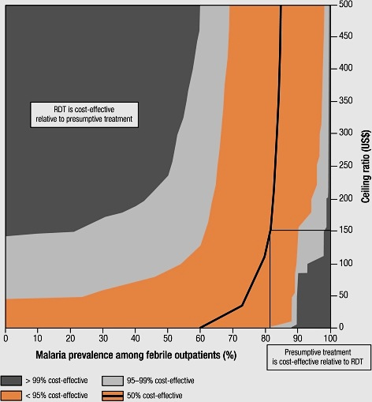
Evaluation of the cost/efficiency relationship
Ex : cost 5$US)/efficiency (DALYs):
RDT malaria
vs presumptive treatment
for a fever
according of malaria prevalence
Hillcutt et al Bull WHO. 2008

Slide 19
Comparison of the RDT sensibility with the other methods of diagnosis?
Ex: bilharziasis in Africa :
Sensibility of urinary RDT using worm Ab (CCA and CAA) >> Kato
under estimation of the disease if studies based on Kato
problem of bilharziasis «eggs positive/worms negative »
In low prevalence area, if Kato is negative ➔ 0 mass treatment
persistence of the transmission but real prevalence x 6-10!!!
➔ abandon Kato and promote the rapid tests Ab especially if prevalence is low
Colley et al. Am. J Trop Med Hyg 2013
Colley et al. Infect Dis Poverty 2017

Slide 20
Rapid diagnosis test by immunochromatographyi in tropical area.
News 2016 (in french). Pierre Aubry et al. (Update 2017 Mars 14).
http://medecinetropicale.free.fr/cours/testrapide.pdf
Symposium SPE on RDT in tropical infectiology. 2014 may 2. Institut Pasteur. Paris (in french). Submissions : http://www.pathexo.fr/standard-1759-1.html et https://bspe.revuesonline.com/resnum.jsp?editionId=3240

Slide 21
E-Pilly Trop free
http://www.infectiologie.com/fr/actualites/epillytrop-2016_-n.html
French-speaking network on Tropical Neglected Diseases (NTD) display
https://i3m.aviesan.fr/index.php?pagendx=510

