Slide 1
The diagnosis and management of cesarean scar pregnancy at Hai Phong hospital of Obstertrics and Gynecology
Nguyễn Văn Học, Nguyễn Hoàng Trang

Slide 2
Introduction
Incidence of caesarean increase → more cesarean scar pregnancy cases are diagnosed.
The risk of suction evacuation/ cesarean scar: haemorrhage, uterine rupture, blood transfusion, hysterectomy.

Slide 3
Objectives of the study
Decribe the methods of diagnosis, management and some related factors to management outcomes of cesarean scar pregnancy.
Notes:
1…
2…

Slide 4
Materials and methods
Selected criterion:
Diagnosis with cesarean scar pregnancy
Treatment at Hai Phong Hospital of obstertrics and gynecology from 1/2013 – 9/2016
Histopathological descriptions: placenta
Sample: convenient, not probable
Study design: restrospective.
Data processing: SPSS 20.0

Slide 5
results and discussion

Slide 6
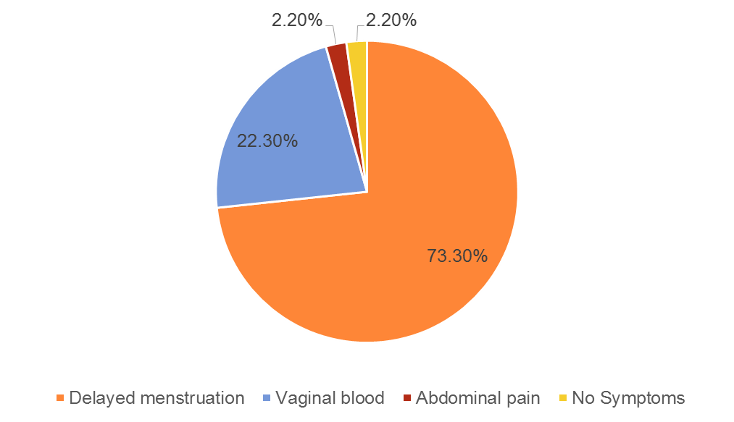
Diagnosis
Functional symptoms
Vaginal blood: DTTThủy 64%, ĐQH 68%, Rotas 1/3 total cases.
Abdominal pain: DTTThủy: 20%, ĐQH 25%, Rotas ¼ total cases.
Rotas: > 50% no symptoms.

Slide 7
Physical symptoms

Slide 8
Subclinical

Slide 9
initial management methods at hospital
Methods | n | %
Suction evacuation (SE) | 27 | 60,0
SE+ Foley's catheter | 14 | 31,1
SE + MTX | 4 | 8,9
Surgery | 0 | 0,0
Total | 45 | 100,0

Slide 10
The link between initial management methods with week of gestaion
week of gestation Management | < 6th weeks |  | 6-8th week |  | >8th week |  | p
 | n | % | n | % | n | %
Suction evacuation (SE) | 16 | 66,7 | 10 | 83,3 | 1 | 11,1 | <0,001
SE+ Foley's catheter | 6 | 25,0 | 0 | 0 | 8 | 88,9
SE+ MTX | 2 | 8,3 | 2 | 16,7 | 0 | 0

Slide 11
Initial management methods and doppler cesarean scar
Doppler | Less blood vessels |  | Many blood vessels |  | p
Management method | n | % | n | %
Suction evacuation (SE) | 25 | 83,3 | 2 | 13,3 | 0,001
SE+ Foley's catheter | 4 | 13,3 | 10 | 66,7
SE+ MTX | 1 | 3,3 | 3 | 20,0

Slide 12
Successful and unsuccessful rate of initial management methods
Method | n | Rate (%) | Success | Unsuccess | P
Suction evacuation (SE) | 27 | 60,0 | 100 | 0 | 0,007
SE + Foley's catheter | 14 | 31,1 | 10 | 4
SE + MTX | 4 | 8,89 | 4 | 0
Total | 45 | 100,0 | 41 (91,1%) | 4 (8,9)
Unsuccess: 2 cases hysterectomy , 2 cases remove gestational sac and repair of the scar.

Slide 13
The link between management result and gestational age
Result Gestational age (week) | Failure |  | Success |  | p
 | n | % | n | %
< 6 | 24 | 100 | 0 | 0 | 0,013
6-8 | 11 | 91,7 | 1 | 8,2
>8 | 6 | 66,7 | 3 | 33,3

Slide 14
The link between initial management result and doppler area of cesarean scar
Result Doppler | Failure |  | Success |  | OR | 95%CI | p
 | n | Tỉ lệ | n | Tỉ lệ
Many blood vessels | 3 | 20,0 | 12 | 80,0 | 7,2 | 1,8-76,8 | 0,04
Less blood vessels | 1 | 3,3 | 29 | 96,7

Slide 15
Conclution
Diagnosis cesarean scar pregnancy
Clinical symptoms: delayed menstruation accounted for the largest proportion (42.2%), followed by vaginal bleeding (33.3%) and abdominal pain (22.2%).
Doppler ultrasound: 30 cases (66.7%) of doppler areas of cesarean scar were less blood vessels; 33.3% of area of ​​incision increased blood vessels.

Slide 16
Management methods of cesarean scar pregnancy and some related factors with management outcomes
Initial management methods of cesarean scar pregnancy included: suction evacuation (60%), suction evacuation + Foley's catheter (31,1%), suction evacuation + MTX (8,9%).
Successful rate decrease gradually by gestational age: 100% with gestational age < 6th week, 91,7% with gestational age 6-8th week, 66,7% with gestational age> 8th week.

Slide 17
- Doppler ultrasound have many blood vessels increase the risk of failure up to 7,2 times in comparison with less blood vessels (p< 0,05).

Slide 18
Recommendations
Gestational age ≤8th week: Suction evacuation + Foley's catheter in case of intraoperative bleeding. Gestational age>8th week should combine different treatment methods .
Recommend pregnant women with cesarean scar should be examed as soon as possible.
To ensure proper cesarean section.
Should use medical abortion with cesarean scar pregnancy <6th week.
More research is needed.

Slide 19
thank you for your attention!

