Slide 1
ROBOTIC ASSISSTED RADICAL PROSTATECTOMY OUR INITIAL EXPERIENCE
Vũ Lê Chuyên, Nguyễn Phúc Cẩm Hoàng, Nguyễn Văn Ân, Trần Vĩnh Hưng, Nguyễn Tiến Đệ, Nguyễn Tế Kha, NGUYỄN NGỌC CHÂU,Đỗ Anh Toàn, Đỗ Lệnh Hùng, Phạm Hữu Đoàn, Nguyễn Trọng Khôi

Slide 2
INTRODUCTION
Radical prostatectomy is gold standard for treating prostate cancer in local or local invasive stage.
There are many technique ti perform including open and laparoscopic surgery.
Applying robotic assisted is a new step that brings many benefits for patients.
We present some experiences with 52 RARP at department of urology, Bình Dân hospital, between 11/2016 and 9/2017.

Slide 3
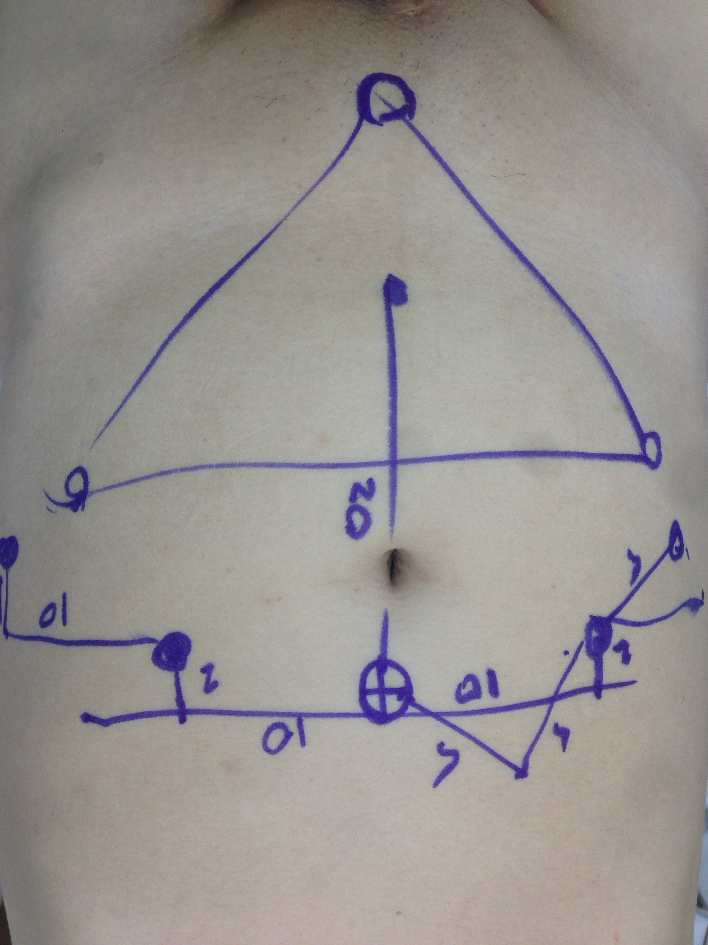
MATERIALS AND METHODS
Case series report
.
52 patients with prostate cancer cT1-cT3.

Slide 4
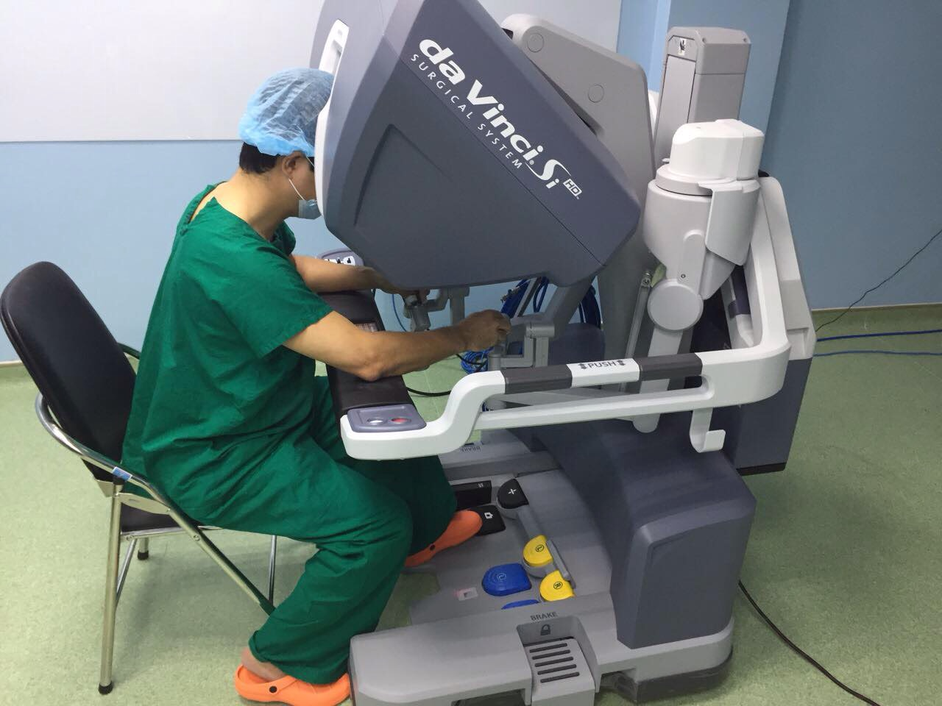
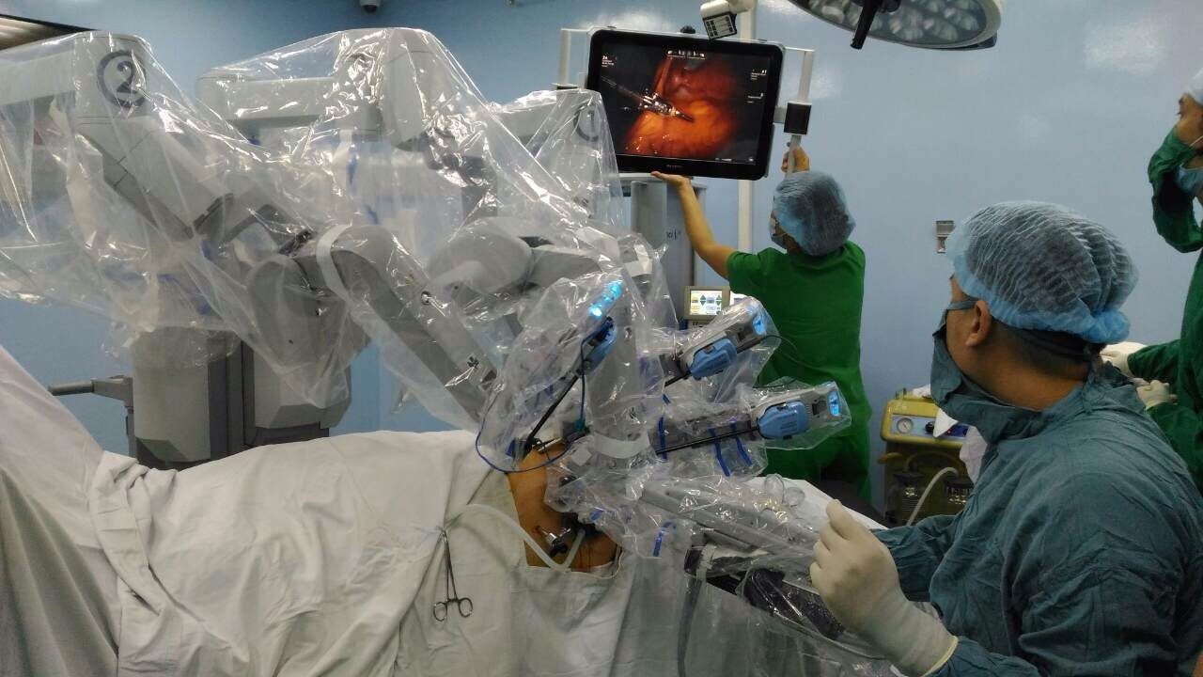

Slide 5
We performed robotic assisted radical prostatectomy type antegrade, with or without nerve sparing, obturator lymphadenectomy.
Data: cancer stage, pre-op and post-op PSA, pre-op and post-op Gleason score, lymph nodes, estimated blood loss, time of surgery, incontinence.

Slide 6
RESULTS

Slide 7
Age
Mean | 66,27 ± 9,9
Min | 49
Max | 80

Slide 8
Prostate size
Mean | 33,36 ± 10.36
Min | 20
Max | 60

Slide 9
PSA pre-op
Mean | 41,51 ± 28,81
Min | 4,5
Max | 100

Slide 10
Time of surgery
Mean | 237 ± 69
Min | 105
Max | 480

Slide 11
EBL
Mean | 346 ± 205
Min | 50
Max | 1400

Slide 12
Drainage time
Mean | 5,67 ± 4,05
Min | 1
Max | 33

Slide 13
Hosptial time
Mean | 5,67 ± 4,05
Min | 1
Max | 33

Slide 14
Gleason score
Gleason | Pre-op | Post-op
4 | 1 | 1
5 | 7 | 6
6 | 12 | 12
7 | 17 | 16
8 | 8 | 8
9 | 3 | 9
10 | 1

Slide 15
Cancer stage
Stage | Pre-Op | Post-Op
T1b | 4 | 6
T2a | 3 | 10
T2b | 9 | 7
T2c | 5 | 2
T3a | 3 | 8
T3b |  | 12
T3c |  | 8

Slide 16
Post-op
Early complications includ
9 prolonged fluid collection, 2 needed redrainage.
2 needed recatherization
1 subcutaneous emphysema.
1 acute cardiac stroke
1 strangulated groin hernia.

Slide 17
Post-op
Incontinence from 3 weeks to 2 months : 16/52 cases.
MED not recognized.
Mean PSA post-op 0,26 ng/ml, max 3,42 ng/ml min 0,05 ng/ml.
Learning curve is good, first case took 8h, last case 1h45min.

Slide 18
Compare with open surgery
Open | Laparoscopy
Large incision | Small incision
More pain | Less pain
Low recovery | Fast recovery
Can do with severe case | Only in organ confined tumor
Cheap | Expensive
Difficult in dissection and suture | Easier

Slide 19
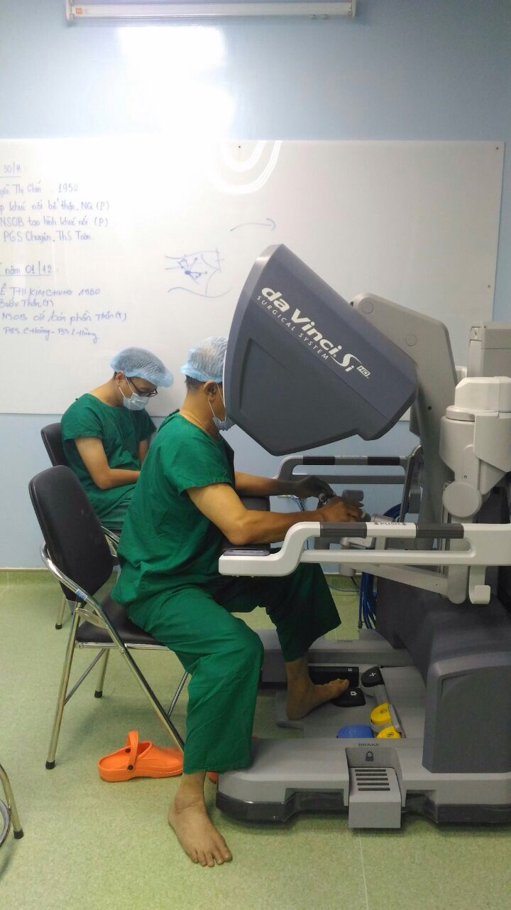
COMPARE WITH LAPAOSCOPY

Slide 20
COMPARE WITH LAPAOSCOPY

Slide 21
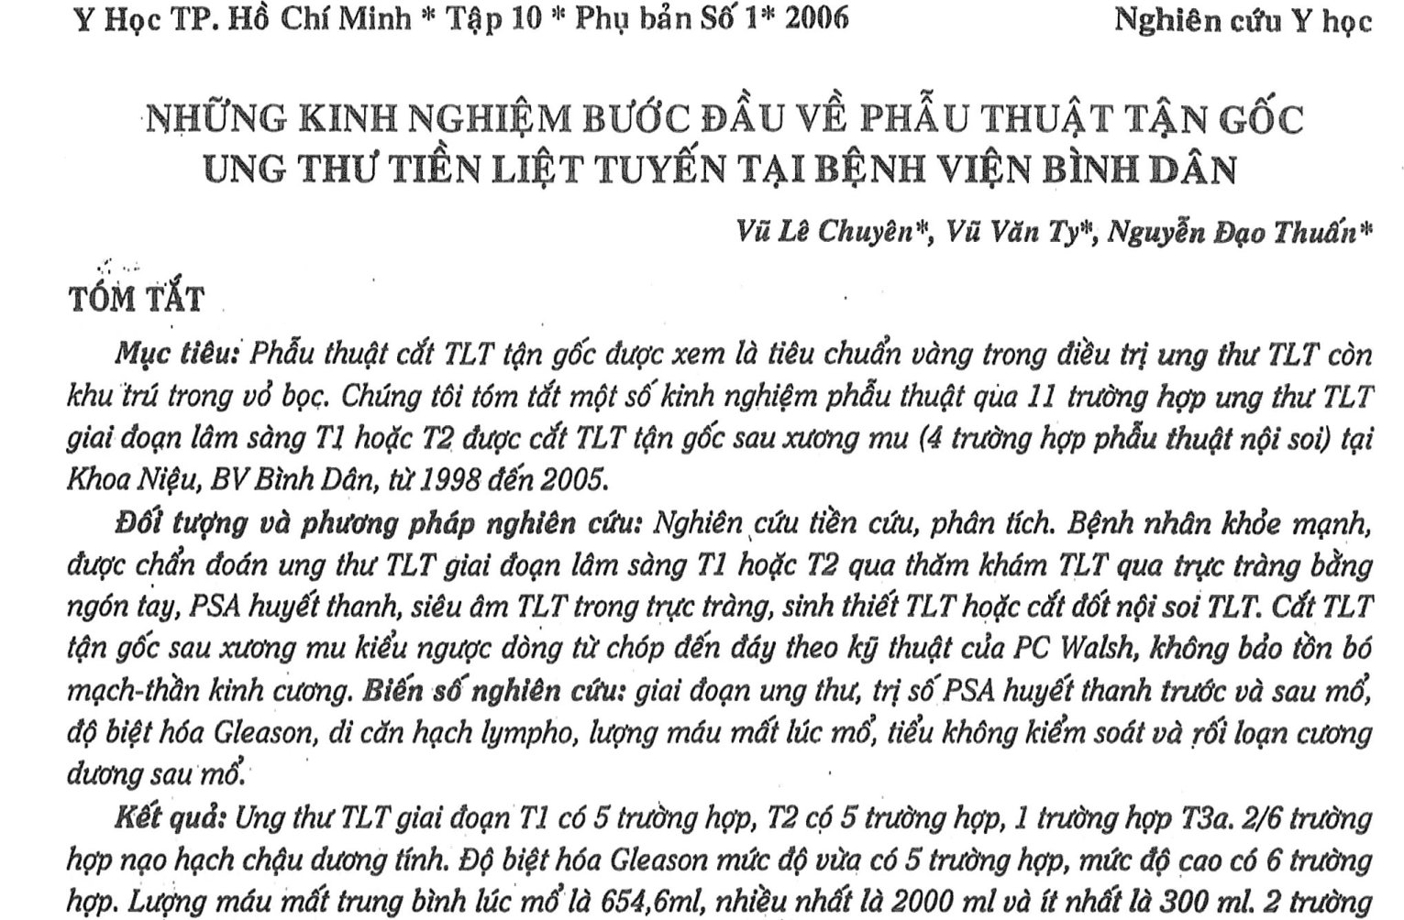
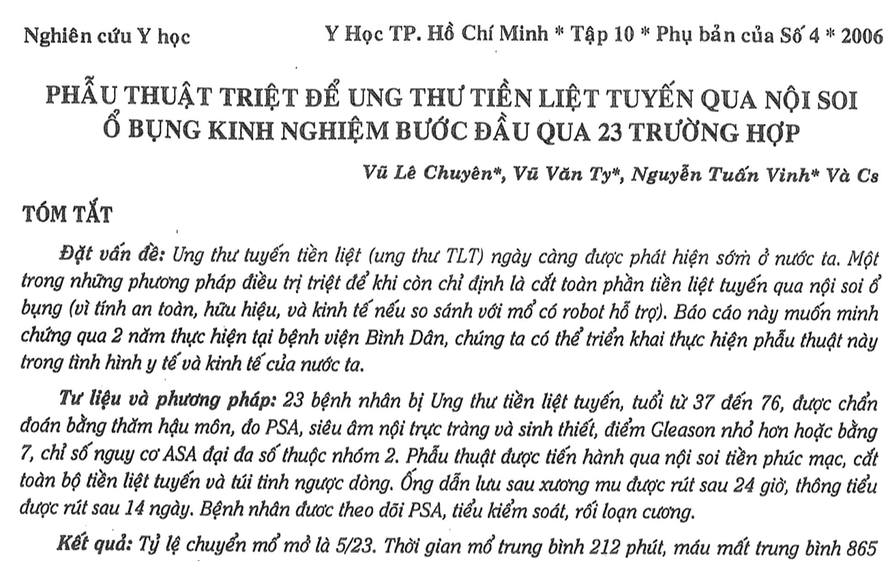

Slide 22
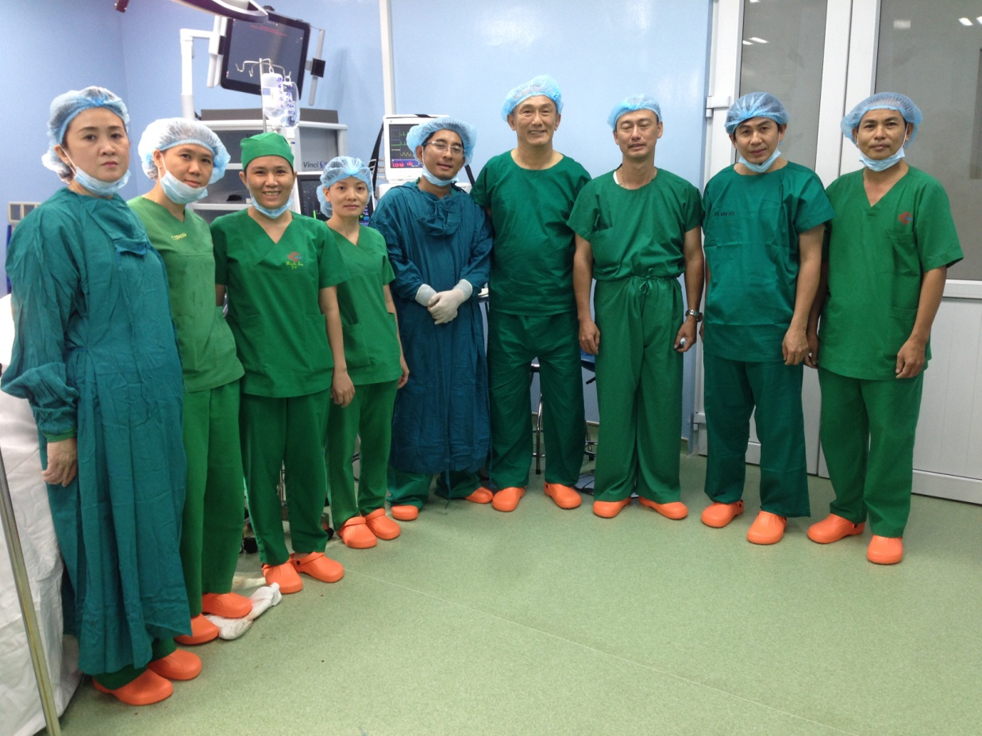
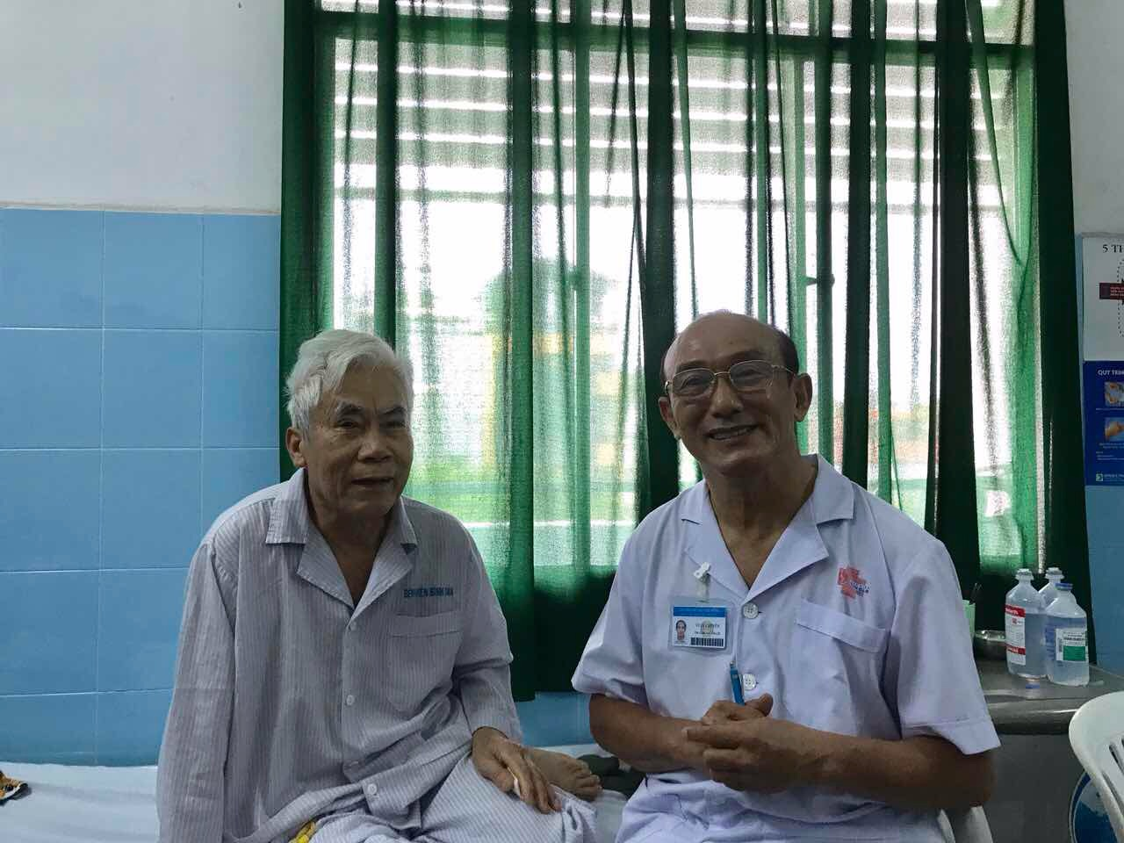
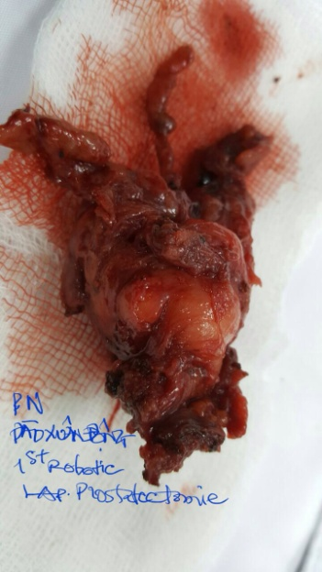

Slide 23
CONCLUSION
Although this is only our initial experiences, small number of cases and short follow up period, the results of RARP are promising, the procedure is feasible and complications are acceptable.

Slide 24
THANK YOU FOR YOUR KIND ATTENTION

