Slide 1
MYCN STRATIFICATION OF RISK IN NEUROBLASTOMA BY Q-PCR
Trương Đinh Kiều Diễm¹, Nguyễn Nhật Quỳnh Như, Võ Văn Thành Niệm¹, Nguyễn Thị Hà Giang¹,Bùi Thị Thanh Huyền², Tô Thùy Nhi², Vũ Trường Nhân², Nguyễn Đình Văn²,Hồ Trần Bản³,Trương Đình Khải³, Carol J.Thiele⁴, Bùi Chí Bảo¹
¹ University of Medicine and Pharmacy at HCM city, ² University of Science HCM city, ² Children Hospital 2, ³ Pediatric Surgery - University of Medicine and Pharmacy at HCM city, ⁴Pediatric Oncology Branch, Center for Cancer Research, NCI, CRC-1W-3940, 10 Center Dr. MSC-1105, Bethesda, MD 20892, USA.

Slide 2
CONTENT
Introduction
Material and methods
Results
Discussion
Conclusion

Slide 3
INTRODUCTION
Neuroblastoma (NB):
a polymorphic disease of the sympathetic nervous system
the most common extracranial solid tumor in childhood
genetic defects:
abnormalities in chromosomes: -1p , -11q, + 17q
MYCN gene amplification
ALK gene amplification
ATRX mutations
→ lead to the lost of growth regulation, give rise to tumorigenesis.
MYCN - A proto-oncogene, located on chromosome 2 at 2p24
MYCN amplification at stage III, IV about 20-25%
Objective: MYCN amplification is closely associated to high-stage neuroblastomas and an inverse correlation with clinical neuroblastoma stages, classified the risk groups by quantitative PCR.

Slide 4
Material and methods
Material: NB samples at the Vietnamese Children Hospital II
Methods:
Sample collection
Cell culture
DNA extraction→qPCR
H&E staining
FISH
Analysis data

Slide 5
RESULTS
Isolation and culture of primary cancer cell: extraction single cell of NB tumor by mechanical method and culture in DMEM medium supplemented with 10% FBS. Cell proliferation was recorded for 12 days (Fig. 1).
Figure 1. Culture of primary single cell collected from NB tumor (x20)

Slide 6
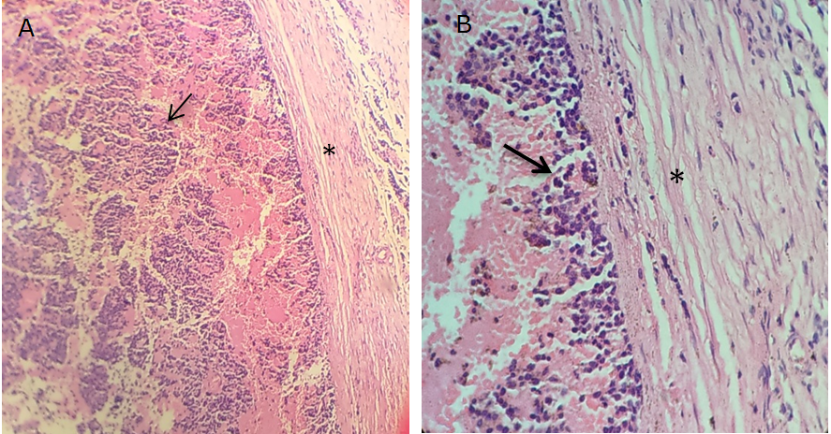
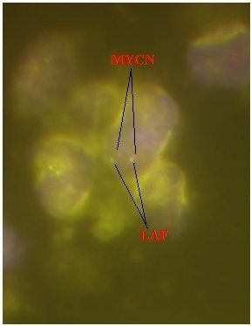
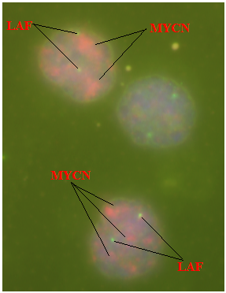
RESULTS
Hematoxiline – Eosin staining and FISH:
Tumor cell specific of NB clearly visible in HE staining: stroma cells and vascular systems ccurring (Figure 2).
FISH showed that some cancer cells extracted from paraffin block appeared MYCN (Figure 3).
Figure 2. Histopathology of formalin-fixed paraffin-embedded tumor tumor sample with Haemotoxylin and Eosin stain. The invasive carcinoma with irregular infiltrating borders (arrow) and stroma (asterisk).
Figure 3. MYCN amplification by FISH. .
A. MYCN non-amplification , B: MYCN amplification.

Slide 7
RESULTS
MYCN (2p24) amplification
MYCN amplified when MYCN copy number was equal or higher than 10
According to statistic result from table 3, MYCN amplified only 5 cases with 15, 344, 96 và 202 copy number (40%), and 6 cases remaining non-amplification MYCN (60%).
MYCN amplified at stage 4, those of cases remaining, the copy number had change but it had not enough to conclude that amplified MYCN gene.
➔the value amplification of MYCN gene depends on age, stage and clinical of NB

Slide 8
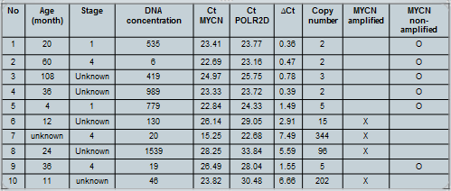
RESULTS
Table 3: List of patient’s information, clinical diagnosis and results for MYCN gene copy number of samples in Neuroblastoma
Note: X: amplified, O: non-amplified

Slide 9
DISCUSSION
Objective and evaluation MYCN amplification by qPCR method:
Discovering high risk NB
Expanding and developing diagnosis methods of NB → predict high or low cancer risk in Viet Nam
A factor of clinical because of stratification risk group and treatment decision

Slide 10
DISCUSSION
There were only 4 cases (40%) MYCN amplification and 6 cases (60%) remaining, it means the ratio of MYCN amplication about 40 % in total patient’s. This ratio similar to other article [10].
Some case diagnosis stage 4 but it did not had MYCN amplification due to:
The ratio MYCN amplificatin at stage 3 and 4 made up 30 – 40% compared with different stages
Stage of NB and MYCN amplification did not correlate, it means the stage uneffected MYCN amplification or not

Slide 11
CONCLUSION
Building successful process of quantitative MYCN amplification by qPCR method
Contributing to support for prognosis treatment NB
Funding was sponsored by Nafosted, code 106-YS.06-2014.48.

Slide 12
REFERENCES
1.Maris, J.M., Recent advances in neuroblastoma. N Engl J Med, 2010. 362(23): p. 2202-11.
2.Matthay, K.K., et al., Long-term results for children with high-risk neuroblastoma treated on a randomized trial of myeloablative therapy followed by 13-cis-retinoic acid: A children's oncology group study. Journal of Clinical Oncology, 2009. 27(7): p. 1007-1013.
3.Mosse, Y.P., et al., Identification of ALK as a major familial neuroblastoma predisposition gene. Nature, 2008. 455(7215): p. 930-5.
4.Ora, I. and A. Eggert, Progress in treatment and risk stratification of neuroblastoma: impact on future clinical and basic research. Semin Cancer Biol, 2011. 21(4): p. 217-28.
5.Tomioka, N., et al., Novel risk stratification of patients with neuroblastoma by genomic signature, which is independent of molecular signature. Oncogene, 2008. 27(4): p. 441-9.
6.Kaneko, M., et al., Intensified chemotherapy increases the survival rates in patients with stage 4 neuroblastoma with MYCN amplification. J Pediatr Hematol Oncol, 2002. 24(8): p. 613-21.
7.Cohn, S.L., et al., The International Neuroblastoma Risk Group (INRG) classification system: an INRG Task Force report. J Clin Oncol, 2009. 27(2): p. 289-97.
8.Ambros, P.F., et al., International consensus for neuroblastoma molecular diagnostics: report from the International Neuroblastoma Risk Group (INRG) Biology Committee. Br J Cancer, 2009. 100(9): p. 1471-82.
9.Baker, D.L., et al., Outcome after reduced chemotherapy for intermediate-risk neuroblastoma. New England Journal of Medicine, 2010. 363(14): p. 1313-1323.
10. Mestdagh, P., Van Vlierberghe, P., De Weer, A., Muth, D., Westermann, F., Speleman, F., Vandesompele, J.A novel and universal method for microRNA RT-qPCR data normalization(2009) Genome Biology, 10 (6), art. no. R64.

Slide 13
THANK YOU!

