Slide 1
THE VALUE OF AUTOFLUORESCENCE BRONCHOSCOPY FOR THE DETECTION OF EARLY PREINVASIVE BRONCHIAL LESIONS
INTERNATIONAL CONFERENCE SURGERY ACCESS IN TROPICAL AREAS AND UPDATES IN ONCOLOGY
Dr. Nguyễn Chi Lăng
Dr. Vũ Khắc Đại
Dr. Nguyễn Lê Nhật Minh
Diagnostic and Interventional Endoscopy Department
National Lung Hospital

Slide 2
INTRODUCTION
Lung cancer: quikly progresion, poor prognosis
At early stages: symptoms are not specific
The prognosis of lung cancer patients correlates with the stage of the disease, the importance of early detection followed by early treatment might improve the prognosis.
detection and treatment at earlier stages is essential
AFB: is a novel modality for the early detection of bronchial premalignant and malignant lesions.

Slide 3
INTRODUCTION
This study was undertaken to asses the diagnostic yield of autofluorescence bronchoscopy in the early detection of bronchial premalignant of individuals at a high risk of developing lung cancer.

Slide 4
OVERVIEW
There are many screening studys in early detection of lung cancer: sputum cytology, screening by chest radiography and CT, serum biomarkers.
Bronchoscopy: investigation of bronchial lesions and biopsy for histological.
Autofuorescence bronchoscopy: detection of premalignant lesions.
Principle: normal bronchial tissues fluoresce strongly in the green, whereas premalignant and malignant tissues have significantly lower green autofluorescence.

Slide 5
OVERVIEW
Lam et al (1998): use LIFE system in multicenter study: 173 patients, AFB more than WB
Venman et al (1998): AFB (98%, 78% ) compared with WB (61% và 88% )
Ikeda N et al (2006): AFB (90%) compared with WB (65%)

Slide 6
METERIAL AND METHOD
Subjects of study: 608 patients
1.1 Criteria for selecting patient
Patients: age ≥40, high risk of lung cancer: smocking history with pack-years > 20, treated radiotherapy or faminy history have lung cancer.
Patients without symptoms underwent chest radiography and autofluorescence bronchoscopy.

Slide 7
METERIAL AND METHOD
Subjects of study
1.2 Exclusion criteria
Patients with hypertension, unstable angina, known or suspected pneumonia, acute brochitis
Patients with bleeding disorders, reactions to lidocine
Patients with chemotherapy and radiotherapy prior to the bronchoscopic procedure.

Slide 8
MATERIAL AND METHOD
2. Methods
Design of the study: using a prospective descriptive study.
Approach:
- Total 608 patients in the study: the study of clinical and para-clinical characteristics.
- Bronchoscopy was performed with AFB (Karl Storz).

Slide 9
MATERIAL AND METHOD
2. Methods
- The bronchoscopy procedure was performed in two stages:
First: to perform with autofluorescence bronchoscopy
At the second stage: white-light examination was carried out.
Final: biopsy specimens for pathologic examination were taken from all suspicious or abnormal areas discovered by WLB, AFB, or both

Slide 10
MATERIAL AND METHOD
2. Methods
Research content
Visual identification of normal and abnormal AFB findings
AFB | Description | Findings
 | Green | negative
 | Brownish-red | Positive

Slide 11
MATERIAL AND METHOD
2. Methods
Research content
Visual identification of normal and abnormal bronchoscopic findings
WB | Description | Findings
 | Erythema, swelling or thickening of the mucosa, anatomic anomalies | Negative
 | Infiltrated mucosa, nodular/polypoid lesions | Positive

Slide 12
MATERIAL AND METHOD
2. Methods
Research content
Pathological characteristics
Negative | Positive
Normal | Moderate/Severe Dysplasia
Bronchitis | Carcinoma in situ
Hyperplasia | Invasive Cancer
Mild dysplasia
Others

Slide 13
RESULT AND DISCUSSION
1. Common characteristics of patients
Age: the average age: 55,4 years(range, 40 to 87 years).
Sexual ratios: 453 (74,5%) male, 155 (25,5%) female.
Family history: There were 197 (32,4%) patients with known family history of cancer and commonly lung cancer (111/608).
Smocking history: There were 448 participants with smocking history. The mean pack-years 27,59±7,89(range, 07 to 50 pack-years).

Slide 14
RESULT AND DISCUSSION
2. Characteristic lesions of chest X-ray
Chest X-ray | (n=608) | (%)
Normal | 574 | 94,4
Abnormal | 34 | 5,6
Characteristic lesions | (n=34) | (%)
Tumor | 2 | 5,9
Nodule | 17 | 50
Pleural effusion | 0 | 0
Mediastinal lymph nodes | 1 | 2,9
infiltration | 7 | 21,2
consolidation | 3 | 8,8
lines | 0 | 0
The others | 4 | 11,6

Slide 15
RESULT AND DISCUSSION
3. The pathological characteristics
Characteristics | (n=608) | (%)
Normal | 164 | 26,9
Hyperplasia | 88 | 14,5
Metaplasia | 21 | 3,4
Dysplasia | 36 | 5,9
Cancer | 0 | 0
Bronchitis | 292 | 48,1
Others | 7 | 1,2
Total | 608 | 100

Slide 16
KẾT QUẢ VÀ BÀN LUẬN
4. The yield of autofluorescence bronchoscopy
AFB | Pathologycal finding
 | NM | HP | MP | Dysplasia |  |  | Can | Bronc | others | Tổng
 |  |  |  | MiD | MoD | SD
Normal | 159 | 84 | 16 | 19 | 4 | 0 | 0 | 263 | 6 | 551
Abnormal | 5 | 4 | 5 | 2 | 7 | 4 | 0 | 29 | 1 | 57
Total | 164 | 88 | 21 | 21 | 11 | 4 | 0 | 292 | 7 | 608

Slide 17
RESULT AND DISCUSSION
5. Sensitivity, specificity of AFB
The yield | AFB
Sensitivity (%) | 73,3
Specificity (%) | 92,2
Positive predictive value (%) | 19,3
Negative predictive value (%) | 99,3
Lam B et al (2006): AFB (91%, 26%), WB (58%, 50%)
Venman et al (1998): AFB (98%, 78%), WB (61%, 88%)
Lam B, Wong MP, Fung SL, et al. (2006). The clinical value of autofluorescence bronchoscopy for the diagnosis of lung cancer. Eur Respir J, Nov;28(5), 915-919.
Venman BJ, Vander Linder JC et al (1998). Early detection of preinvasive lesions in high risk patients. A comparision of conventiona fiberoptic and fluorescence brochoscopy. J. Bronchol, 5, 280-283.

Slide 18
CONCLUSION
The mean age of 55,4 years (range, 40 to 87 years).
There were 453/608 (74,5%) men and 155/608 (25,5%) female.
Chest x ray: 34 (5,6%) abnormal
Pathology: bronchitis: 292 (48,1%); hyperplasia 88 (14,5%) and dysplasia 36 (5,9%) (severe dyplasia: 4, moderate dyplasia: 11, mild dysplasia: 21). Cancer:0
The yield of AFB: the sensitivity, specificity, positive predictive value and negative predictive value was 73,3%, 92,2%, 19,3% và 99,3% respectively, compared with WB (no detect premalignant lesions).

Slide 19
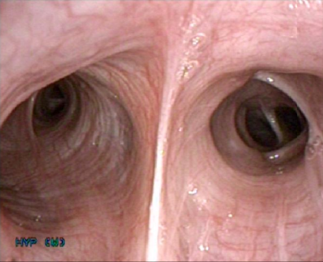
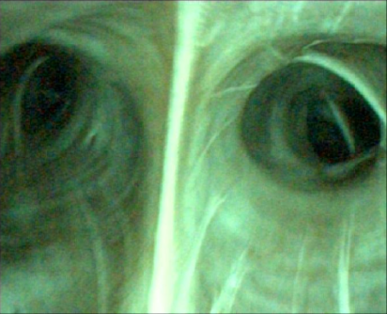
WHITE LIGHT AND AUTOFLUORESCENE BRONCHOSCOPY
Show normal appearance with WB and AFB

Slide 20
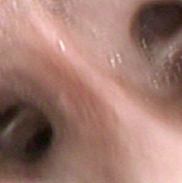
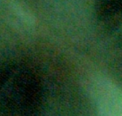
WHITE LIGHT AND AUTOFLUORESCENE BRONCHOSCOPY
Show abnormal appearance with WB and AFB

Slide 21
INTERNATIONAL CONFERENCE SURGERY ACCESS IN TROPICAL AREAS AND UPDATES IN ONCOLOGY
THANK YOU SO MUCH!

