Slide 1
Research about shoulder dystocia
NGUYEN Hai Long
Jean Verdier 2017

Slide 2
Definition
according to Jacques Lansac's definition [1], shoulder dystocia is defined by the use of obstetric maneuvers other than gentle traction on the head and / or the restitution maneuver to clear the shoulders. It varies from 0.5 to 1% of vaginal deliveries. It doubles in nascent children after 42 weeks. In 60 to 70% of cases, it is observed in children weighing more than 4000g. The frequency of dystocia increases with the weight of children, it doubles beyond 4500g. It is multiplied by two to four in children of diabetic mothers whose biacromial diameter is 2 to 3 cm higher than that of children of the same weight of a non-diabetic

Slide 3
Definition
In 60 to 70% of cases, it is observed in children weighing more than 4000g. The frequency of dystocia increases with the weight of children, it doubles beyond 4500g. It is multiplied by two to four in children of diabetic mothers whose biacromial diameter is 2 to 3 cm higher than that of children of the same weight of a non-diabetic mother

Slide 4
Diagnostic
In the labor room when the head of the baby has been expelled but remains in the vulva, motionless without the tendency to make its movement of restitution. The stump of the anterior shoulder does not appear in the vulva despite gentle traction downwards and can be palpated above the symphysis

Slide 5
METHODE
a case-control study of dystocia of the shoulders and without shoulder dystocia was performed on the delivery files between 01/04/2011 and 15/06/2017 at the Jean Verdier hospital in Bondy. Patients followed up at the hospital and performed an oral hyperglycemia test for the detection of gestational diabetes. All patients diagnosed with diabetes treated by diabetologists.

Slide 6
METHODE
Pour les accouchements par voie basse, on va les mettre dans deux groupes : dystocie des épaules dans le groupe « cas » et sans dystocie des épaules dans le groupe « témoins ».

Slide 7
METHODE
The figures were analyzed by the SPSS 16.0 application to estimate:
Frequencies
average values
the value of p (test χ2)
the relative risk
independent-samples T test to compare two average values
the ROC curve

Slide 8
RESULT
Variantes | Shoulder dystocie (A) n=205 | Control group(B) n= 11197 | RR (95%CI) ou (p)
Height | 163,49 ± 6,3 | 164,12 ± 6,48 | 0,166
Weight | 71,45 ± 15,96 | 66,7 ± 14,394 | <0,001
BMI | 26,61 ± 5,29 | 24,71 ± 4,9 | <0,001

Slide 9
RESULT
Diabete | 49 (23,9%) | 1963 (17,5%) | 1,36 (1,06-1,74) p<0,05
Diabète Gestationnel | 43 (21%) | 1881 (16,8%) | 0,114
Diabète insulino-dépendant | 0 | 31 (0,3%)
Diabète non-insulino-dépendant | 6 (2,9%) | 51 (0,5%) | 6,42 (2,78-14,8) P<0,001

Slide 10
Obstetrique History
Nullipare | 63 (30,7%) | 4098 (36,6%) | 0,084 non significative

Slide 11
RESULT
Term | 40,28 ± 1,02 | 39,63 ± 1,71 | <0,001
Declenchement | 59 (28,8%) | 2170 (19,4%) | <0,001
Spatules | 47 (22,9%) | 1304 (11,6%) | <0,001
Ventouse | 11 (5,4%) | 526 (4,7%) | 0,655 Non-significative
Forceps | 14 (6,8%) | 372 (3,3%) | <0,01
Duration of the travail | 6,47 ± 3,89 | 5,31 ± 3,57 | <0,001

Slide 12
RESULT
Weight average | 3907,78 ± 399,72 | 3281,46 ± 493,65 | <0,001
>4000g | 83 (40,5%) | 684 (6,1%) | RR=6,628 95%CI (5,53-7,94) p<0,001
>4500g | 15 (7,3%) | 47 (0,4%) | RR=17,43 95%CI (9,912-30,657) p<0,001

Slide 13
Complications
Complications | 14 (6,8%) | 16 (0,1%) | <0,001
Fracture de la clavicule | 12 (5,9%) | 16 (0,1%) | <0,001
Plexus brachial | 2 | 0

Slide 14
diabète
 | n | BMI maternel | Le poids du nouveau-né
Non diabète | 9390 | 23,95± 5,49 | 3280,32± 498,7
Diabète isulino-dépendant | 31 | 25,91± 5,7 | 3202,9± 591,81
Diabète non insulino-dépendant | 57 | 30,76± 6,35 | 3438,25±692,64
Diabète gestationnel | 1924 | 26,39± 5,95 | 3350,42±488,10
Valeur de p |  | < 0,001 | <0,001

Slide 15
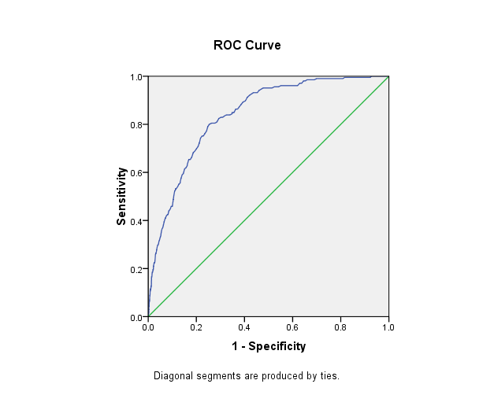
ROC of fœtal weight and shoulder dystocia
Cut off = 3602,5 gr

Slide 16
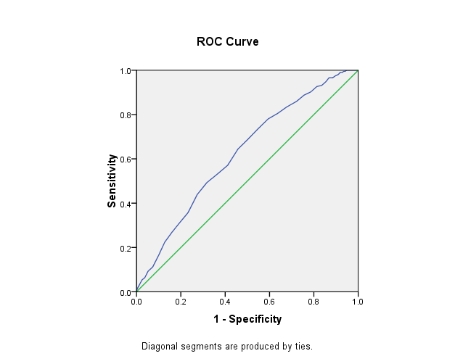
ROC of term and shoulder dystocia
Cut off = 39,7 SA

Slide 17
Conclusion
The risk factors for shoulder dystocia are:
Diabetes
Especially non-insulin-dependent diabetes
Obesity
Macrosomia

Slide 18
Proposition
An ultrasound of estimation of fetal weight is held at 37 SA. At 38-39 weeks, if the estimated fetal weight is around 4000g and 4500g, we will discuss a vaginal delivery. On the other hand, if the fetal weight estimates more than 4500g, we will propose a caesarean prophylaxis

Slide 19
MERCI DE VOTRE ATTENTION
XIN CHÂN THÀNH CẢM ƠN

